Slide 1
2024 NICTC Workshop:
Interim Analyses of Clinical Trials:
Practical Considerations
Greg Pond
McMaster University

Slide 2
Disclosures
Traferox Technologies: Consulting Fees
I have a close family member who is employed by Roche Canada and who owns stock in Roche Ltd.
Many of these slides were initially created by Chris O’Callaghan ☺

Slide 3
Learning Objectives
Describe different types of interim analyses
Review the who, what, when, why, and how of conducting interim analyses
Discuss how to incorporate practical considerations into interim analysis decision making

Slide 4
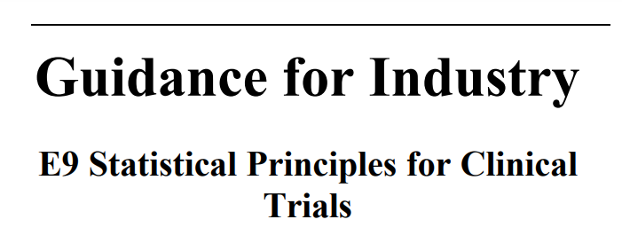
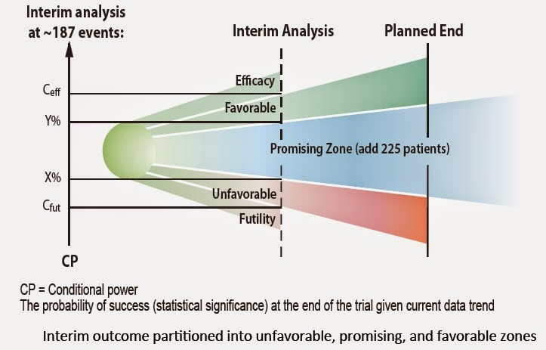
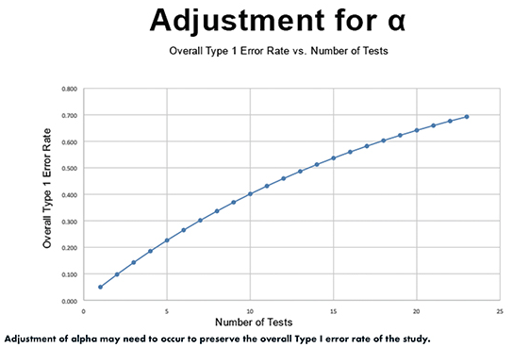
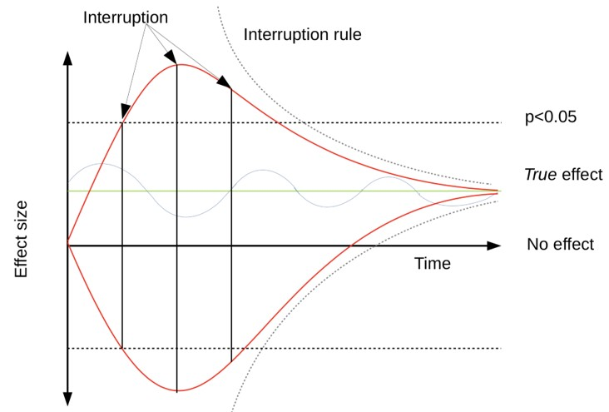
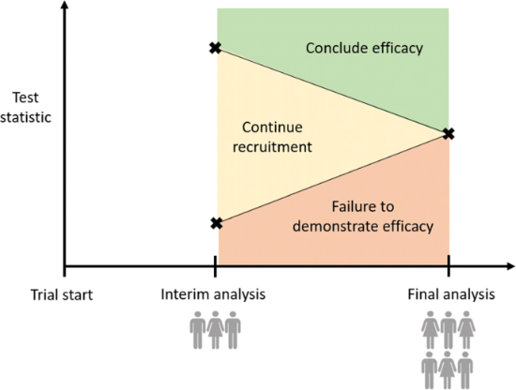
Interim Analyses in Clinical Trials: What, Why, When, How and Who

Slide 5
What?
An interim analysis is simply an analysis of the data before data collection has ‘completed’, i.e. before the pre-specified criteria for a planned ‘final’ analysis have been met

Slide 6
Why?
An option to stop / modify the trial for:
Safety
spare patients overwhelming or excessive adverse events or non-beneficial treatment (risk:benefit ratio; ethical conduct)
Efficacy/Superiority
expedite declaration of benefit (“superiority”) thereby saving resources and maximizing impact (NDA, change of SOC)
Futility (or benefit or of trial conduct)
recognize logistical or practical impediments ($)

Slide 7
Why?
An opportunity to re-estimate the sample size
pursue encouraging results
response adaptive randomization or enrichment
rare. And must be a priori defined
An opportunity to modify the trial design
true adaptive trial designs (e.g platform, basket, etc)
amend protocol due to new, external information, or due to accrual concerns (careful!!!!)

Slide 8
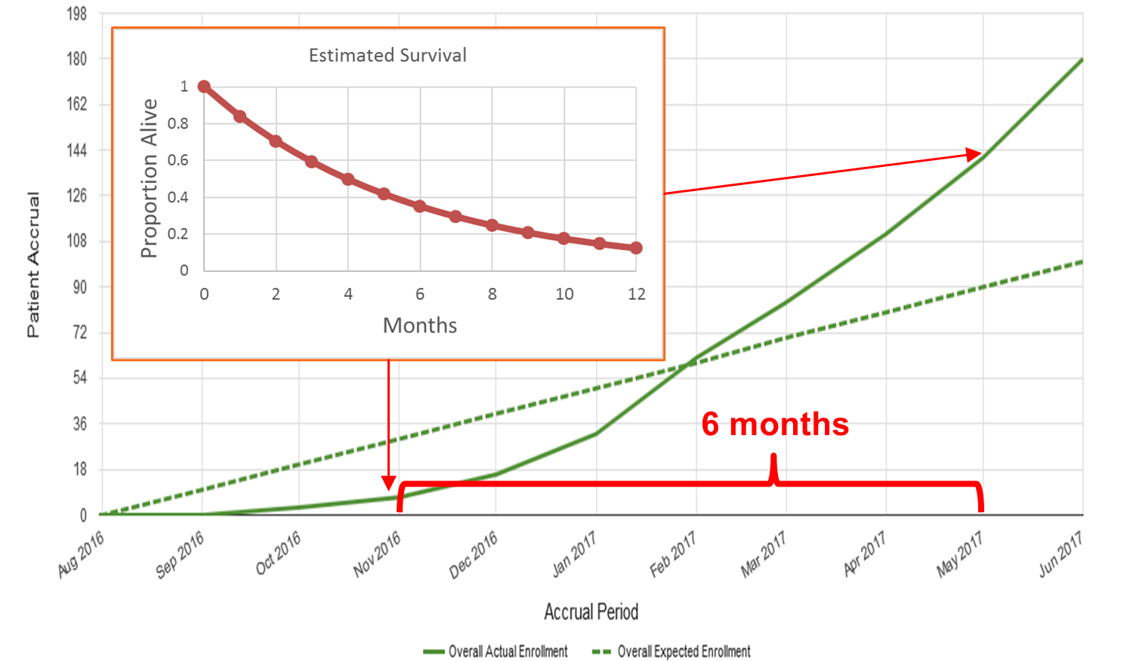
When?
Pre-specified (time or trigger); more than 1?
Timing, timing, timing… Need to balance valid and accurate decisions against expediency and efficiency:
Can it actually succeed?
depends on estimated unknowns: underlying event rate, presumed accrual rate and accrual pattern.
a rapidly accruing trial with a time-to-event analysis (e.g. disease progression or survival) in a moderate or relatively good prognosis population may not!

Slide 9
How?
Trial assessed against pre-specified metrics according to pre-planned design:
Safety: deaths on trial, SAEs, rates of higher grade AEs, AEs of special interest/significance, etc.
Futility of Conduct: accrual rate, patient compliance, loss-to-follow-up, withdrawal of consent, observed event rate and pattern, etc.
Efficacy/Superiority: statistical significance of outcome measure
Futility of Effect: statistical significance of outcome measure

Slide 10
Aside: Power, P-value and Errors
Sample
UNKNOWN
State of Nature (Reality)
No Effect
Effect
✓
Type II
(β) error
No Effect
‘Accept’ null hypothesis
when it is true
‘Accept’ null hypothesis
when it is false
Results of
Statistical Analysis
Type I
(α, p) error
✓
Effect
Reject null hypothesis
when it is true
Reject null hypothesis
when it is false

Slide 11
Considerations for Statistical Analyses
There is a cost to pay (in terms of alpha spending) for each interim efficacy analysis
Each analysis increases the chance of an error
To ensure the total trial error rate (alpha <0.05), each interim analysis / decision point must be based on alpha<0.05

Slide 12
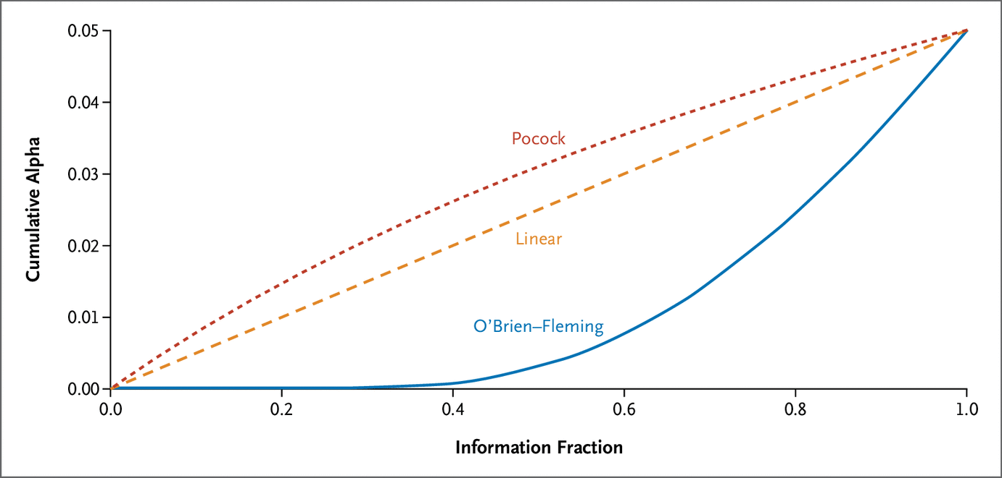
Considerations for Statistical Analyses
Depending on rules, you can have interim / final analyses with p-values of (say) 0.042 be ‘not significant’
This cost ‘may’ be avoided if a surrogate measure is used in the context of a decision-point interim analysis (e.g. PFS for phase 2 of phase 2/3 trial with primary endpoint of OS or to continue cohort in an adaptive trial design).

Slide 13
Who?
Independent Data and Safety Monitoring Committee (DSMC)
Experts with no interest in outcome of results
Ensures integrity of the trial through unbiased decision-making, permitting Trial Committee Members and Principal Investigators to remain blinded to interim outcome data.
CCTG maintains a standing DSMC
Small, phase I (maybe phase II) safety analysis may not need independent DSMC
E.g. 10 patients from 3 centres – may be best reviewed by study and centre PI’s

Slide 14
What if an Interim Analysis Stops the Trial?
Futility of Benefit:
Stop further accrual
Expeditiously inform collaborating organizations
Consider whether patients that are apparently benefiting clinically may continue on treatment and how that decision will be made
Consider whether or how trial should continue and/or statistical analysis should be revised

Slide 15
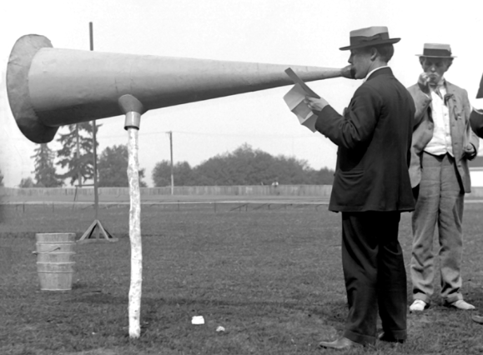
What if an Interim Analysis Stops the Trial?
Superiority/Efficacy:
Stop further accrual (?)
Expeditiously inform collaborating organizations
Consider whether patients that are on control arm should cross-over to effective arm and how that decision will be made
Consider whether or how trial should continue and/or statistical analysis should be revised
CAUTION: Consider effect on society (e.g. do regulatory bodies / funding authorities have needed information to assess benefit? Are there biosimilar agents under study?)

Slide 16
Questions?

