Slide 1
Patient Reported Outcomes
New Investigator Course
Thursday August 22
Joe Pater
Thanks to CCTG QOL Committee and, particularly, Michael Brundage

Slide 2
Conflicts
None

Slide 3
Objectives
Discuss the nature of patient-reported outcomes (PROs) including quality of life
Identify the key elements essential to the science of quality PRO assessments in clinical trials
Access and integrate the many educational resources available to guide PROs as primary or key secondary clinical trial outcomes

Slide 4
What are PROs?
“A PRO is any report of the status of a patient’s health condition that comes directly from the patient, without interpretation of the patient’s response by a clinician or anyone else.”
https://www.fda.gov/media/77832/download

Slide 5
Types of Clinical Outcomes Assessment
Based on standardized task(s) performed by a patient Examples: treadmill exercise test, cognition, and attention
Reported directly by patient
Examples: global impression, functional status, well-being, symptoms, health-related quality of life
Performance
(PerfO)
Patient-Reported
(PRO)
Clinical Outcomes Assessment
Reported by someone other than the patient or a health professional
Examples: seizure frequency, surgical scar appearance
Observer-Reported
(ObsRO)
Clinician-Reported
(ClinRO)
Reported by a trained health-care professional
Examples: treatment toxicity, disease severity
https://www./clinical-outcome-assessment-compendiumfda.gov/drugs/development-resources

Slide 6
Historical Background

Slide 7
History QOL
1979: NCIC (now CCSRI) decides to have a formal cooperative clinical trials group
1980: NCIC Clinical Trials Group established at Queen’s University
1982: First Phase III Trial with QOL (BR.5)

Slide 8
History QOL

Slide 9
BR.5 QOL
Shortly after the trial started, centres were asked to participate in the QOL component of the trial
They were given the option to use both Sickness Impact Profile (SIP) and Functional Living Index –Cancer (FLIC) questionnaires, only FLIC, or not participate
Almost all centres agreed to participate and most chose to use both instruments

Slide 10
History QOL
Low compliance (<25%) with QOL collection in BR.5 was due to many factors
Evident that QOL measurement would not “just happen”
Subsequently implemented measures that resulted in much better compliance with QOL data collection

Slide 11
History – Other PROs: Toxicity

Slide 12
Types of Clinical Outcomes Assessment
Based on standardized task(s) performed by a patient Examples: treadmill exercise test, cognition, and attention
Reported directly by patient
Examples: global impression, functional status, well-being, symptoms, health-related quality of life
Performance
(PerfO)
Patient-Reported
(PRO)
Clinical Outcomes Assessment
Reported by someone other than the patient or a health professional
Examples: seizure frequency, surgical scar appearance
Observer-Reported
(ObsRO)
Clinician-Reported
(ClinRO)
Reported by a trained health-care professional
Examples: treatment toxicity, disease severity
https://www./clinical-outcome-assessment-compendiumfda.gov/drugs/development-resources

Slide 13
History – other PROs: toxicity

Slide 14
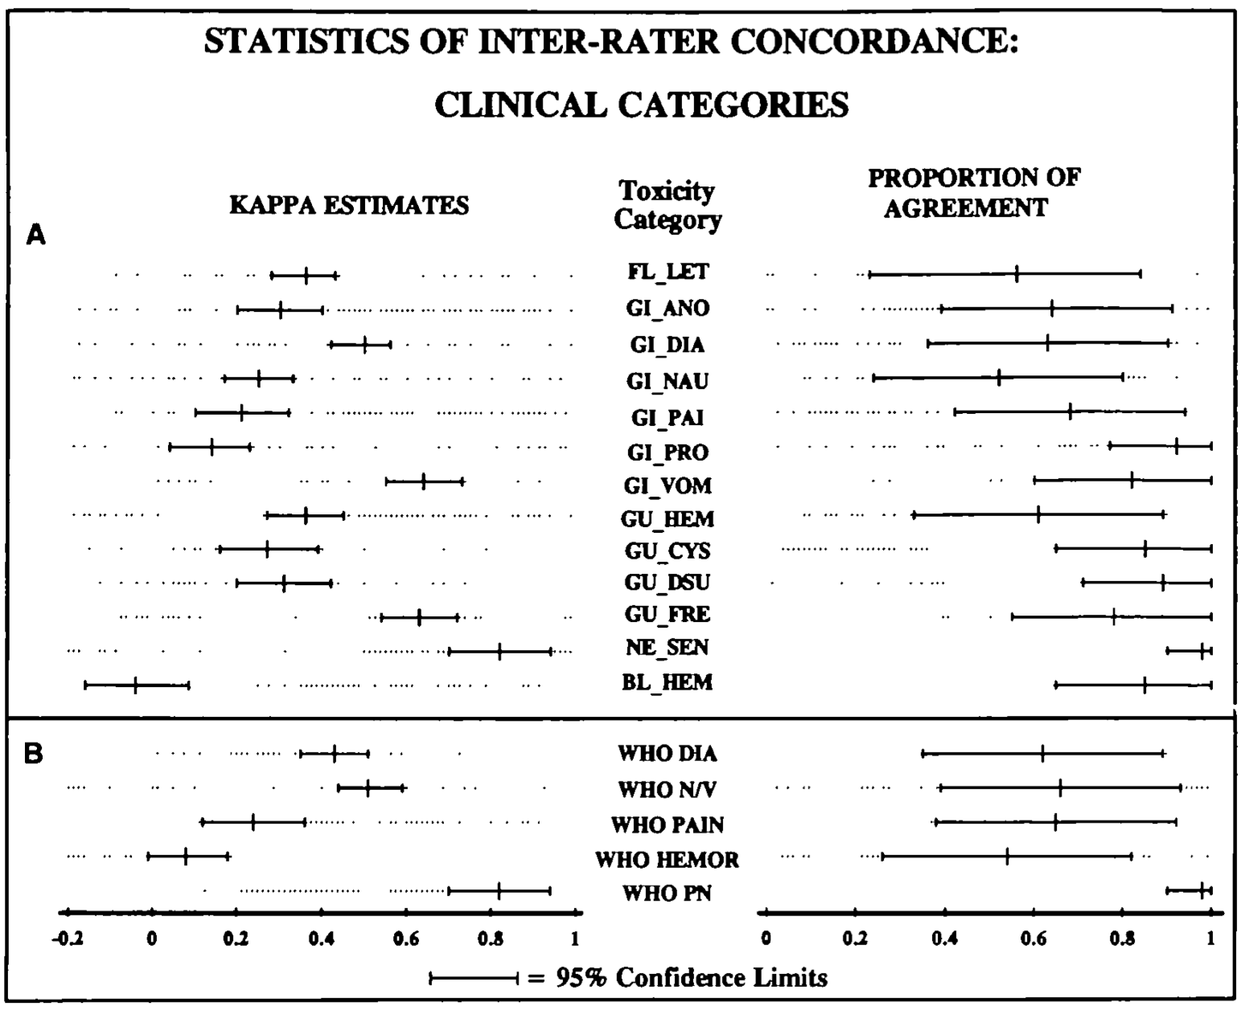

Slide 15
History – other PROs: toxicity
Support Care Cancer (1997) 5 :307–313

Slide 16
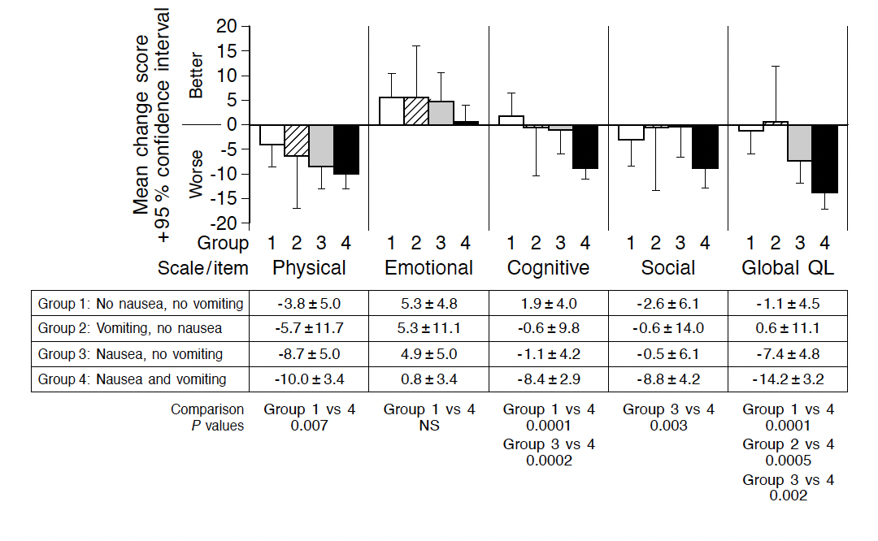
History – Other PROs: Toxicity

Slide 17
Types of PROs

Slide 18
Types of PROs
Multidimensional instruments aimed at assessing health status and health related quality of life
General vs cancer specific
Instruments focused on particular aspects of health status
Instruments aimed at the “utility” of current health status
Needed for cost utility analyses
Collections of questions designed to elicit disease symptoms and treatment toxicity

Slide 19
Multidimensional global instruments aimed at assessing health status and health related quality of life
General
Examples: Sickness Impact Profile and SF36
Cancer specific
Examples: EORTC QLQ-C30; FACT-G
Both assess similar domains, for example, physical, emotional, social functioning as well as overall quality of life
QLQ-C30 follows:

Slide 20
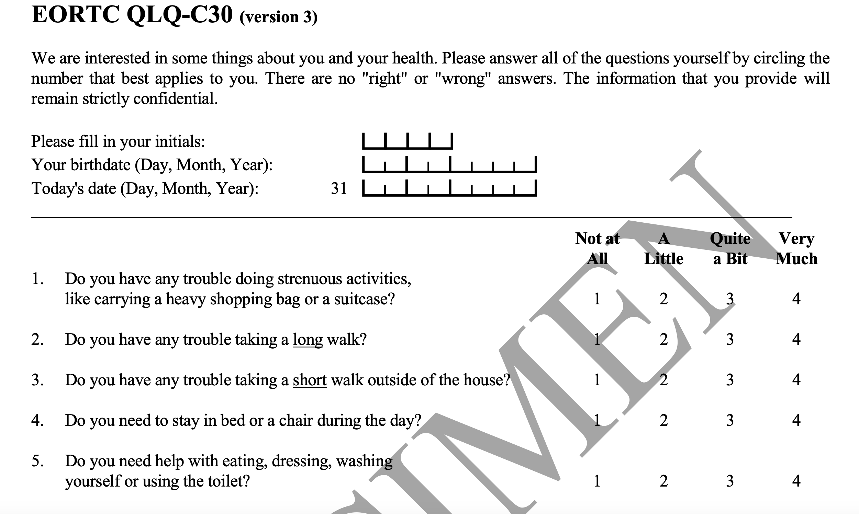

Slide 21
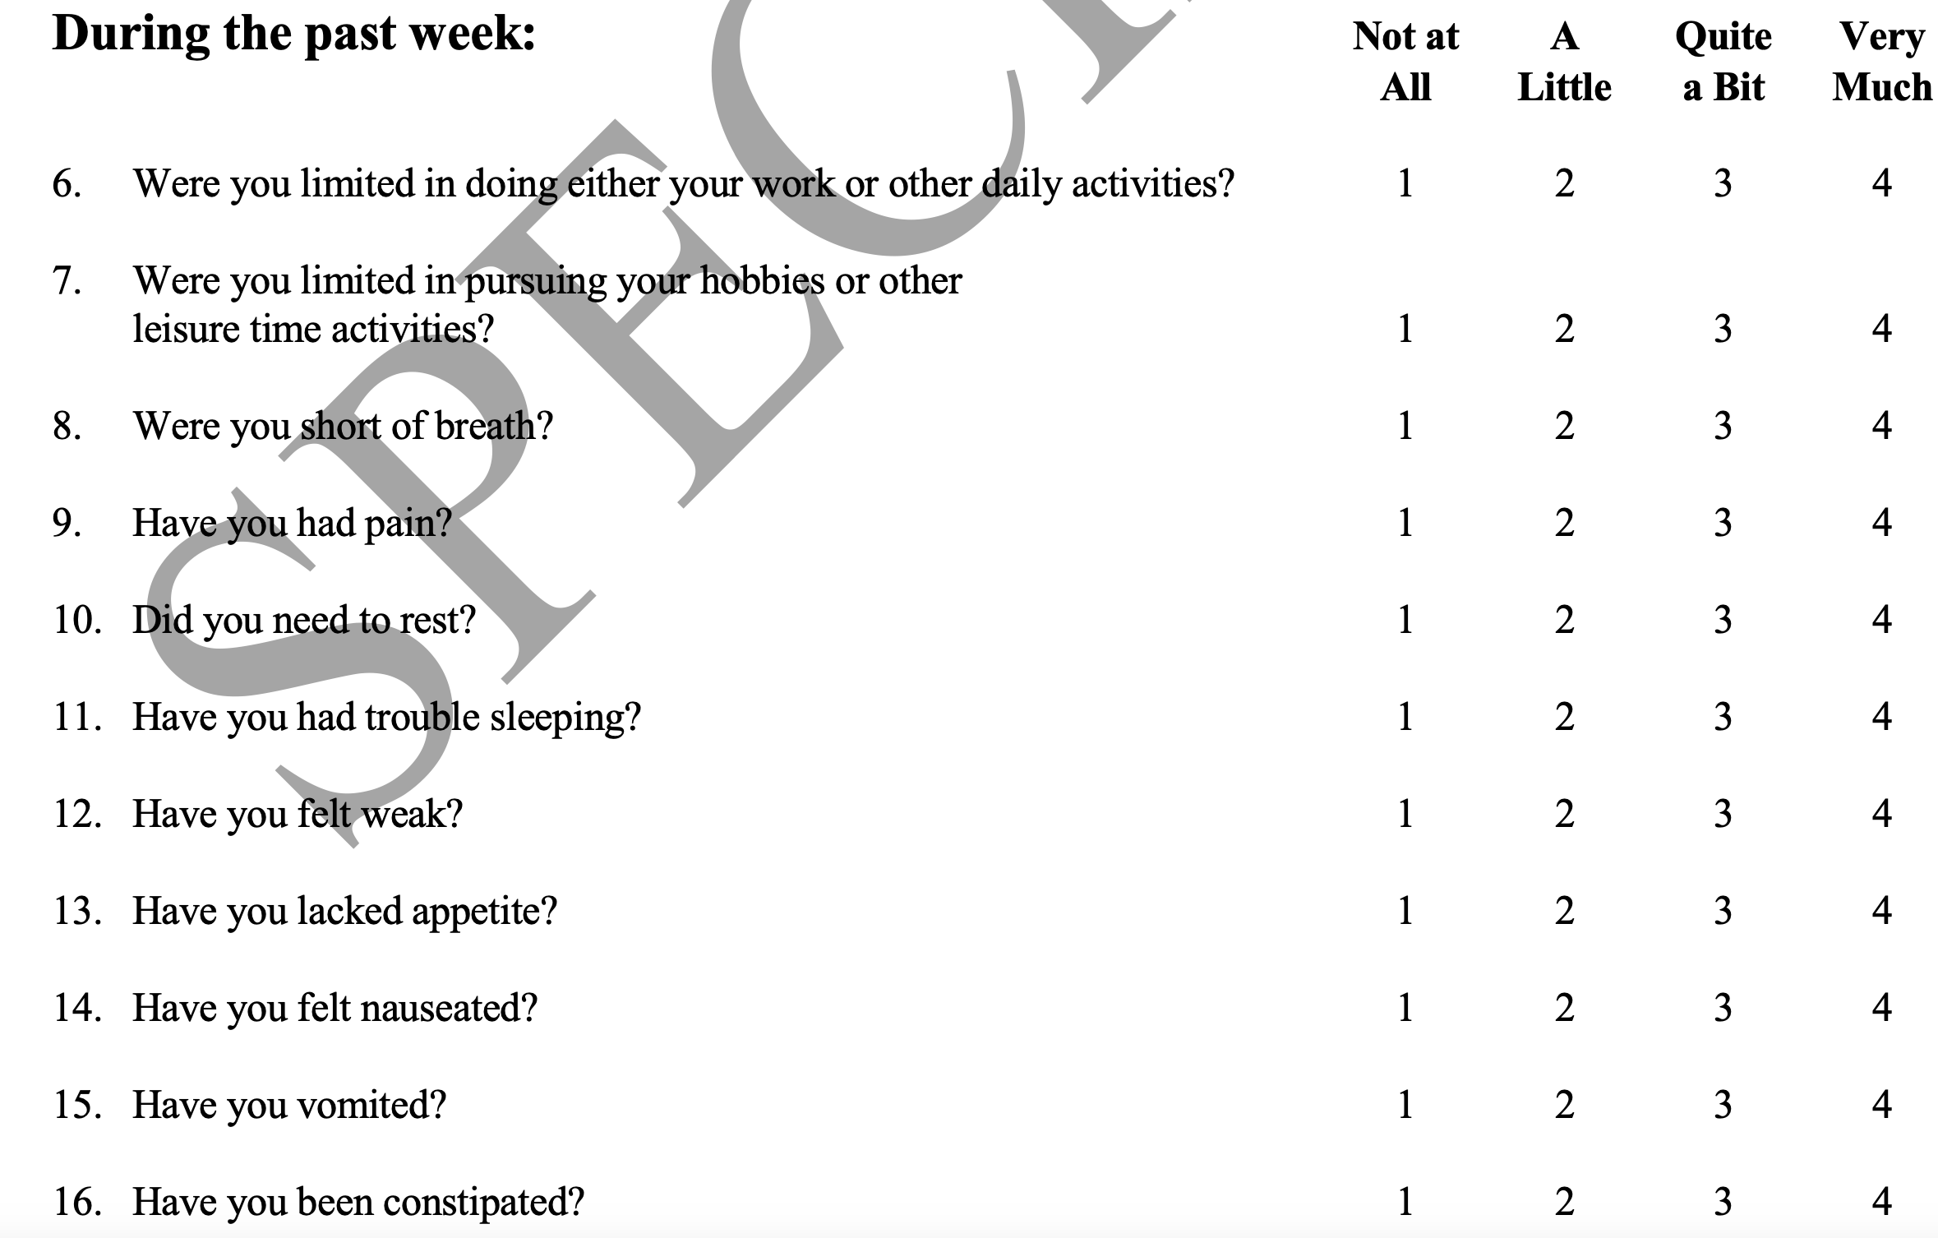

Slide 22
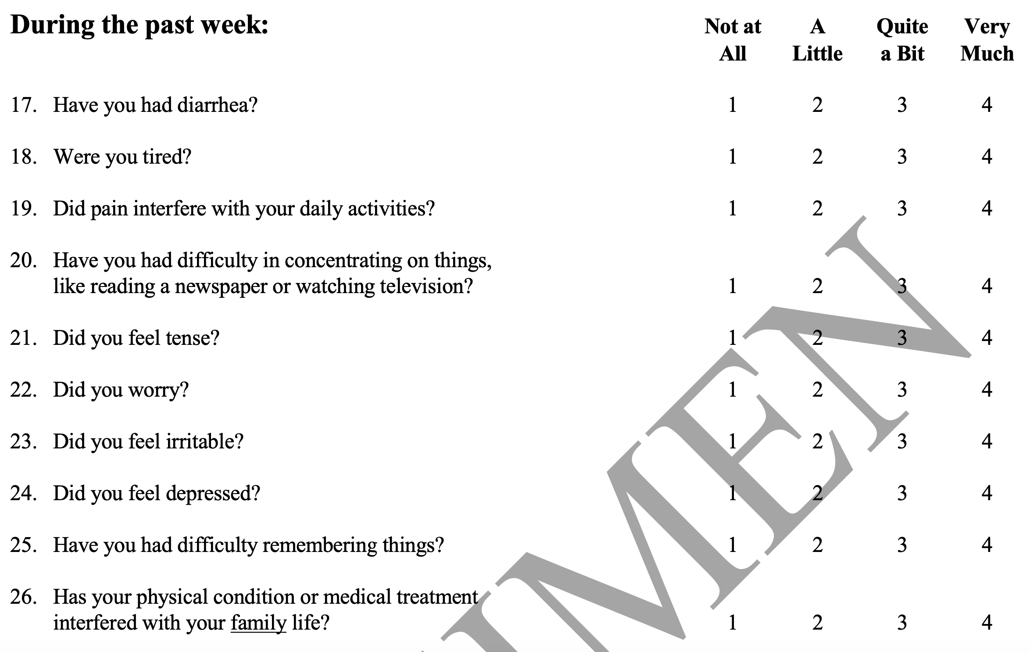

Slide 23
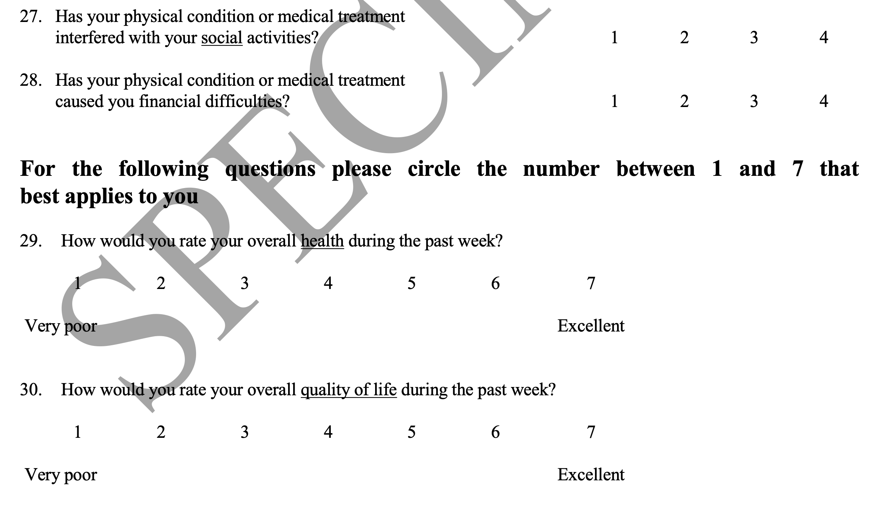

Slide 24
More specific instruments (modules) for particular settings
Modules differ in their content. They may relate, for example, to QOL issues affecting particular tumour types (e.g. primary site, metastatic site), aspects of care (e.g. patient satisfaction) or patients’ psychological needs or experiences (e.g. information). Modules have been developed for defined patient groups (e.g. elderly), specific symptoms (e.g. fatigue, cachexia), treatment side-effects (e.g. radiation proctitis), or other areas of relevance and importance to specific groups (e.g. activities of daily living in people with brain tumours). In principle, most modules are developed to be used at diagnosis and then during treatment and follow-up. Modules are sometimes developed as ‘stand-alone questionnaires’ (for example, to assess patient satisfaction).

Slide 26
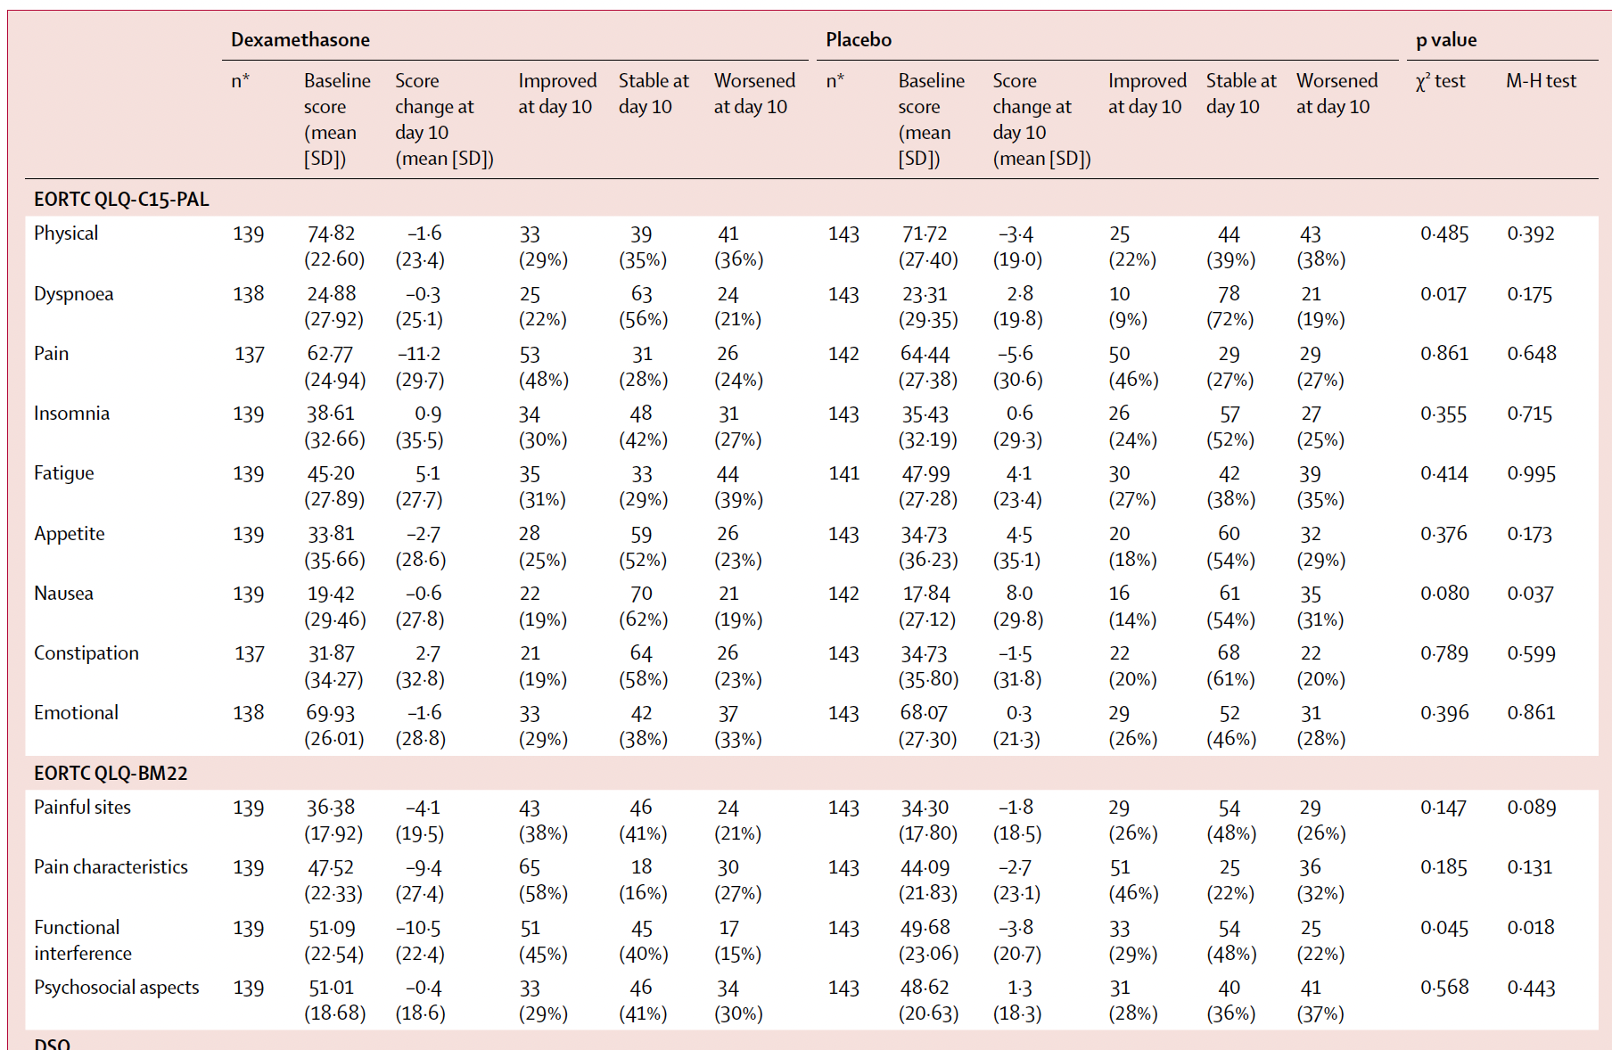

Slide 27
Instruments aimed at the “utility” of current health status
Examples
EQ-5D
Health Utility Index
Next talk will amplify

Slide 28
Collections of questions designed to elicit disease symptoms and treatment toxicity
Symptom “data banks”
PRO-CTCAE
An NCI library of 80 symptom terms that enable patient reporting of common toxicities
Investigators select individual items to create a data collection instrument pertinent to a given study
PRO-CTCAEs are PROs, but are NOT intended to be a QOL measurement

Slide 29
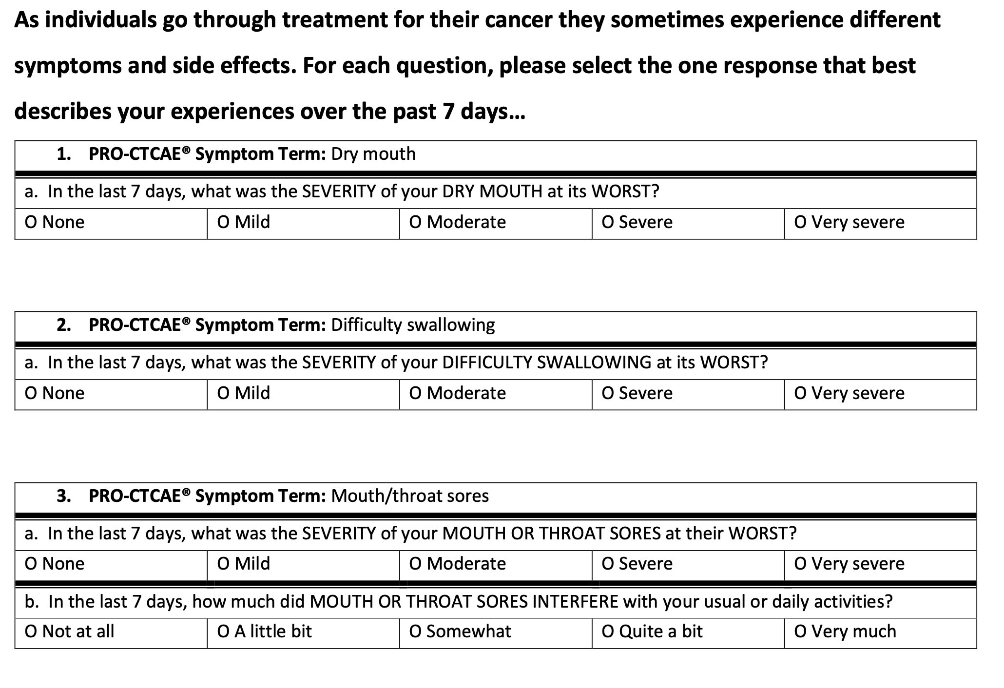

Slide 30
Incorporating PROs into Trials – Key Considerations

Slide 31
Incorporating PROs into trials – key considerations
Instrument selection
Frequency and timing of assessments
Addressing the missing data problem
Method of analysis and presentation of data

Slide 32
Instrument selection
In current trials, all four of the PRO measurement types just described are often used

Slide 33
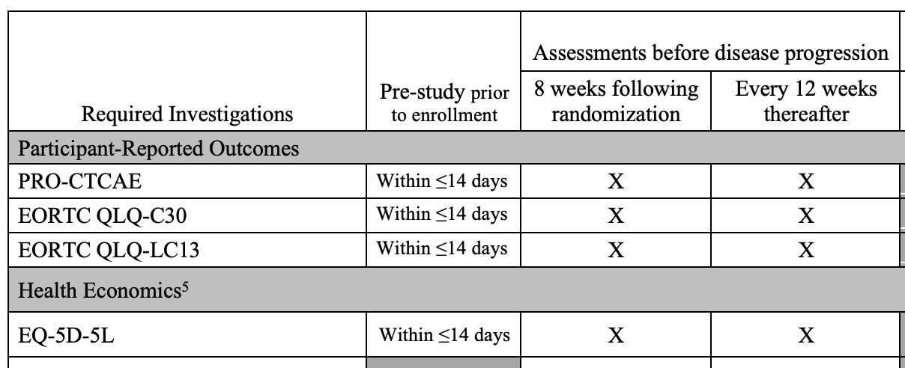

Slide 34
Instrument selection
In current trials, all four of the PRO measurement types just described are typically used
Selection of instruments requires knowledge of the clinical condition under consideration as well as expertise in the field of patient reported outcomes
CCTG’s QOL committee has members with these qualifications serving as liaisons to disease sites
Fine tuning a PRO collection plan depends upon collaboration between the QOLC liaison and the trial committee

Slide 35
Frequency and timing of assessments
The frequency of assessments chosen must reflect a balance between collecting the information desired and avoiding over-burdening patients
Because most PRO instruments have a limited time frame (“this past week,” for example), it is very important to collect data at the time the expected effects are likely to occur

Slide 36
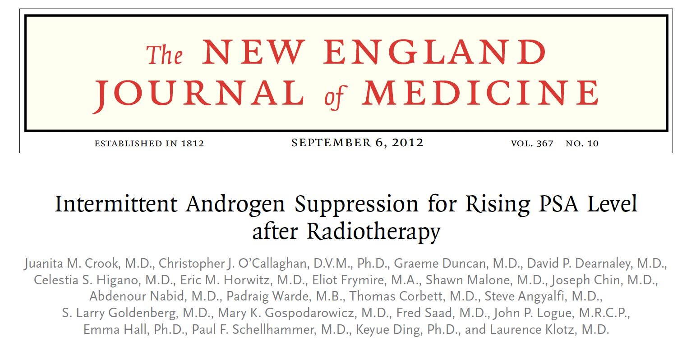

Slide 37
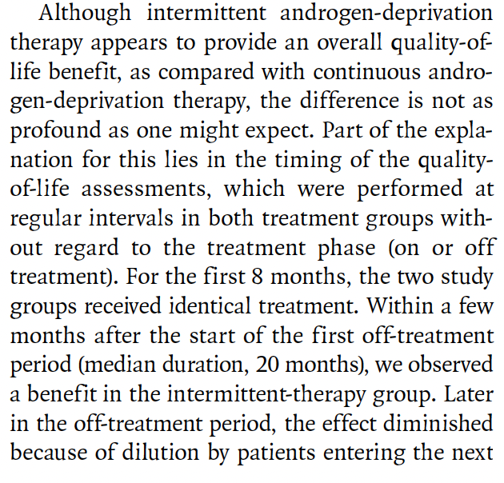
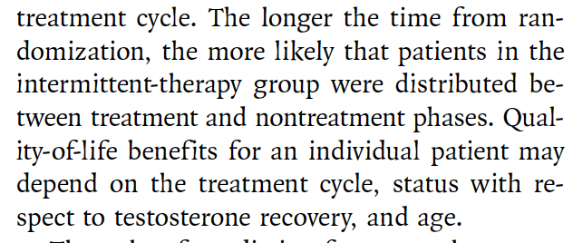

Slide 38
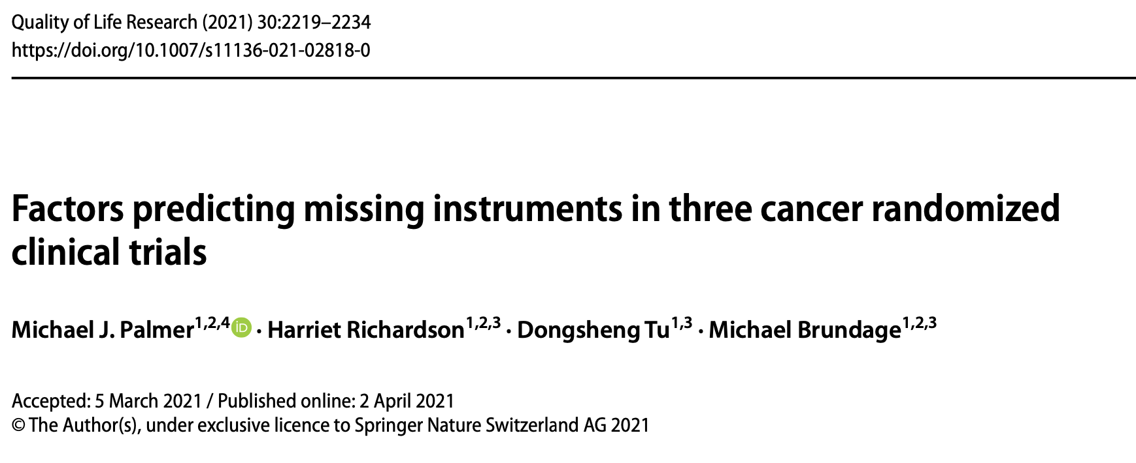
Addressing the missing data problem

Slide 39
Addressing the missing data problem

Slide 40
Example of how missing data can mislead
In a single arm study all patients are treated, QOL data are collected regularly, and, at the end of the study, compared to baseline values
75% of the patients complete the study and, at the end, their mean QOL is substantially higher than it was among the same patients at baseline (a complete case analysis)
The investigator could conclude that the intervention improved QOL
BUT, of course, it could just be that the patients who dropped out were the ones who were doing poorly and had worse QOL, that is, the apparent improvement in QOL in the patients who completed the study was a “survivor effect”

Slide 41
Method of analysis and presentation of data
Two main approaches to analyzing and displaying PRO results from randomized trials
Comparing group mean scores over time either as changes from baseline or as observed values
Assessing the number of participants who improved or deteriorated by a pre-specified amount (response analysis)
Requires an accepted minimally important difference
Can be used as a time dependent endpoint

Slide 43
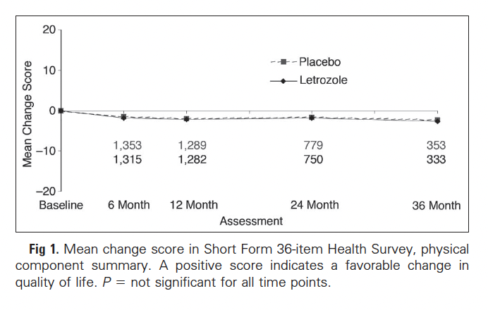

Slide 45
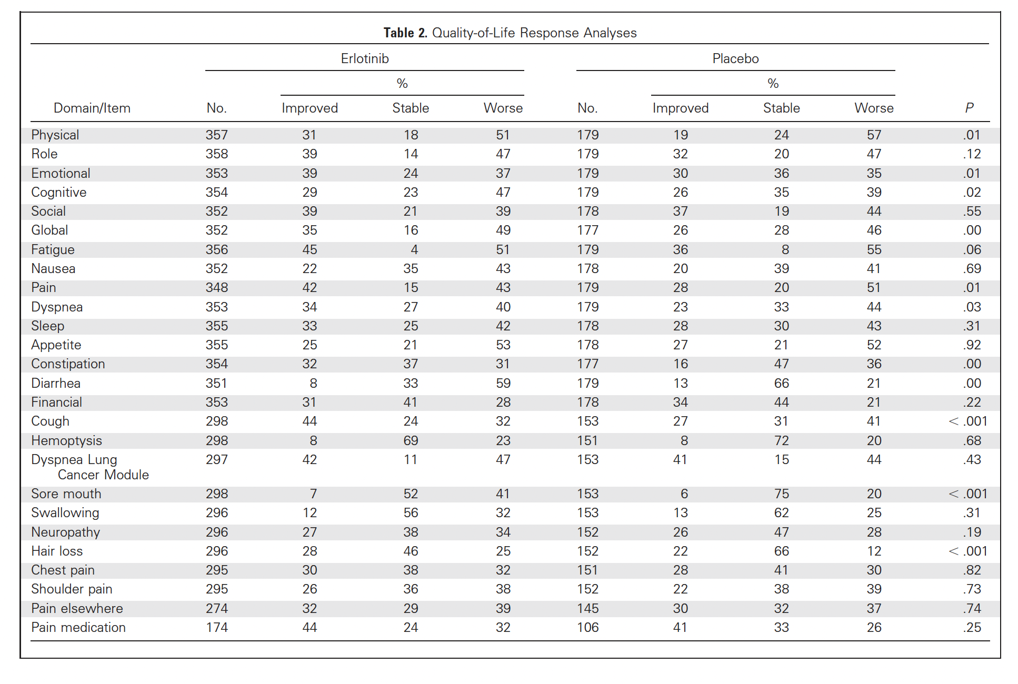

Slide 46
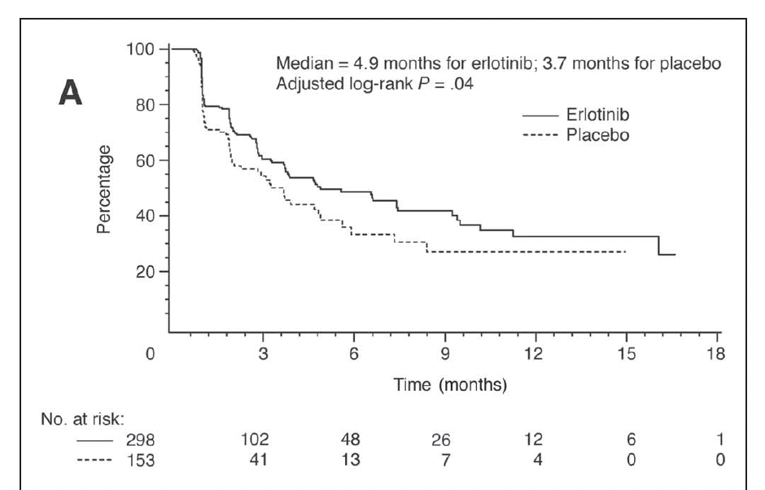

Slide 47
Future directions
E-PROs
Collecting PRO data electronically has several advantages:
Reduces CRA workload
Improves accuracy
Allows for remote trial participation
CCTG has developed its own system called SPROUT and there are many others
Technical, privacy and other considerations are slowing adoption
Integration with clinical data collection
Challenging, but ultimately needed

Slide 48
Resources
Lancet Oncol 2020; 21: e83–96

Slide 49
Resources

Slide 50
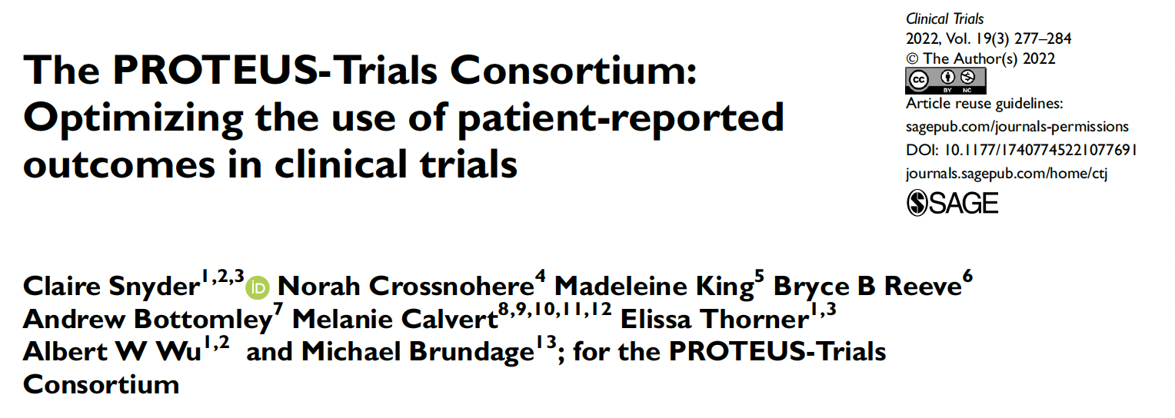
Resources

