Slide 1
Plenary Session 3: Molecular Biomarkers in Clinical Trials - Clinical Interpretation of Genomic Variants
Dr. Peter Sabatini, PhD, FCCMG
Clinical Laboratory Scientist, University Health Network
Toronto, ON

Slide 2
Disclosure
Honoraria: Illumina, Astrazeneca

Slide 3
Learning Objectives
Assess how molecular testing methods translate into clinical reports
Differentiate the clinical relevance of genomic variants using evidence criteria
Apply standardized classification recommendations to interpret the clinical relevance of genomic variants
Become proficient at reading and interpreting the clinical reports from high complexity genomic tests

Slide 4
Interpret this Variant so the Oncologists Can Consider What They Should Do
As part of genomic tumor profiling study, you find the following mutation in a triple-negative breast carcinoma sample. The trial is evaluating the efficacy of a novel EGFR inhibitor to treat these patients.
Genomic Variant Identified:
EGFR: c.2236_2250del (p.Glu746_Ala750del) VAF: 34%
Results from 523 gene
next-generation sequencing panel

Slide 5
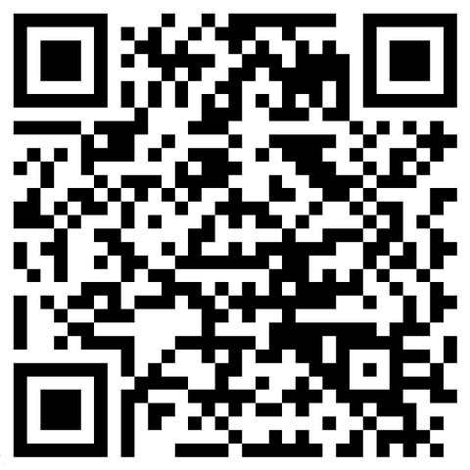
Poll 1
Please scan the QR code with your camera app and click the link to access the Poll.
Results

Slide 6
Content AND Context Matter for Clinical Genetic Testing and Trial Eligibility
- What you are testing:
- Why are you testing it:
Drives the interpretive process
PMID: 31937368

Slide 7
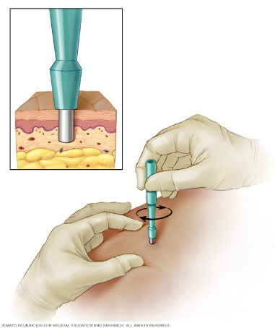
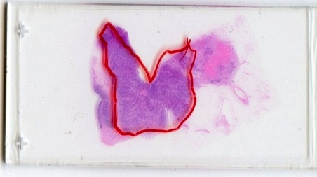
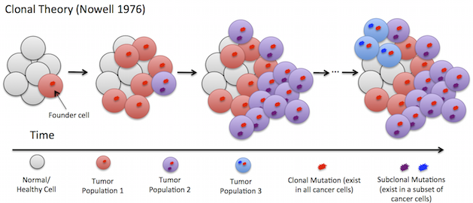
What/Why are we Testing: Variant Type Definitions
Germline Variant
Occurs in germ cells (usually in every cell)
Stable, Inherited/de novo
Why test
Mechanism for a clinical diagnosis
Family’s Matter
Germline
Somatic Variant
Occurs anywhere except in the germ cells
Unstable, acquired
Why test
Diagnosis, Prognosis, Therapeutic
Germline+Somatic
Both types of variants can contribute to oncogenesis

Slide 8
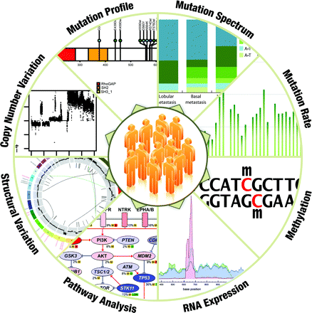
Complexity of the Cancer Genome
Also foreign pathogens
L Ding, Hum Mol Gen 2010

Slide 9
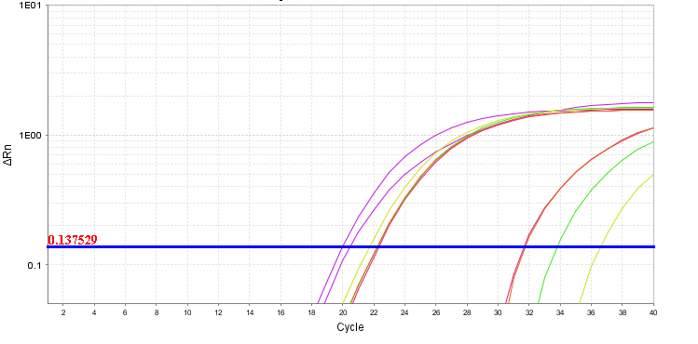
Scope Genomic Regions Captured Depends on Methodology and Indication
Multiplex PCR Panels
e.g. qPCR for many EGFR mutations
Large NGS Gene Panel, DNA/RNA panels, Exomes, Whole Genomes:
SNV, CNV, SV mutations
Mutation-specific tests: e.g. BRAF V600E
(non-NGS)
Test Complexity
More comprehensive scope across genome
Increased cost and turn around time
Increased scientific and clinical expertise

Slide 10
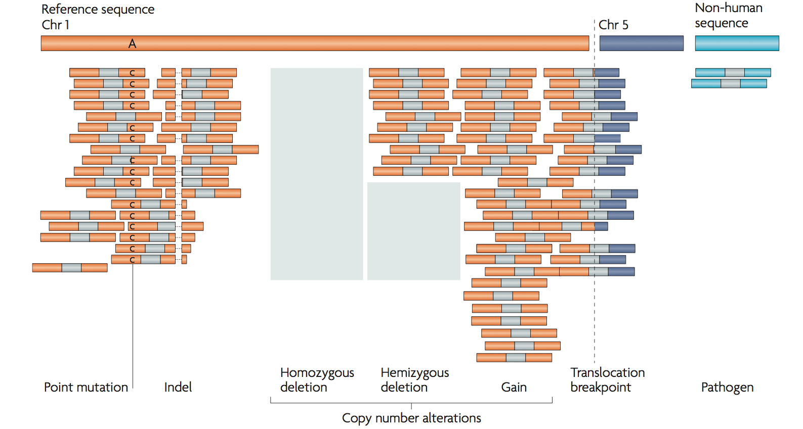
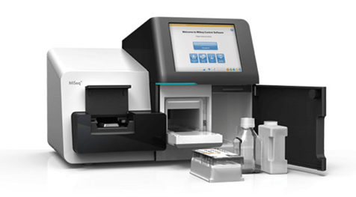
Next Generation Sequencing Simultaneously Detects SNV, CNV and Fusions
Step 1
SNV Detection
CNV Detection
Fusions
DNA or RNA
Step 2
Library of fragments
(amplicon, hybridization
Panel, Exome, Whole Genome)
Step 3
Step 4
Alignment, analysis, variant filtering and interpretation
NGS Sequencer
Meyerson, Gabriel, Getz. Nat Rev Genet. 2010
Notes:
Sequenced fragments are depicted as bars with coloured tips representing the sequenced ends and the unsequenced portion of the fragment in grey. Reads are aligned to the reference genome (for example, mostly chromosome 1 in this example).
The colours of the sequenced ends show where they align to.
Different types of genomic alterations can be detected, from left to right: point mutations (in this example A to C) and small insertions and deletions (indels) (in this example a deletion shown by a dashed line) are detected by identifying multiple reads that show non-reference sequence; changes in sequencing depth (relative to a normal control) are used to identify copy number changes (shaded boxes represent absent or decreased reads in the tumour sample); paired-ends that map to different genomic loci (in this case, chromosome 5) are evidence of rearrangements; and sequences that map to non-human sequences are evidence for the potential presence of genomic material from pathogens.

Slide 11
Standardized Variant Nomenclature Description (e.g. AKT1 E17K)
Position in transcript
Base Change
AKT1 (NM_001014432.1): c.49G>A (p.Glu17Lys) VAF:67%
Protein Change
Alternative: E17K
Allele Fraction (abundance of variant)

Slide 12
NGS Workflow for Reporting Clinically Relevant Variants – An Interpretation Bottleneck
A few potentially
relevant variant
outputs
Many variant
inputs
Good, Benjamin M., et al. Genome Biol 15.8 (2014): 438.

Slide 13
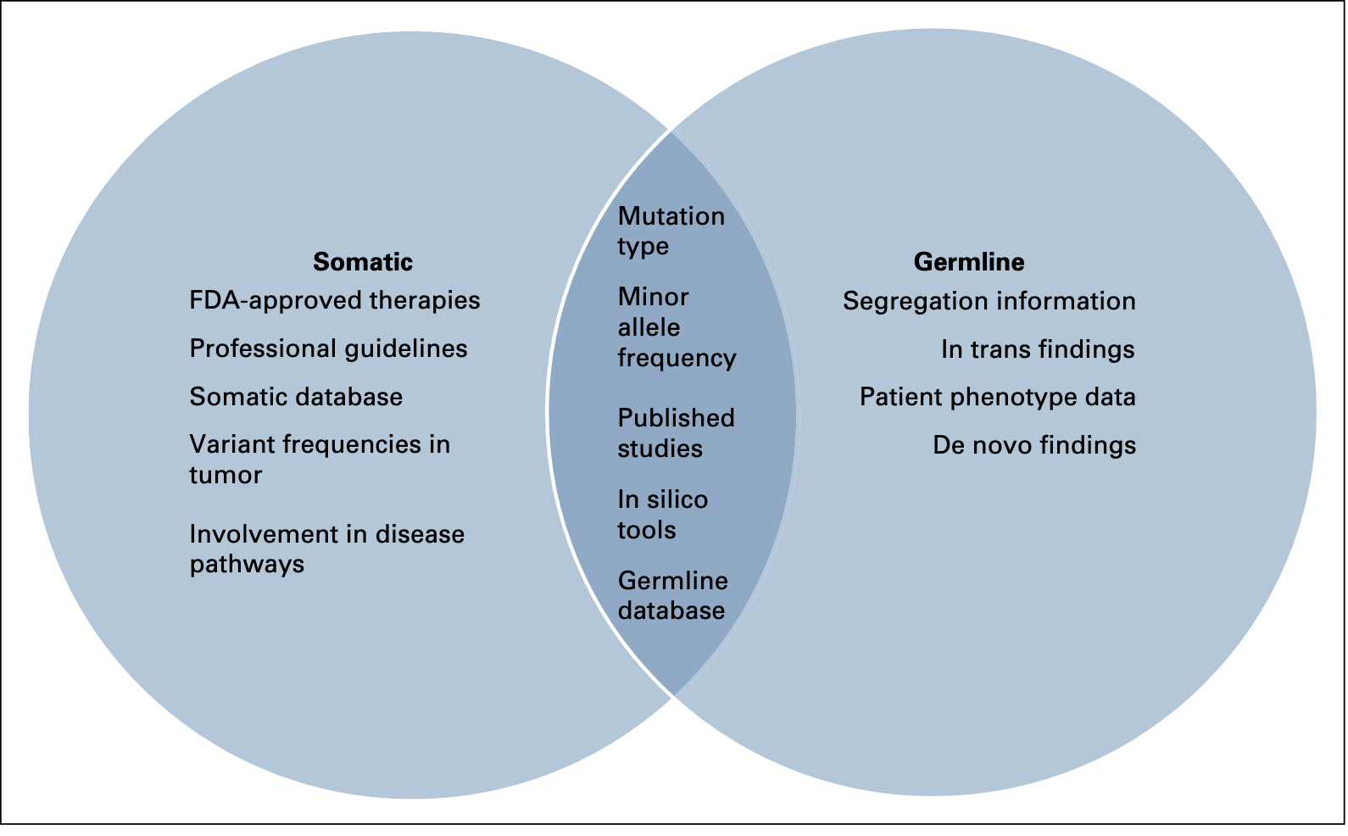
Interpreting Variants Left After Filtering - Not all Variants are Relevant -
Variants ‘Prioritized’ on their Pathogenicity/Oncogenicity/Actionability
Context for testing matters (familial predisposition vs tumor vs clinical trial)
Somatic Evidence
Germline Evidence
PMID: 35100725

Slide 14
Interpreting Variants Left After Filtering - Not all Variants are Relevant -
Variants ‘Prioritized’ on their Pathogenicity/Oncogenicity/Actionability
Context for testing matters (familial predisposition vs tumor vs clinical trial)
ALWAYS Based on Discrete Lines of Evidence:
Type of variant and location
Regulatory Clearance and Clinical Practice Guidelines
Cancer Databases
Hereditary Databases
Publications (e.g. functional studies, case control, clinical trials)

Slide 15
Type of variant and location

Slide 16
Type of Variant and Location Assist in Determining Functional Impact on Protein
Tumor Suppressor Genes
-proteins that repair DNA (caretaker)
-proteins that provide proliferation check points (gatekeeper)
Loss of function promotes proliferation
Truncating mutations occur throughout coding sequence
Missense variants usually in critical protein domains
Oncogenes
-proteins that stimulate growth
Gain of function promotes proliferation
Mutations in critical domains to create active protein
Variants occur in a specific protein domain or exon and mostly recurrent
Truncating variants or large deletions in tumor suppressor genes (LOF mutations are rarely recurrent)

Slide 17
EGFR Oncogene Held in Active State by In Frame Exon 19 Changes
Genomic Variant Identified:
EGFR: c.2236_2250del (p.Glu746_Ala750del) VAF: 34%
PMID: 31536605, 31562956

Slide 18
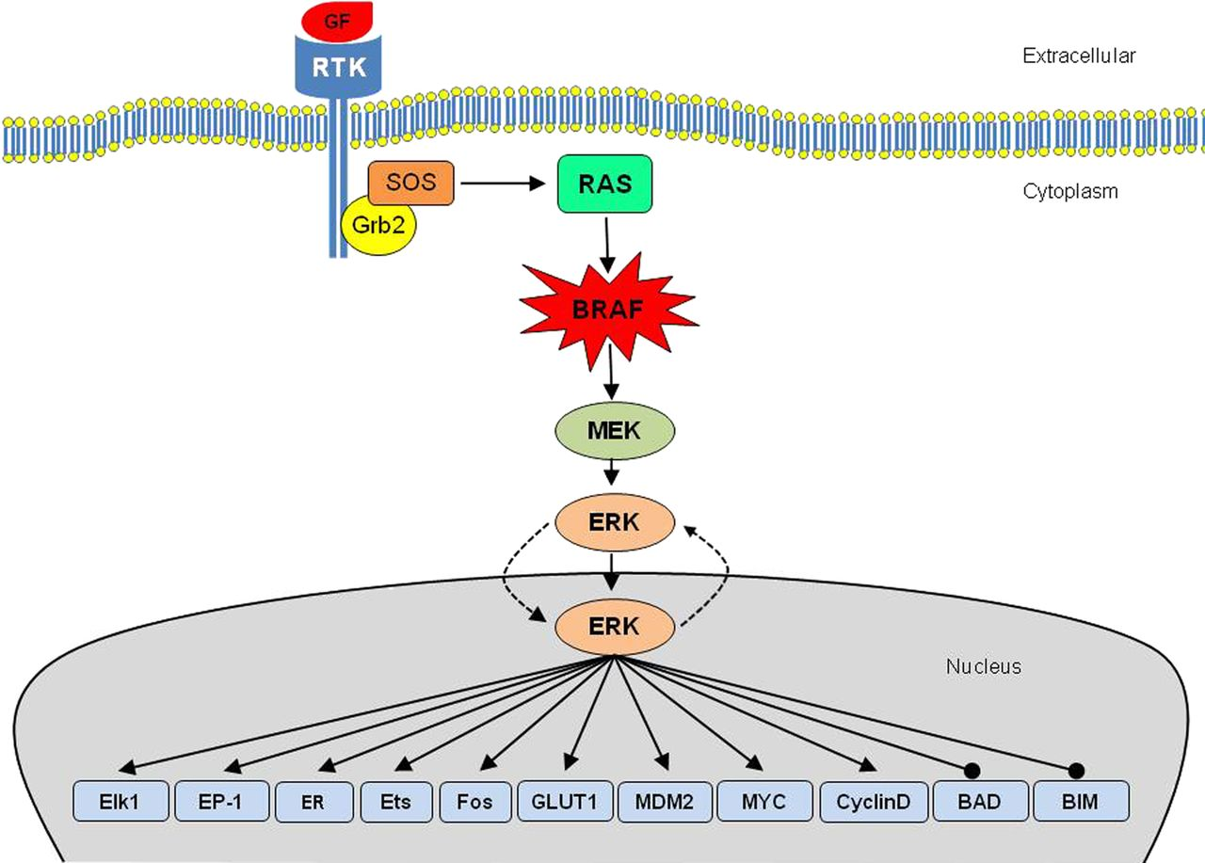
BRAF Participates in MAPK/ERK Signalling
Constitutive activation of
BRAF
promotes signaling
and cell growth
Dhirendra Govender, and Runjan Chetty J Clin Pathol 2012;65:986-988
Notes:
The RAS/RAF/MEK/ERK pathway: cellular interactions. Activate, line with arrow head; block, line with dot; ERK, extracellular signal-regulated kinase; GF, growth factor; Grb2, growth factor receptor bound-2; MEK, mitogen-activated protein kinase extracellular signal-regulated kinase; RTK, receptor tyrosine kinase; SOS, Son-of-sevenless.

Slide 19
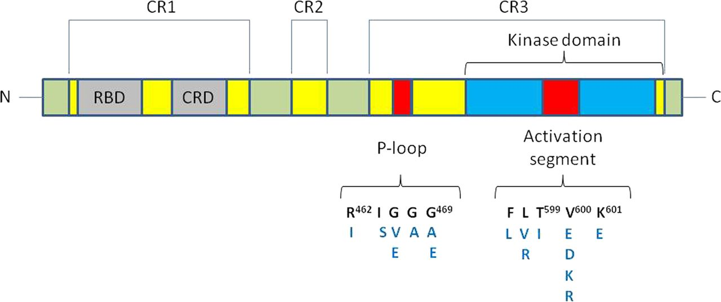
P-Loop and Kinase Domain Mutations Can Cause Constitutive Activation
PLX4032 – BRAF V600 Inhibitor in Melanoma
Domains that participate in kinase activity
Dhirendra Govender, and Runjan Chetty J Clin Pathol 2012;65:986-988
Notes:
Schematic representation of BRAF structure showing domains and some of the common BRAF mutations.CRD, cystine-rich domain; RBD, RAS binding domain.

Slide 20
What Does a ‘BRAF Positive’ Melanoma mean?
By NGS sequencing, you find a BRAF R462I (p.Arg462Ile) variant. Your clinical trial enrols patients with BRAF positive metastatic melanoma.
---------------- Is your patient eligible? -----------------
Dhirendra Govender, and Runjan Chetty J Clin Pathol 2012;65:986-988
Notes:
Schematic representation of BRAF structure showing domains and some of the common BRAF mutations.CRD, cystine-rich domain; RBD, RAS binding domain.

Slide 21
Distribution of BRCA1 Variants in 194 Patient’s with Triple Negative Breast Cancer
Different kinds of mutations found in BRCA1 from triple negative breast tumors
Loss of function variants (premature stop codons)
Missense changes usually in functional domains
Occur across entire coding sequence of gene
PMID: 28123851

Slide 22
By NGS sequencing of tumor tissue, you find a BRCA1 p.R1751X variant (p.Arg1751*). Your trial is evaluating a novel treatment for patients with known germline BRCA1 variants.
---------------- Is your patient eligible? -----------------
Tumor only testing does not differentiate germline variant. Need normal/unaffected tissue (e.g. blood)
PMID: 28123851

Slide 23
Regulatory Clearance and Clinical Practice Guidelines

Slide 24
Regulatory Clearance Process – Where is this Variant (or this type of variant)?
Biomarker
Discovery
Therapeutic Targeting
Drug Development
Pre-Clinical Phase
Clinical Trials
Phase I, 2, 3
Clinical Study Phase
New Drug Submission
Health Canada
FDA
EMA
Market Clearance
Restrictions on indications
e.g. tumor histology
Regulatory Review
Phase

Slide 25
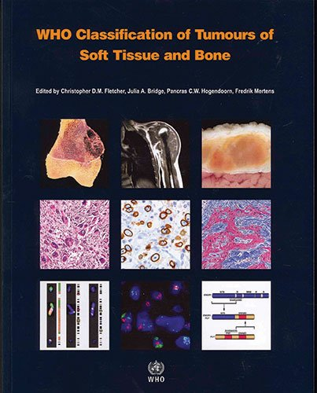
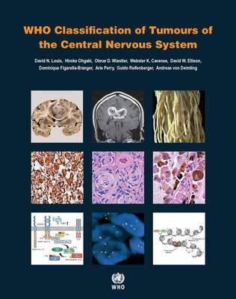
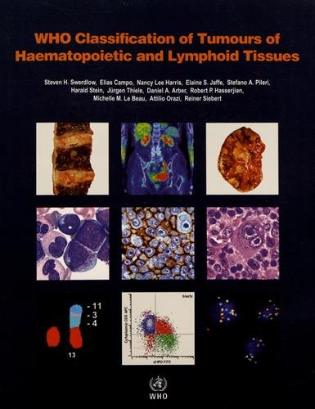
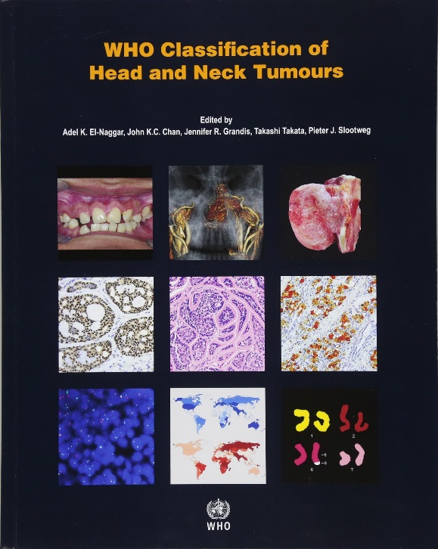
WHO Classification of Tumors

Slide 26
Clinical Practice Guidelines
National Comprehensive Cancer Network (NCCN)
European Society for Medical Oncology (EMSO)
Provide evidence based clinical practice guidelines
Guidance on EGFR sensitizing
mutations and first line
treatment of NSCLC

Slide 27
First Line Therapy Indications for Anti-TKI with Activating Exon 19 Variants
Genomic Variant Identified:
EGFR: c.2236_2250del (p.Glu746_Ala750del) VAF: 34%
Indication for First-line TKI therapy in lung, no indication for response to invasive breast cancer.

Slide 28
Cancer Databases and Hereditary Databases

Slide 29
Somatic Annotation Sources/Databases
Cancer Databases
COSMIC, TCGA (for rarer tumor types)
Frequency in cancer.
Number of reported cases found/submitted
Knowledgebase
MyCancerGenome
Well-established variants in a particular tumor type
OncoKB, CIViC, PMKB, DoCM, JaxLab KB; literature (PubMed, OMIM, MasterMind, Google Scholar)
Published clinical trials for emerging therapies, prognostic/diagnostic evidence
In vitro and in vivo preclinical evidence of actionability, functionality (damaging or activating)
Knowledge of other variants at that codon/domain

Slide 30
EGFR Variant is very Rare in Breast, but does occur
Genomic Variant Identified:
EGFR: c.2236_2250del (p.Glu746_Ala750del) VAF: 34%

Slide 31
Germline Databases
ClinVar – Repository for Clinical Labs to Add Variant Information
Use primary research sources, ClinVar submissions NOT sufficient source of evidence
Always source primary functional studies, case control, clinical trials
Can help correlate findings
Human Gene Mutation Database

Slide 32
EGFR Exon 19 deletions are not reported in Germline
Genomic Variant Identified:
EGFR: c.2236_2250del (p.Glu746_Ala750del) VAF: 34%
No germline submissions in ClinVar
None in reference population (Gnomad)
No literature reports.

Slide 33
NCCN, FDA, mycancergenome.org
COSMIC, TCAG
Therapeutic Target
In frame deletions of exon 19
targets for erlotinib (EGFR inhibitor) in lung
- Not available for breast
Frequency in Cancer
Common in lung
Rare, but seen in breast
Creating Some Meaning From All Evidence Sources
Alamut, pubmed, mycancergenome.org
gnomad
Type of variant
In frame deletion in exon 19
of EGFR
- Known to be activating
Frequency in ‘control’ population
Not found

Slide 34
Creating Meaning From All Evidence Sources
Oncogenic
Likely Oncogenic
Uncertain Significance (VUS)
Likely Benign
Benign
Somatic
Clinically Actionable?
Pathogenic
Likely Pathogenic
Uncertain Significance (VUS)
Likely Benign
Benign
Disease Causing?
Functional impact?
Germline

Slide 35
Clinical Interpretation of Variants Required to Assess Actionability
Recurrent, actionable variants
Rare, unknown variants
511 tumor exomes, 121 genes
Van Allen et al Nat Med 2014
Few recurrent variants, many rare variants
Driver versus passenger mutations
Notes:
TARGET database, a curated set of genes that are linked to predictive, prognostic and/or diagnostic clinical actions when somatically altered in cancers.
(f) This approach highlights the long tail of potentially clinically relevant alterations in TARGET genes (n = 121) that may be present in an individual patient but does not occur sufficiently to be labeled a biological driver across a cohort. The majority of events occur in genes that individually are altered in less than 2% of the overall cohort.

Slide 36
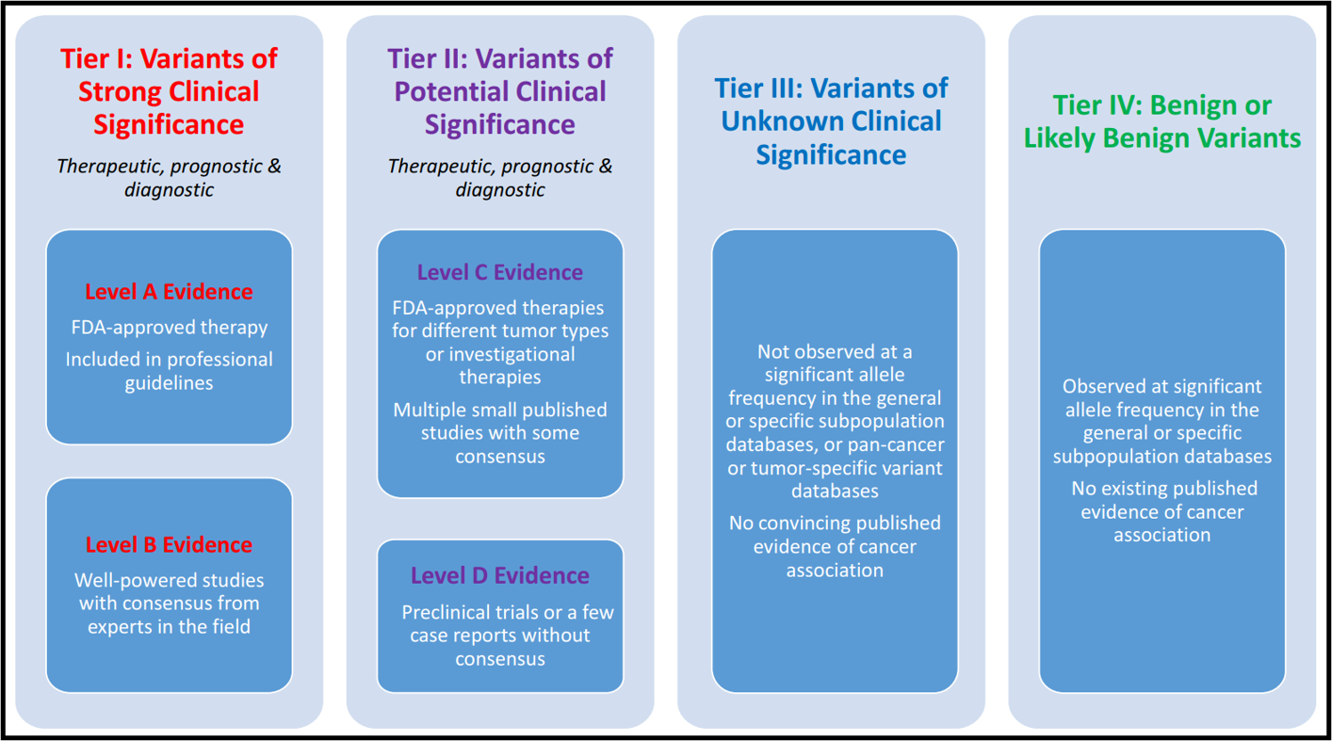
Most Labs Classify Somatic Variants as per AMP/ASCO/CAP
Change Treatment
Probably Should Not
Change Treatment
Not reported
PMID: 27993330

Slide 37
What Does a ‘BRAF Positive’ Melanoma mean?
Your Clinical Trial Enrols Patients With Tier 1 and Tier 2 BRAF Positive Metastatic Melanoma. Your BRAF R462I (p.Arg462Ile) variant is reported as Tier 3 (Variant of Uncertain Significance)
-------- Is your patient eligible? --------
Dhirendra Govender, and Runjan Chetty J Clin Pathol 2012;65:986-988
Notes:
Schematic representation of BRAF structure showing domains and some of the common BRAF mutations.CRD, cystine-rich domain; RBD, RAS binding domain.

Slide 38
Interpret this Variant so the Oncologists Can Consider What They Should Do
As part of genomic tumor profiling study, you find the following mutation in a triple-negative breast carcinoma sample. The trial is evaluating the efficacy of a novel EGFR inhibitor to treat these patients.
Genomic Variant Identified:
EGFR: c.2236_2250del (p.Glu746_Ala750del) VAF: 34%
Results from 523 gene
next-generation sequencing panel

Slide 39
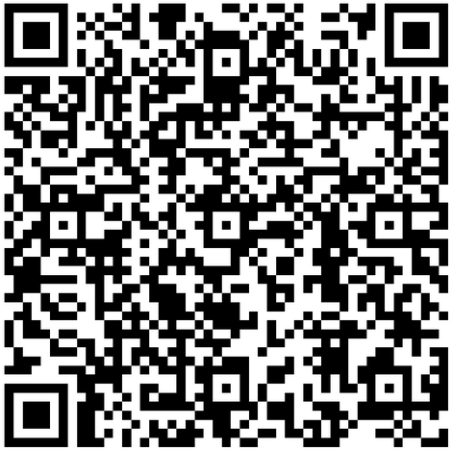
Poll 2
Please scan the QR code with your camera app and click the link to access the Poll.
Results

Slide 40
Summary
Differentiating Tumor vs Germline Variant requires ‘normal’ specimen
Ensure clinical report identifies variants of uncertain significance (if reported) and genomic regions evaluated
Always critically evaluate what you receive using scientific evidence sources
Clarify the eligibility criteria for enrolment into clinical trial

Slide 42
How do you report this variant back to the oncologist
so they will know what to consider?
Strong Clinical Significance
Potential Clinical Significance
Unknown Significance
Benign/Likely Benign
I have no idea
Notes:
Poll Title: How do you report this exon 19 (c.2236_2250del) variant in EGFR https://www.polleverywhere.com/multiple_choice_polls/UgdUCOehvekA8QGpxzJdn

Slide 43
Could this EGFR variant cause a familial predisposition to cancer in this patient and their family members?
A. Yes
B. No
C. Uncertain
D. I have no idea

Slide 44
Clinical Report for our EGFR Positive Patient
Specimen: FFPE, Left breast lumpectomy, skin anterior, stitch lateral
Results: EGFR: c.2236_2250del (p.E746_A750del) VAF: 34%
Interpretation: Potential Clinical Significance (Tier 2A)
- Activating EGFR variant
- Patients with lung cancer respond to targeted therapies, unknown in breast.
Genes Tested: Coding Sequences for 523 cancer related genes
(available on request)
Methods/Limitations:
Next-generation sequencing performed from genomic DNA and RNA using a custom panel.
100% Specificity, 99% Sensitivity, 5% limit of detection

