Slide 1
Phase II Study Design in Oncology Drug Development
Wendy R. Parulekar MD FRCP
Senior Investigator, Canadian Cancer Trials Group;
Wei Tu PhD
Senior Biostatistician, Canadian Cancer Trials Group.

Slide 2
Disclosures
WP: Pfizer, Celgene, Hecht Foundation, CBCF, CIHR, AstraZeneca, TerSera, Roche, Novartis/AAA;
WT: None.

Slide 3
Learning objectives
To define the role of a phase II study in oncology drug development
To describe the statistical parameters that provide the framework and sample size for a phase II study
To recognize and describe the objectives and design elements of commonly used randomized phase II designs

Slide 4
Roles of phase II study
Primary purpose of phase II clinical trials in cancer is to identify promising regimens to take forward to a larger phase III trial. Depending on specific settings, a phase II trial will:
Assess efficacy;
Determine optimal dosage balancing efficacy and safety;
Evaluate safety and side effect;
Explore biomarker and identify subgroups;
Inform Phase 3 trial design.

Slide 5
Characteristics of phase II study
Moderate sample size: typically range from 30 to 200 patients, depending on disease stage and study design.
Intermediate or surrogate endpoints: often use surrogate endpoints like tumor shrinkage to provide early indications of efficacy.
Relaxed statistical errors: allows for more relaxed type I and type II error rates to achieve a feasible sample size.
Moderate duration: typically lasts from a few months to a few years.
Flexible design: employs a range of designs tailored to the research question and available resources.

Slide 6
Overview of phase II study design
Design a phase II trial
1. Therapeutic considerations
Targeted/cytostatic vs cytotoxic
Single vs combination therapy
2. Trial aim
Proof of concept for phase III
Biomarker dependent vs not
Treatment selection for phase III
3. Outcome of interest
Activity +/- toxicity, +/- quality of life
4. Outcome measure
Categorical (response/no response)
Continuous (biomarker)
Time to event (OS, PFS)
Adapted from Brown, S. R., et al. "Designing phase II trials in cancer: a systematic review and guidance." British journal of cancer 105.2 (2011): 194-199.

Slide 7
Overview of phase II study design (continued)
5. Hypothesis
Superiority
Non-inferiority or equivalence
6. Randomization
Single arm (no randomization)
Randomization to experimental arms only
7. Other design choices category
One-stage vs two-stage vs multiple stage
Randomization including control arm with no formal comparison
Randomization including control arm with formal comparison
Response adaptive design
Design a phase II trial
Phase II/III design
Interim analysis for safety and/or efficacy
Adapted from Brown, S. R., et al. "Designing phase II trials in cancer: a systematic review and guidance." British journal of cancer 105.2 (2011): 194-199.

Slide 8
Randomization: PROs and CONs
Randomization | Design | PROs | CONs
Single arm¹ | Single arm design; two stage design. | Simple, efficient and easy to implement. Useful in rare diseases and signal detection. | Lack of control data
Randomization to experimental arms only | Screening/selection design | Allow exploration of multiple treatments (dosage, combination, etc.). Efficient use of resources. | Lack on control data
Randomization including control arm with no formal comparison | Noncomparative randomized design (like 2 parallel single arm designs) | Contemporaneous control allows meaningful interpretation of experimental arm. Sample size still moderate. | Larger sample size comparing with single arm study; no formal statistical comparison.
Randomization including control arm with formal comparison | Randomized control trial | Robust evidence. Minimizes bias. Regulatory acceptance. | Large sample size; long trial duration; complexity and cost.
Includes platform design where patients were assigned to each cohort/substudies based on biomarker since each cohort can be viewed as a single arm study.

Slide 9
What key factors should be considered when picking one of these 4 designs?
ⓘ Start presenting to display the poll results on this slide.

Slide 10
Randomization: yay or nay
Consideration | Yay | Nay
Use of historical control data to specify their design. | Reliance on historical control data for setting target response makes results of single- arm trials unreliable. | For several diseases, well-established resources allow for determination of historical response to treatment.
Success in phase II should reliably predict that clinical benefit will be observed in phase III. | The classical single-arm paradigm has per- formed poorly in predicting clinical benefit in phase III; randomized designs would perform better. | No evidence is available to suggest the use of randomization in phase II has improved success in phase III.
There is a trade-off between trial complexity and quality. | In conducting a randomized trial, you “get what you pay for,” with better quality data accrued. | Single-arm trials are simpler and easier to conduct.
Randomized phase II designs appear more similar to phase III designs than conventional phase II designs. | A highly statistically significant P value from a randomized trial would provide a strong case for seeking regulatory approval. | Investigators may incorrectly interpret the results of randomized phase II trials as though they are from a large phase III study.
Molecularly targeted agents may often be cytostatic and not in general lead to tumor shrinkage. | PFS should be the preferred primary out- come for cytostatic agents, which in turn makes randomization preferable. | The use of tumor response is still appropriate because several cytostatic agents have led to statistically significant tumor regression.
Grayling, Michael J., et al. "A review of perspectives on the use of randomization in phase II oncology trials." JNCI: Journal of the National Cancer Institute 111.12 (2019): 1255-1262

Slide 11
Which design do you think is mostly used for phase 2 trials?
ⓘ Start presenting to display the poll results on this slide.

Slide 12
Systematic review of phase II oncology trials
Based on 557 phase II and phase II/III oncology clinical trials published from 2010-2015.
More than half (57%) used single-arm design, and 21% used randomized comparative design.
For single arm design, ORR is the most common endpoint (41%); for randomized comparative design, PFS is the most common (40%).
Sample size is smallest for single-arm design while largest for randomized comparative design.
Randomized comparative design has a lower positive result rate than other designs (28% vs 70%+).
Grayling, Michael J., et al. "A review of perspectives on the use of randomization in phase II oncology trials." JNCI: Journal of the National Cancer Institute 111.12 (2019): 1255-1262

Slide 13
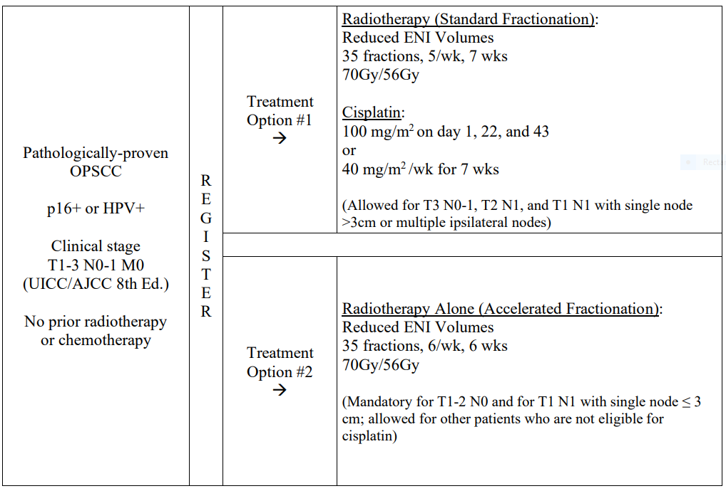
Example: single arm single stage (HN10)
Primary endpoint: 2 year EFS rate (binary).
Hypotheses: H0, 2 year EFS </= 85%; HA, 2 year EFS > 85%. Non-inferiority margin 6%.
Statistical parameters: one-sided alpha 0.1, power 80%.
Sample size: 100
Triger for analysis: 304.7 person-years of follow up
Go/no go decision: H0 rejected if observed 2 year EFS rate higher than 88.85% or less than 18 EFS events.
Status: final analysis done and primary publication pending.

Slide 14
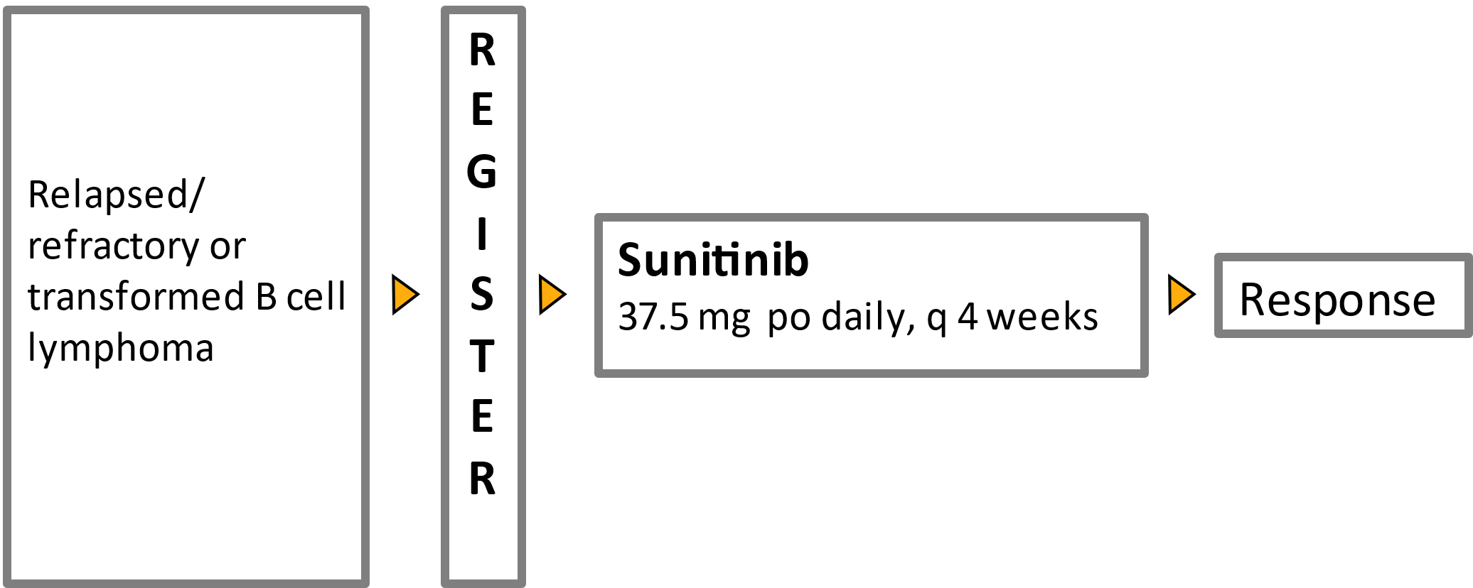
Example: single arm two stages (IND.182)
Primary endpoint: Objective response using standard criteria for non-Hodgkin lymphoma.
Hypotheses: H0: ORR </= 5%; HA: ORR >/= 20%.
Statistical parameters: one-sided alpha 0.12, power 89%.
Sample size: first stage 15, continue if at least one response; second stage additional 10.
Go/no go decision: H0 rejected if at least 3 responses among 25 patients.
Result: first stage 17 eligible patients, 15 evaluable for response. No responses seen – study stopped. No convincing pharmacodynamic evidence of antiangiogenic activity
Buckstein, Rena, et al. "Sunitinib in relapsed or refractory diffuse large B-cell lymphoma: a clinical and pharmacodynamic phase II multicenter study of the NCIC Clinical Trials Group." Leukemia & Lymphoma 52.5 (2011): 833-841

Slide 15
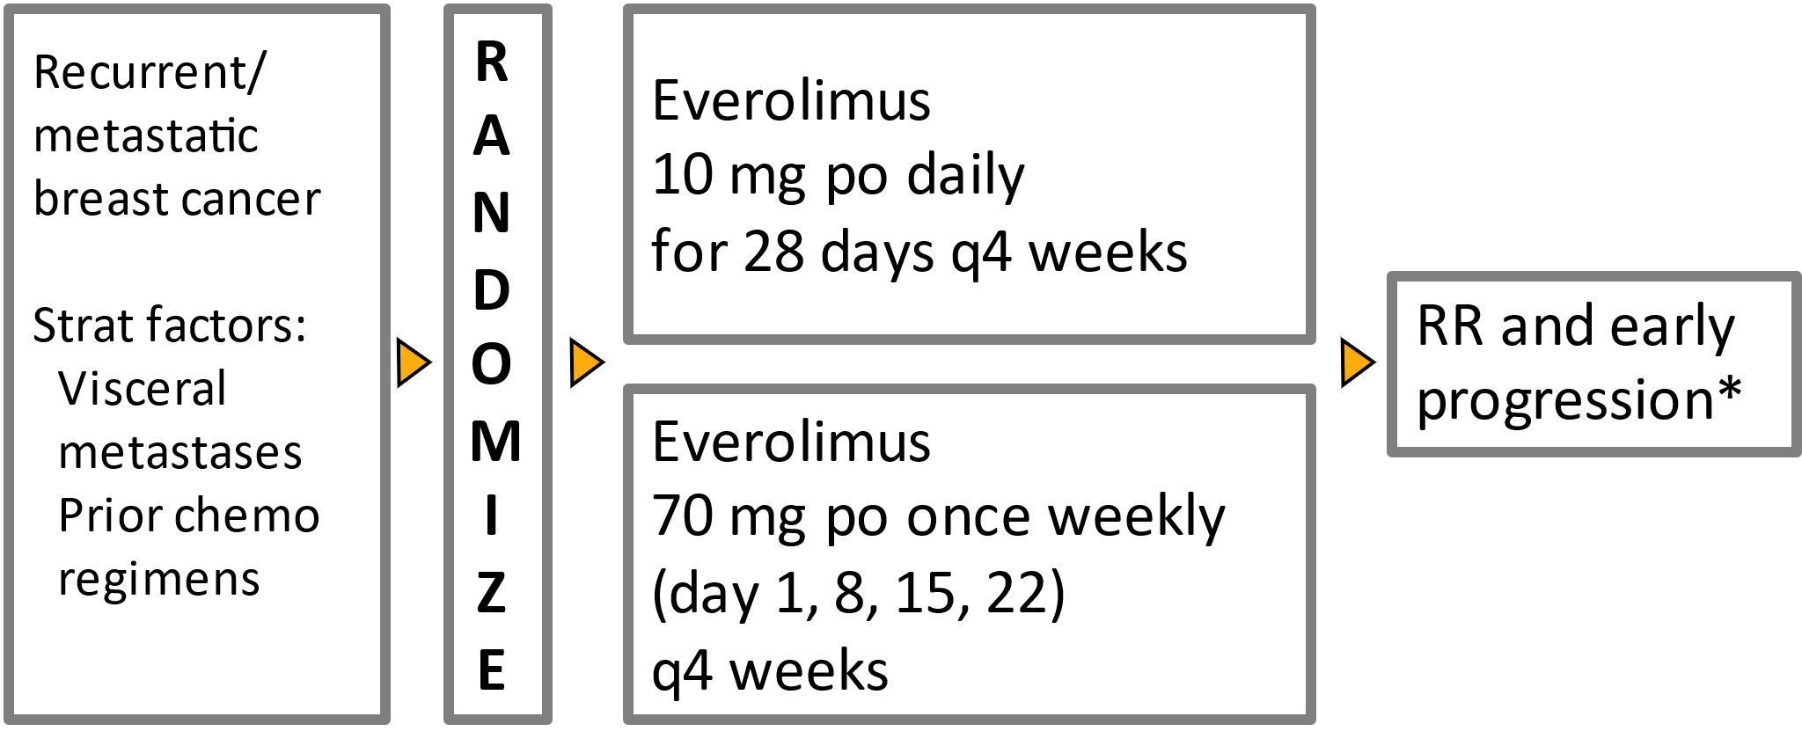
Example: randomized to multiple experiment arms (IND.163)
Primary endpoint: objective response or lack of early (< 8 weeks) progression
Hypotheses: H0: ORR </= 5% and early progression rate >/= 60%; HA: ORR >/= 20% or early progression rate </=40%.
Statistical parameters: two-sided alpha 0.1, power 93%.
Sample size: stage 1, 15 patients randomized to each arm; if no response or more than 10 early progression, stop; otherwise, stage 2 adds another 15 patients randomized to open arm.
Go/no go decision: H0 rejected if at least 4 response or less than 13 early progressions among 30 patients.
Result: weekly schedule: no response and 11 early progression, stopped at stage 1; daily schedule: 4/30 responses (ORR = 12%).
Ellard, Susan L., et al. "Randomized phase II study comparing two schedules of everolimus in patients with recurrent/metastatic breast cancer: NCIC Clinical Trials Group IND. 163." Journal of Clinical Oncology 27.27 (2009): 4536-4541.

Slide 16
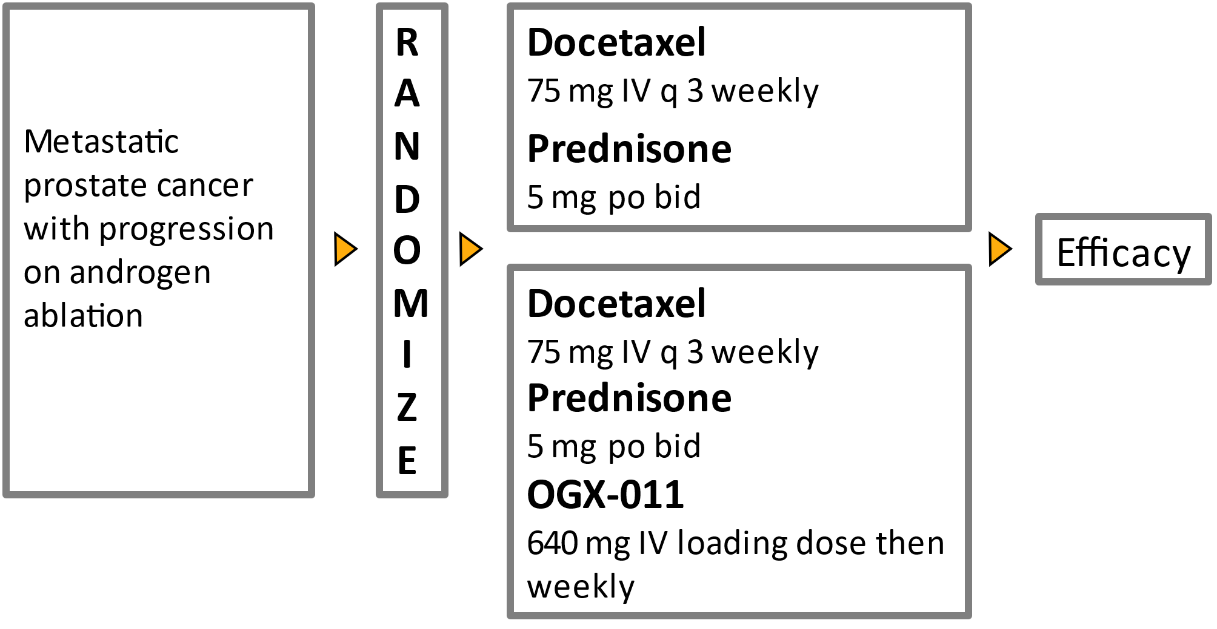
Example: Randomization including control arm with no formal comparison (IND.165)
Primary endpoint: Proportion of patients with PSA decline > 50% from baseline Hypotheses: H0: experimental arm PSA response </= 40%; HA: PSA response >/= 60%.
Statistical parameters: one-sided alpha 0.1, power 90%.
Sample size: 40 patients each arm. Total = 80.
Go/no go decision: H0 rejected if 20 or more responses seen in experimental arm.
Result: Docetaxel + Prednisone: 54% (90% CI 39.8-67.1); Docetaxel+ Prednisone + OGX 011: 58% (90% CI 43.3-70.8).
Chi, Kim N., et al. "Randomized phase II study of docetaxel and prednisone with or without OGX-011 in patients with metastatic castration-resistant prostate cancer." Journal of clinical oncology 28.27 (2010): 4247-4254.

Slide 17
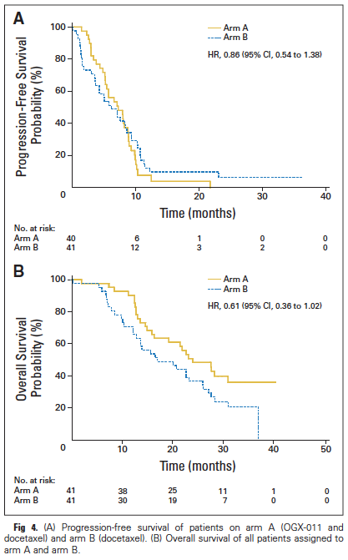
Example: Randomization including control arm with no formal comparison (IND.165)
Secondary Endpoint | Docetaxel + Prednisone + OGX 011 | Docetaxel + Prednisone
RR (95% CI) | 19% (95% CI 6.6-39.4) | 25% (95% CI 9.8-46.7)
Median PFS (95% CI) | 7.3 months (95% CI 5.3-8.8) | 6.1 months (95% CI 3.7-8.7)
Overall Survival (95% CI) | Median 23.8 months (95% CI 16.2-not reached) | 16.9 months (95% CI 12.8-25.8)

Slide 18
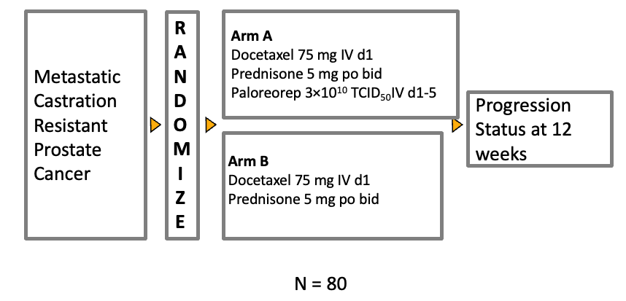
Example: Randomization including control arm with formal comparison (IND.209)
Primary endpoint: Proportion of patients lack of progressive disease (LPD) at 12 weeks.
Hypotheses: H0: LPD = 20%; HA: LPD = 50%.
Statistical parameters: two-sided alpha 0.1, power 90%.
Sample size: 40 patients each arm. Total = 80.
Go/no go decision: H0 rejected if p value smaller than 0.1.
Result: 12-week LPD rate was 61% (Arm A experimental) and 52.4% (Arm B control) p=0.51 (not statistically significant).
Eigl, Bernhard Josef, et al. "A randomized phase II study of pelareorep and docetaxel or docetaxel alone in men with metastatic castration resistant prostate cancer: CCTG study IND 209." Oncotarget 9.8 (2018): 8155.

Slide 19
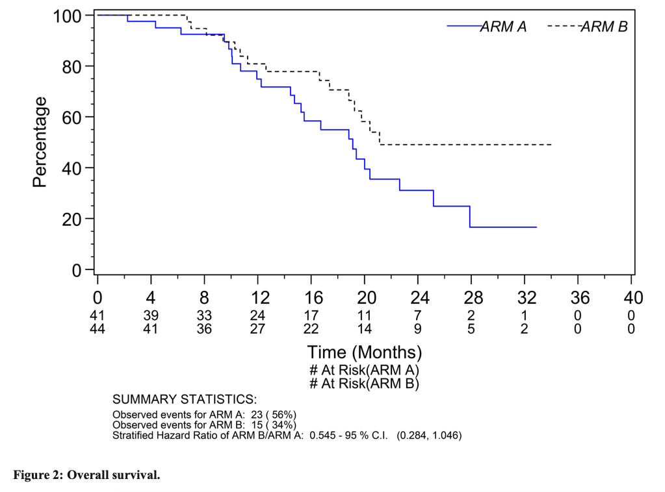
Example: Randomization including control arm with formal comparison (IND.209)
No survival benefit observed.

Slide 20
Any other questions?
ⓘ Start presenting to display the poll results on this slide.

