Slide 1
Technological Advances in Clinical Trial Conduct: CCTG Perspective
August 23, 2024
Lam Pho, Chief Information Officer

Slide 2
Learning Objectives
To review the current advancements in technologies for CCTG clinical trial conduct
Review examples such as mobile apps (SymptomIQ and SPROUT) for real-time patient self-reporting.
To review the future direction of technologies at CCTG
Data Analytics & Visualizations
EHR and EDC Integration
Medidata Data Integrated Platform - Clinical Data Studio

Slide 3
Information Technology at CCTG
Safety Monitoring & Engagement
IT Infrastructure & Administration
SAE & Safety Reporting & Reminders
e-Assessment System
Pharmacovigilance
Reporting to Regulatory & Partners
CIOMS, PDF, XML
Electronic Data Capture
CCTG Data Integrated Platform
CCTG Data Centre & Storage Facilities
Database Encryption At-Rest & In-Transit
CAS Single Sign-On
Cybersecurity Baseline Controls
Cloud Network Services
SAS Data Checking & Analysis
Help Desk Support & Change Management
Financial Management & Site/Trial/Per Case Funding
Safety Monitoring & Reporting
IT Infrastructure & Administration
Site Monitoring & Reporting
Comprehensive eTMF Solution
Accrual Utility
Trial & Site Management
Centre Performance Index
Central Office Monitoring
Data Checking System
On-Site Monitoring
Audit Database
Regulatory
& Safety
Data
Collection
Tissue & Imaging
Site Monitoring & Audit
Omics
Patient Enrollment, Scheduling & Tracking
Training & Assessments
Mango: Central Enrollment & Credentialing System, Drug Distribution, Tracking & Management
Molecular Tumour Board Review
CRF Scheduling & Reminders
Supporting Document Upload
CRF Tracking, Review Status, & Metrics
Regulatory & Trial Management
Patient Engagement
RIPPLE: Account Management & Trial Delegation Log
Membership Roster
Ethics Tracking & Reminders
Regulatory Documents
Radiotherapy Site Credentialing
Trial Webpage
Protocol, Consent & Amendment Management
Data Management Materials & Manuals
Oversight
Support
Regulatory & Trial Management
Patient Enrolment
Scheduling & Tracking
Data Sharing & Visualization
Electronic Data Capture
iMedidata Rave EDC, REDCap EDC
CDISC Compliant eCRF Templates
Serious Adverse Events
Central Lab Tracking
Radiotherapy QA Central Review
Training & Assessments
Data Sharing & Visualization
Tissue & Imaging
Omics
EDC e-Learning
GCP & Health Canada Division 5
STU: Site Training Utility
CCTG Supplementary Training
CCTG Document Management & Training
Data Visualizations & BI Dashboard
Utilize External Data Platforms (i.e. OHDP) for eSource EMR/EHR
Collaborative Data Sharing & Linkage Across Network Partners
CCTG Data Sharing Platform
LETTUCE: Electronic Tissue Tracking
Specimen & Image Collection & Tracking
CAR-t Cell Tracking & Linkage
Digitalize Tissue Imaging/records
Raw Data & Results
Patient Engagement
Multi-platform ePRO, eCOA
eConsent
Patient-Centric Platform/Portal
Notes: Some are new/planned initiatives

Slide 4
CCTG Digital Transformation
Digital transformation is the adoption of digital technology by an organization. Common goals for its implementation are to improve efficiency, value or innovation
CCTG Digital Transformation Strategy
Mobile applications, wearables, biosensors, connected devices
Automation & Platforms
Cognitive Technologies
Data Analytics & Visualizations
Data Science
Digital Approach Areas of Focus: Trial Start Up, Trial Conduct, Trial Closure, and Trial Analysis
Today’s presentation will be focused on:
CCTG’s electronic Patient Reported Outcome (ePRO) called SPROUT
Digital Remote Patient Monitoring App (pilot for BL13F trial, funded by AstraZeneca)
Data Analytics & Visualizations
EHR and EDC Integration
Medidata Data Integrated Platform - Clinical Data Studio

Slide 5
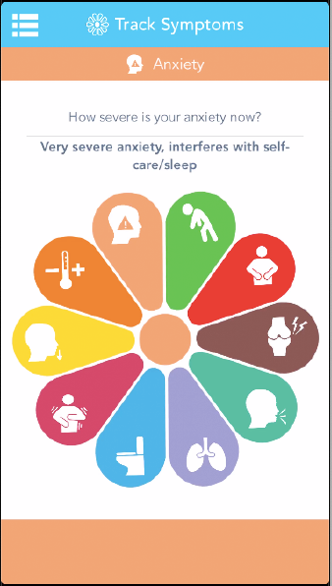
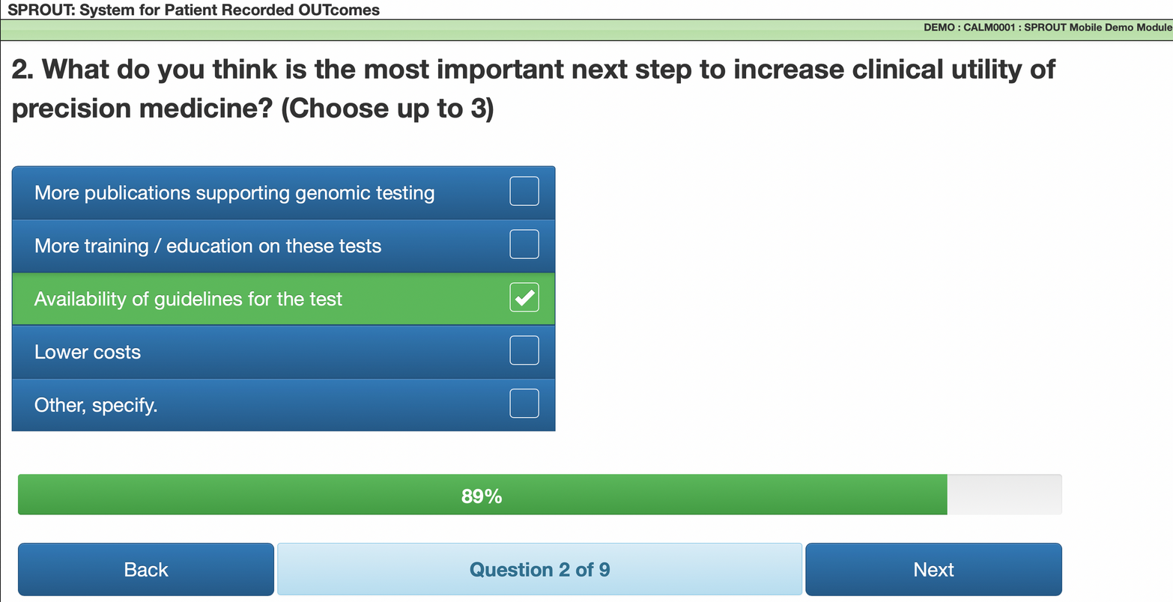
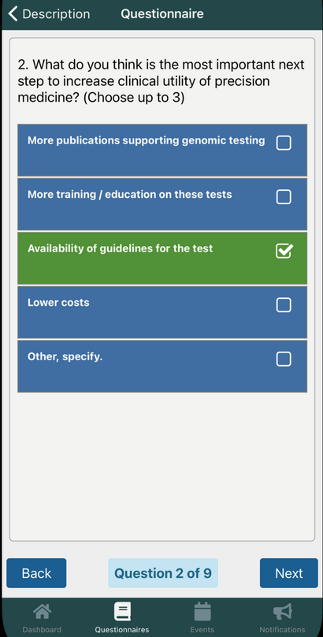
Mobile App Technology
e-PRO using in-house developed mobile-friendly web application SPROUT (System for Patient Recorded Outcomes)
uMotif’s mobile health app Symptom-IQ – subject’s self-tracking of symptoms for adverse event reporting
CCTG eCOA
&
ePRO
Currently developing SPROUT as a true native mobile app (for iOS and Android)

Slide 6
SPROUT (System for Patient Recorded Outcomes)
SPROUT is a CCTG application that allows electronic completion of ‘Patient Reported Outcomes’ – e.g. QoL questionnaires
Sprout has been implemented since 2015
The patient can complete the questionnaires in a clinic using iPad, their own phone / other mobile electronic device or at a home using provided PIN. PIN can be provided in person or emailed to the participant.
Complete the questionnaires on paper by patient is an option – the CRA subsequently enters the information in SPROUT on the patient’s behalf
CCTG provided iPads to sites in supporting of Sprout roll-out

Slide 7
Modules Built in SPROUT
Module Name | Version
ECR-M16 (Brief Experiences in Close Relationships Scale) | 2014
BPI (Brief Pain Inventory) | 1991
FACIT-COST | 2.0
Decisional Conflict Scale (DCS) | Traditional
EQ-5D-5L | 2.0
FACT-HN (Head & Neck) | 4
FAMCARE P16 | 2014
FCRI (Fear of Cancer Recurrence Inventory) | 1.0
FACIT-Sp (Spiritual Well-Being) | 4
Lost Productivity Questionnaire | 2018
MDADI (MD Anderson Dysphagia Inventory) | 1
MSAS (Memorial Symptom Assessment Scale) | 1
PHQ-9 (Patient Health Questionnaire) | 1
PRO-CTCAE | Multi Versions
PCL-5 (PTSD Checklist for DSM-5) | 2018
EORTC QLQ-C30 | 3
EORTC QLQ-BM22 | 2008
EORTC QLQ-EN24 | 2010
SASRQ (Stanford Acute Stress Reaction Questionnaire) | 1

Slide 8
PRO-CTCAE Module Summary
PRO-CTCAE is the Patient Reported Outcomes version of the Common Terminology Criteria for Adverse Events (PRO-CTCAE®)
The PRO-CTCAE Item Library includes 124 items representing 78 symptomatic toxicities drawn from the CTCAE
Scored on a scale 0-4 and used as a companion to the traditional CTCAE
AT CCTG, it has been used in 10 trials (only 2 with SPROUT) and 3 more in the planning phase
Available in over 31 languages. At CCTG, PRO-CTCAE is available in English and French languages with a request for Spanish in progress

Slide 9
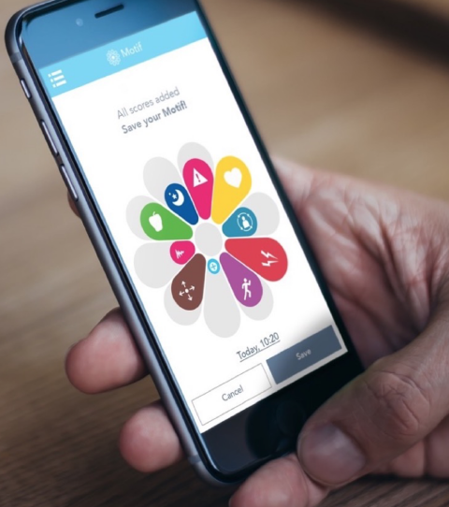
Digital Remote Patient Monitoring
Remote patient reporting of immunotherapy symptoms using a PRO measure-aligned with toxicity grades.
RPM uptake in clinical trials increasing with advantages of real-time data on symptoms, adverse events-learning enterprise.
Can include physiological data from wearables.

Slide 10
Survival
Real-time data = better insights into underlying mechanisms

Slide 11
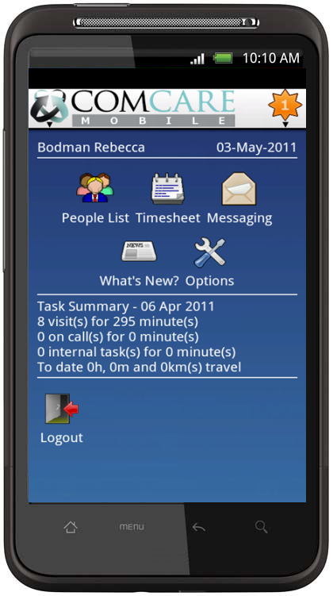
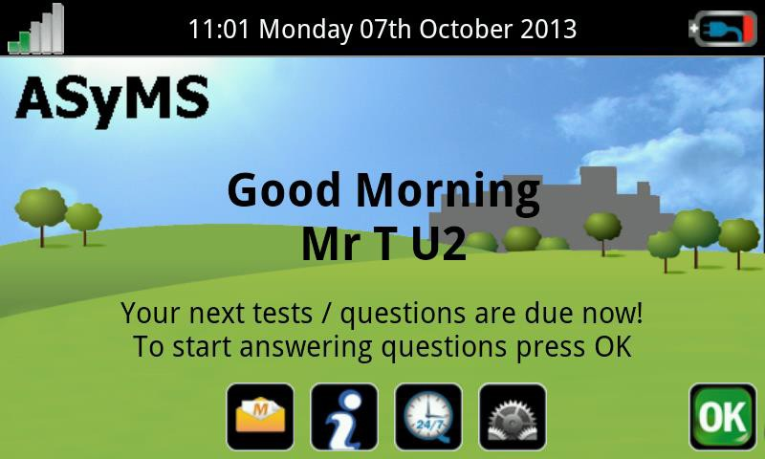
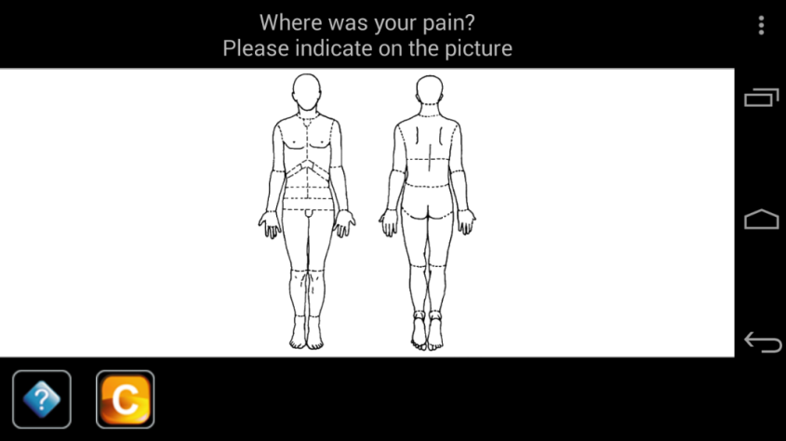
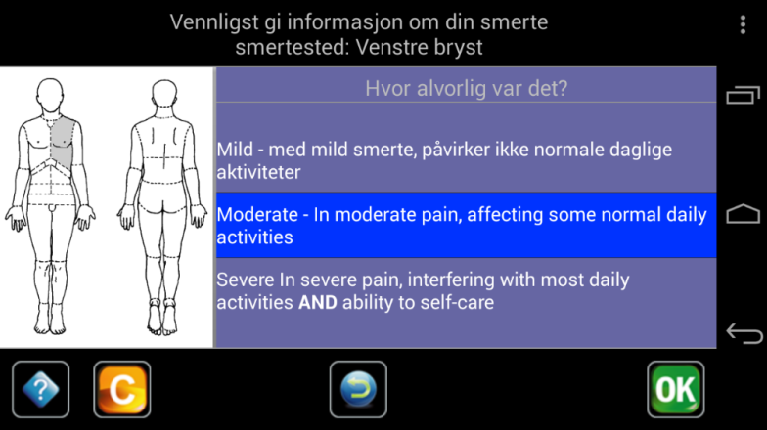
Medical Device (Class II): ASyMS-Canada Version
Patients complete PRO-Chemo-toxicity questionnaire.
Backend risk algorithm calculates-a risk score
Automated self-care advice
Risk-based alerting

Slide 12
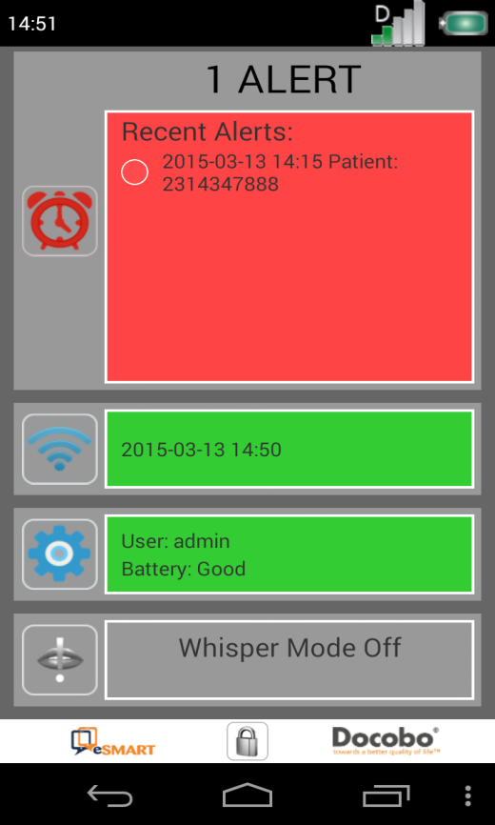
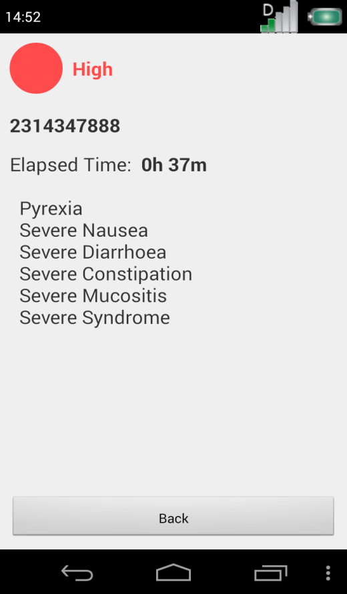
Clinician Alerted and Automated Patient Self-Care Advice

Slide 13
Data Analytics & Visualization
Data analytics is a discipline focused on extracting insights from data. It comprises the processes, tools and techniques of data analysis and management, including the collection, organization, and storage of data.
Data visualization is the graphical representation of information and data. By using visual elements like charts, graphs, and maps, data visualization tools provide an accessible way to see and understand trends, outliers, and patterns in data.
Power BI: Microsoft’s data visualization and analysis tool to create and distribute reports and dashboards

Slide 14
Benefits Of Implementing Power BI
Interactive Data Exploration: Power BI allows users to interact with the data directly, filtering and drilling down into specific metrics in real-time
Enhanced Visualization: With Power BI, data is presented in a visually compelling and dynamic manner, enabling better insights through customizable dashboards and reports.
Real-Time Data Updates: Unlike static reports, Power BI provides up-to-date information by connecting directly to live data sources, ensuring decision-makers have the most current data.
Efficient Reporting Process: The implementation of Power BI has streamlined the reporting process, reducing the time and effort required to compile, distribute, and update reports.
Improved Accessibility: Reports and dashboards in Power BI can be shared easily across teams and departments, and they are accessible on multiple devices, enhancing collaboration.

Slide 15
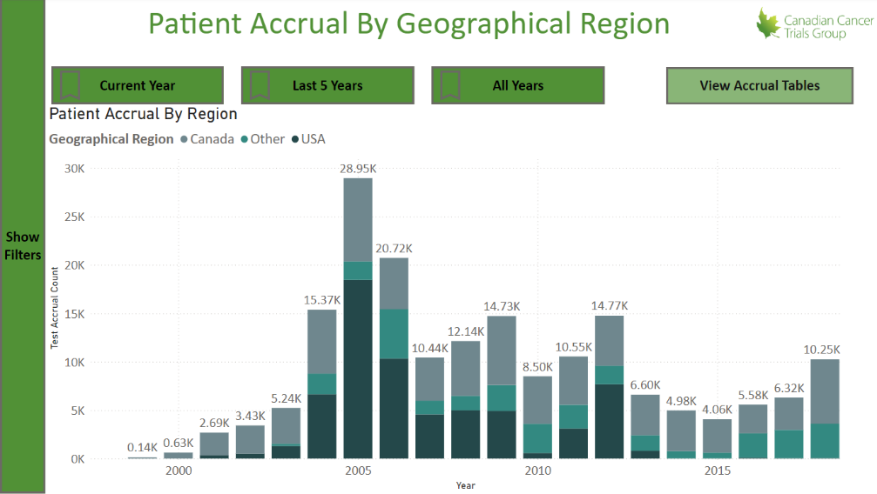
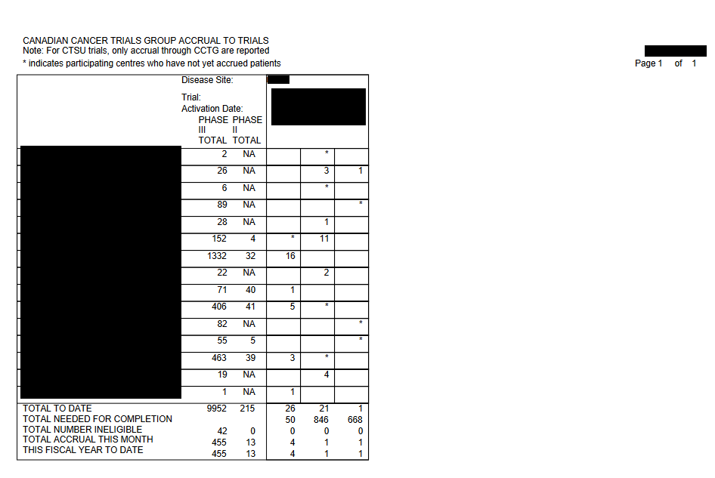
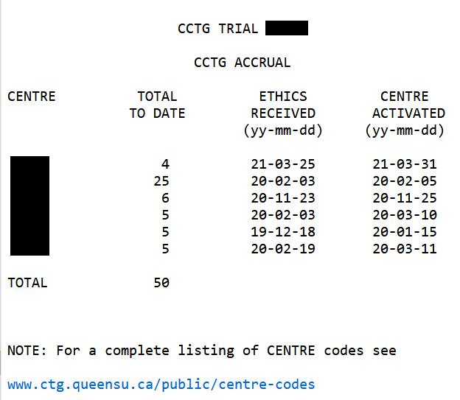
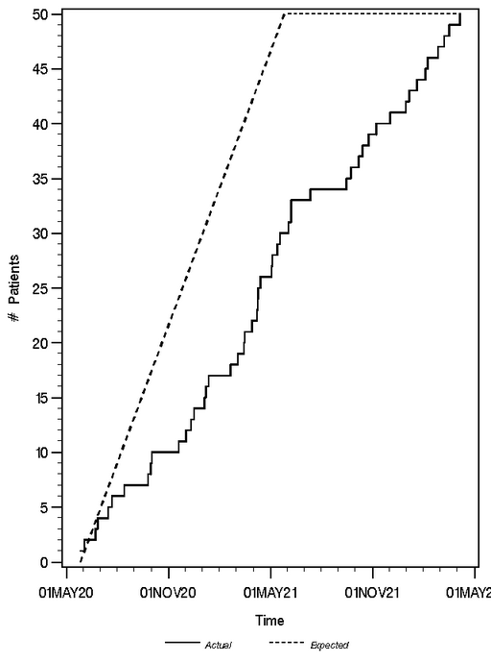
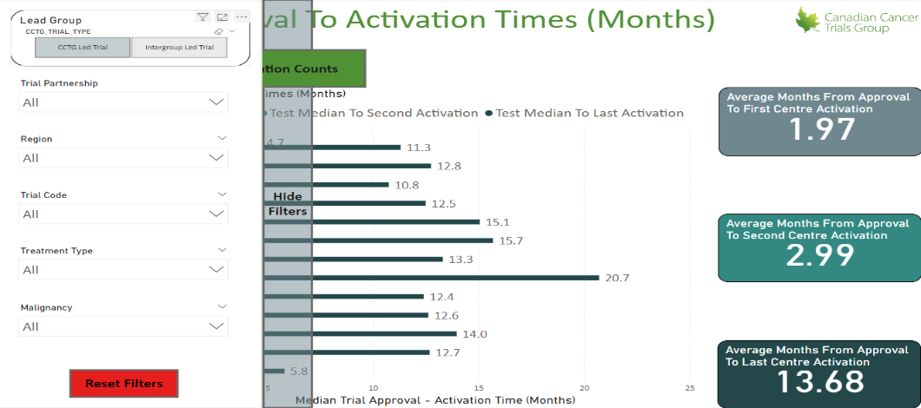
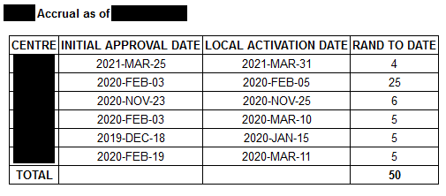
An Example of Data Analytics & Visualization Transformation: Accrual Utility
Power BI provides interactive, dynamic, and filterable data visualizations and tables, with export options and role-based access for enhanced decision-making.
Accrual reports that are mostly tabular and static (not real-time)
Note: The numbers are shown on the graphs are not real numbers

Slide 16
EHR and EDC Integration
What is EMR/EHR and EDC Integration?
Electronic Health Record to Electronic Data Capture integration entails using software to automatically transfer data from the EHR to the EDC system to populate its fields.
Powering a whole new level of collaboration between clinical research and healthcare
Who benefits from this integration:
Sponsors
Faster Delivery of more Accurate Data
Reduced operational costs
Faster Time to Data Cuts
Faster Time to Decision
Faster Time to Data Lock
Sites
Fewer Errors = Fewer Queries
Up to 80% reduction in manual entry of data
Increased staff time to spend with patient

Slide 17
Many Vendors in this space : Medidata, nCoup, proXimity, etc.

Slide 18
Medidata Clinical Data Studio
Is a transformative AI-powered data management and quality experience created for a study team to work as one. Multi-source data is integrated, transformed, and analyzed to shorten timelines, reduce risks, and ensure patient safety.
Not available in Canada until next year.
Main components:
Multi-Source Data (EDC, RWD, Imaging, Lab, eCOA, etc.); Collect; Ingest.
Standardize; Transform.
Monitor; Manage; Deliver.

Slide 19
CCTG must continues to advance its technologies while maintaining commitments to quality, integrity and security.
Questions?

Slide 20
Thank you

