Slide 1
Data Science in Clinical Trials
Fundamentals of Data Elements and Integration
New Investigator Clinical Trials Course - August 2024
#SolveCancerTogether
Lam Pho, Chief Information Officer, CCTG
Wei Tu, Senior Biostatistician, CCTG; Assistant Professor, Department of Public Health Sciences, Queen’s University

Slide 2
Learning Objectives
To understand the how clinical data sciences can support the collection, management, and analysis of clinical data
Define data science, how it applies to clinical trials, data sources and types, teams involved
To review the current adoption of data science at CCTG
Review some CCTG’s examples of projects
To review the future of data science at CCTG
Review CCTG’s goals and potential uses for clinical trial sponsors and sites

Slide 3
CCTG Scientific Agenda
Understand Cancer Biology and Use this Knowledge to Improve Cancer Therapies and Outcomes
Patient Reported Data
Reduce the Burden of Cancer and Its Treatment for Patients and Their Carers
Real-World Data
Improve Cancer Care by Demonstrating the Value of Cancer Treatments
Correlative Science Data

Slide 4
Please download and install the Slido app on all computers you use
What is Data Science to you?
ⓘ Start presenting to display the poll results on this slide.

Slide 5
What is Data Science?
Data science is the study of extracting value from data – value in the form of insights/hypothesis or conclusions. A conclusion may be in the form of a: Prediction of a consequence; Recommendation of a useful action; Clustering that groups similar elements; Classification that labels elements in groupings; Transformation that converts data to a more useful form; Optimization that moves a system to a better state.
Domain
Expertise & Knowledge
Research & Analysis
Processing &
Development
Data
Science
Mathematics &
Statistics
Computer
Science & IT
Machine
Learning
Spector, Alfred. "Data Science and AI in Context: Summary and Insights." Harvard Data Science Review(2024).

Slide 6
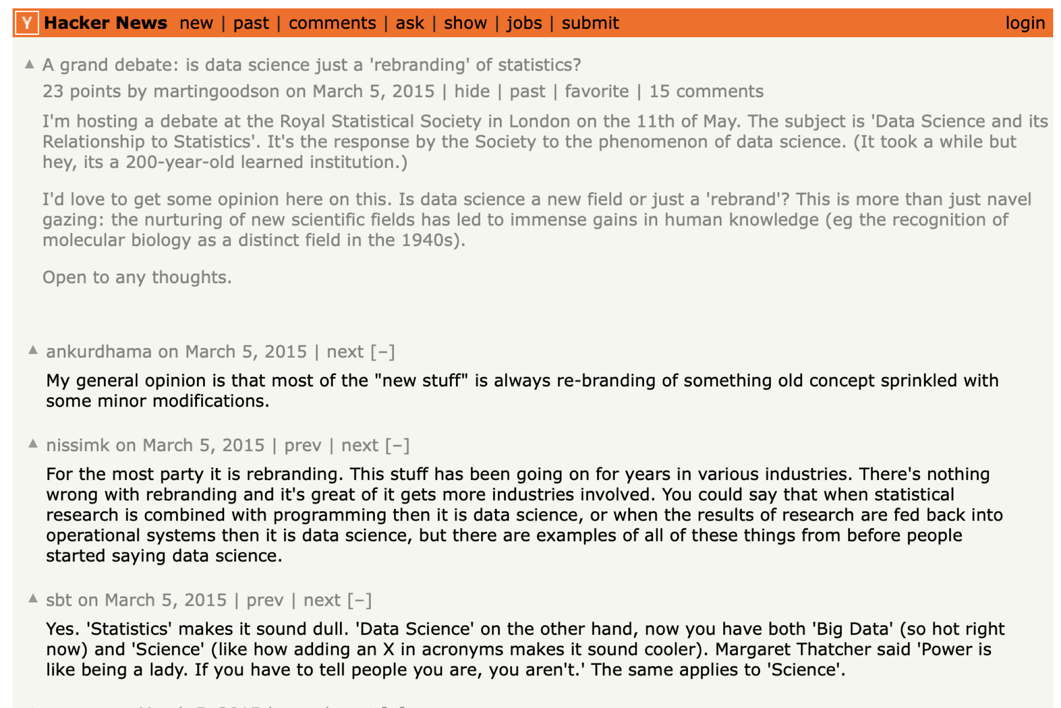
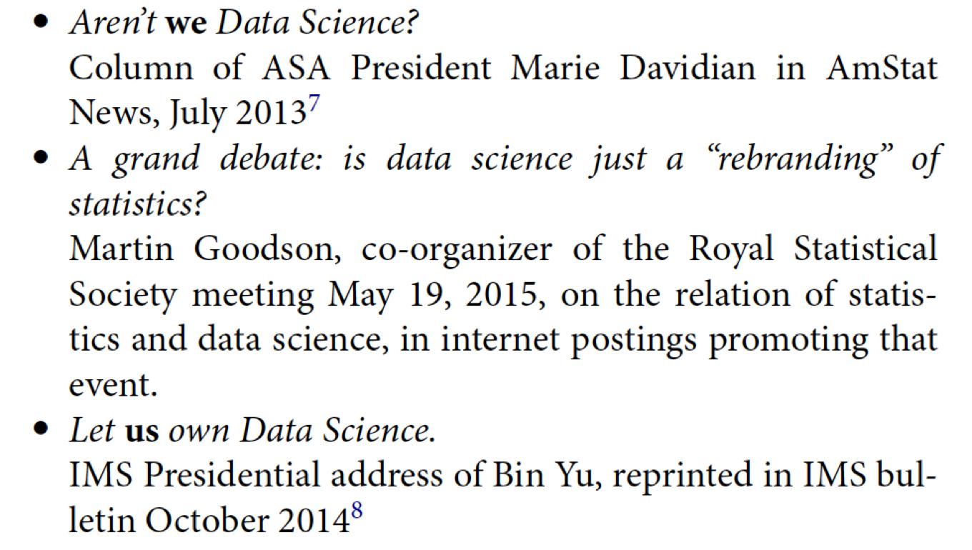
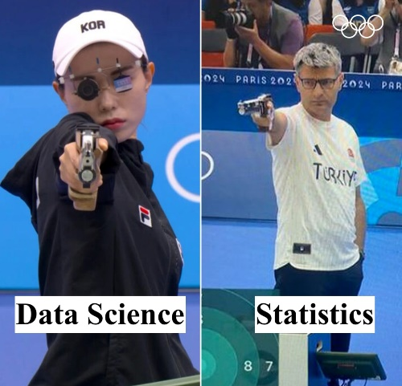
Data Science vs Statistics

Slide 7
Data Science Life Cycle
Data conceptualization
Generation/Collection
Processing
Storage/management
Analysis/visualization
Interpretation
Curation and provenance

Slide 8
What is Clinical Data Science?
Clinical data science applies the methods and insights of data science with clinical data
Clinical data scientists work within clinical trials to in data management and analysis
Clinical data science incorporates biostatistics, clinical programming, clinical data management

Slide 9
Types of Data
Structured
Quantitative data that consists of numbers and values, relational data, etc.
e.g. CRF data, patient demographics
Unstructured
Qualitative data that consists of audio, video, sensors, descriptions, text, etc.
e.g. DICOM images, Physician notes/narratives
Semi-Structured
Lies midway between structured and unstructured data; doesn't have a specific relational or tabular data model but includes tags and markers that scale data into records and fields in a dataset
Consists of free text or data partially annotated with some specific keywords or metadata from a controlled terminology.
e.g. data repositories, ClinicalTrials.gov

Slide 10
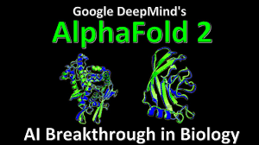
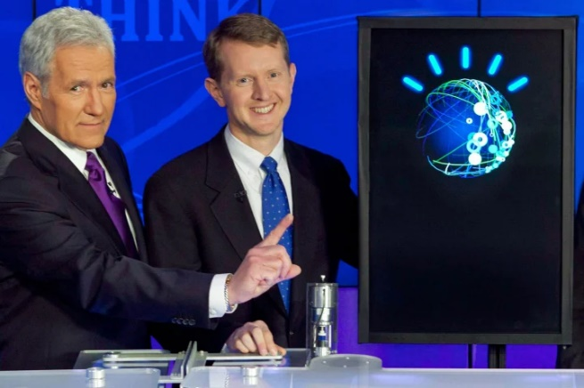
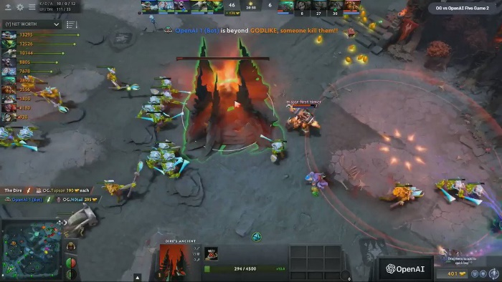
Data Science/AI Success Story

Slide 11
Please download and install the Slido app on all computers you use
Which areas of clinical trials Data Science can help with?
ⓘ Start presenting to display the poll results on this slide.

Slide 12
Data Science in Cancer Research and Trials
Cancer Research
Diagnosis
Early detection
Biomarkers
Prognosis prediction
Personalized patient care
…
Cancer Clinical Trials
Biomarker discovery
Adaptive trials
Meta analysis
Clinical trials + Real world data
Data Sharing
Do better at what we are already doing
…

Slide 13
Health Data Platforms

Slide 14
Challenges
Operational challenges
Ethics
Volume of data
Cost
Heterogeneity (data, disease, patient, treatment, etc.)
Ethics
Data literacy
Data Privacy
Regulations
Data conceptualization
Generation/Collection
Processing
Storage/management
Analysis/visualization
Interpretation
Curation and provenance

Slide 15
Data Science Platform at CCTG
Patients
Clinicians
Correlative Scientists
Statisticians
Clinical Research Associates
AI researchers
Heath Economists
Policymakers
Regulators
…
Clinical Trial Data
Correlative Science
Data
Sharable, Generalizable,
Transparent,
Efficient,
Knowledge translation
Data Science Platform at CCTG
#SolveCancerTogether
Real-world Data
Patient reported Data

Slide 16
What is Clinical Data?
Clinical data is information gathered for the broad purpose of clinical research on the micro-level (patient care) to the macro-level (broad applications within a health system)
Clinical data is patient data collected throughout the course of patient care, or as part of a formal clinical trial program.

Slide 17
Sources of Data
eCRFs, IxRS, Supporting/Source Documents, CTMS, etc.
Clinical Trial
Data
Any “Biomarker” done on biospecimens (tissue, blood, cell, spinal fluid, etc.) -Immunohistochemistry results, FISH analysis, cytogenetics, a myriad of genomic testing, metabolomics, proteomics
Central pathology review
Radiomics
Pathological diagnosis
Digital images
Clinical correlates
Electronic health records (EHRs)
Claims and billing activities
Product and disease registries
Social Media
Patient-generated data including in home-use settings
Data gathered from other sources that can inform on health status, such as mobile devices
CLINICAL
DATA
SCIENCE
Correlative
Science
Data
Real World Data
Patient Reported Data
ePRO, eCOA, screening questionnaire, sensors/wearable devices

Slide 18
Oversight, Operations & Support
Trial Team: Senior Investigator/Data Manager/Monitor/Biostatistician/IT/etc.
Central Office Data Executive Committee
Data and Safety Monitoring Committee (DSMC)
Clinical Trial
Data
CLINICAL
DATA
SCIENCE
Correlative Science and Tumour Biology Committee
Correlative
Science
Data
Committee on Economic Analysis
Real World Data
Data Science Working Group
CCTG Senior Management
Patient Reported Data
Quality of Life Committee
Support Care Committee

Slide 19
CCTG’s Goals
Further standardize clinical trial data plan, collect, organize and analyze
Standardized, generalizable, scalable, and sharable clinical trial database across trials
Clinical Trial
Data
Develop a pilot project to highlight the significance and test the infrastructure of the platform
Define policies and workflow of routinely link trial data to cancer and mortality registry data as well as develop infrastructure to secure store sensitive data
A built-in trial component to use RWD as a complement for clinical data to allow long term follow-up and economic analysis
Develop protocols, data infrastructure and different correlative data collection, processing, storage and analysis
A standardized and sharable digital data bank including different correlative data for different cancer types
CLINICAL
DATA
SCIENCE
Correlative
Science
Data
Real World Data
A platform that is available to different users in cancer research and care to collaborate and #SolveCancerTogether
Patient Reported Data
Expand the use and functionality of current CCTG developed patient self-reporting application
An interactive patient portal that can capture different dimensions of patient outcomes and provide useful knowledge/support/feedback to the patient

Slide 20
Some Examples of Projects
CDISC Data Standards (CDASH, STDM, ADaM)
CDISC Global Library of eCRFs
Dash Sharing Platform
Clinical Trial
Data
Biospecimen Management System
Image Management System
Repository of Omics & Results i.e. genome sequencing data
Build an inventory of correlative data to identify gaps in standardizing the biomarker validation process
LIFE study: Testing feasibility and value of long-term clinical trial follow up using administrative data sources i.e. link clinical trial data with Cancer Care Registry and Statistics Canada census data
EHR-to-EDC
Correlative
Science
Data
CLINICAL
DATA
SCIENCE
Real World Data
Patient Reported Data
Expanding use of SPROUT - ePRO
Longitudinal online outcome collection from patients in SC.27
Remote symptom monitoring in BL.13F
Virtual delivery of SC intervention in SC.26
Mobile app development
Medidata Patient Cloud module (HN.11)
Portal to allow patients to complete their ePROs, see their outstanding surveys, study materials, etc.

Slide 21
Challenges in Data Science
Data: managing a variety of high volume, velocity data
Adoption: adopting a problem-solving approach
Tools and Technologies: understanding and choosing the right analytical tools and models, keeping up with the latest advancements
Integration and Interoperability: data originating from difference systems and sources
Data Privacy: implementing measures to ensure compliance and data privacy/protection, keeping up with latest regulations
Staff: getting people with the right skill sets to drive the data science initiative and platform

Slide 22
Data Science for Sponsors
Leverages AI to:
streamline data aggregation, standardization, and management workflows so that multiple users can act on real-time data in ways that reduce burden, shorten review timelines, increase quality, reduce risk, and improve patient safety (Medidata Clinical Data Studio: Data Surveillance & Data Quality Management)
Automation of Data Review: Identify data trends and anomalies
Natural Language Processing of Narratives: Extract annotated data from unstructured clinical text to streamline the process and accuracy of data review
Vendor Oversight: Data-driven insights on performance related to vendor service on multiple trials
Audit Trail Review: Identify actions not performed by authorized individuals, timing of data entry (e.g. all-at-once/batch entry vs timely entry per protocol)

Slide 23
Data Science for Sites
Medical Image Analysis: Advanced techniques to enhance image analysis, detect abnormalities/deformities
Natural Language Processing of Narratives: Extract annotated data from unstructured clinical text to gain more insight into the overall patient care experience
Monitoring Patient Health: Wearable devices, symptom reporting, etc. can help physicians monitor patients real-time (as initiated by trial sponsor in some cases)
Social Media: Many platforms can target a wider range of potential patients
Virtual Care: Comprehensive platform to support patient care, self-monitoring, online assistance

Slide 24
Review of Learning Objectives
To understand the how clinical data sciences can support the collection, management, and analysis of clinical data
Defined data science, how it applies to clinical trials, data sources and types, teams involved
To review the current adoption of data science at CCTG
Reviewed some CCTG’s examples of projects
To review the future of data science at CCTG
Reviewed CCTG’s goals and potential uses for clinical trial sponsors and sites

Slide 25
Discussion
What other potential areas, applications, projects do you see for clinical data science?

Slide 26
Thank you!

