Slide 1
Clinical Trial Regulations and Guidelines
&
Quality in Clinical Trials:
How to Remain in Compliance
Michelle Savoie, Manager, Office of Compliance and Oversight
Jessica Sleeth, Director of Compliance

Slide 2
Agenda
Overview of clinical trial regulations and guidelines
History
Current state
What this means for you as an investigator
Quality processes at CCTG
Central Monitoring
On-site Monitoring
Audit
Inspections
Examples of inspection observations

Slide 3
Objectives
List the organizations and documents that define the regulatory standards in Canada
Identify investigator responsibility according to applicable Regulations and Guidelines
Describe quality management systems

Slide 4
Which Regulations & Guidelines apply?
Criteria | Regulations & Guidelines
All research involving human subjects | Nuremburg Code Declaration of Helsinki ICH Good Clinical Practice Local Requirements (e.g. REB)
Human research funded by Canadian federal granting agencies (e.g. CIHR) | Tri Council Policy Statement (TCPS)
Clinical Trials Involving Drugs | Canada – Food and Drugs Act US – FDA Regulations
Clinical Trials Involving Natural Health Products | NHP Regulations
Clinical Trials Involved Medical Devices | Medical Device Regulations
Human research funded by US federal funds (e.g. NIH) | US Federal Regulations (e.g. OHRP) The Common Rule Clinical Trial Monitoring Branch Guidelines (CTMB)

Slide 5
Nuremburg Code
10 standards physicians must conform to when carrying out experiments on human subjects
Key principles include but are not limited to:
Informed consent
Research must be necessary and based on prior animal experimentation
Risk is proportionate to importance
No unnecessary physical/mental suffering
Freedom to withdraw at any time

Slide 6
Declaration of Helsinki
Medical progress is based on research, research improves treatments and understanding of disease but involves risks and burdens, and therefore must be subject to ethical standards
Key principles include but are not limited :
Content of protocol
Consent of the informed consent form
Independent ethics review
Well-being of subject overrides science and society
Participation is voluntary and informed
Informed Consent requirements
Protection of privacy and confidentiality of subjects
Publication requirements

Slide 7
Tri Council Policy Statement
Joint policy of Canada’s three federal research agencies – the Canadian Institutes of Health Research (CIHR), the Natural Sciences and Engineering Research Council of Canada (NSERC), and the Social Sciences and Humanities Research Council of Canada (SSHRC)
1st TCPS came out in 1998. Revised to TCPS 2 in December 2014; Revised again in 2018 (released in late 2019)
Current is TCPS 2 (2022) released January 11, 2023
Key principles
Respect for Persons
Concerns for Welfare
Justice
Includes, but not limited to:
Informed consent
REB
Privacy
Genetic research
Research involving First Nations, Inuit and Metis peoples

Slide 8
Conduct of Clinical Trials in Canada

Slide 9
Canadian Food and Drug Regulations
Health Canada Food and Drugs Act (FDA)
Food and Drug Regulations (FDR), Division 5 “Drugs for Clinical Trials Involving Human Subjects”
Came into effect on September 1, 2001
Includes GCP (C.05.010)
Applies to all Phase I to Phase IV clinical trials
Health Canada: Guidance Document - 0100
Released 2019. Guidance Document: Part C, Division 5 of the Food and Drug Regulations “Drugs for Clinical Trials Involving Human Subjects”
Link: https://www.canada.ca/en/health-canada/services/drugs-health-products/compliance-enforcement/good-clinical-practices/guidance-documents/guidance-drugs-clinical-trials-human-subjects-gui-0100.html

Slide 10
Canadian Food and Drug Regulations
Marketed agents used outside of their approved use in Canada require a Clinical Trial Application (CTA)
E.g. clinical use, dose / formulation, route of administration or target patient population
CTA submissions include
Drug information, protocol, consent, product monograph / Investigator’s Brochure, safety information, required forms
30-day review period by Health Canada
No Objection Letter (NOL) = trial can proceed
May require a ‘Request for Information’ = additional information must be submitted to Health Canada
Not Satisfactory Notice (NSA) = trial / amendment may not proceed

Slide 11
International Conference on Harmonization of Technical Requirements for the Registration of Pharmaceuticals for Human Use (ICH) Good Clinical Practice

Slide 12
ICH E6 Revision 3 in process
2014 – identify need for update
2015 – draft addendum; public consultation
2016 – revise and prepare final document
Original E6(R1)
ICH approval May 1996
GCP E6(R2)
ICH approval Nov. 2016
Health Canada implemented 2019Apr01
GCP E6 (R3)
Draft 2023May19, public consultation
Final version expected 4Q2024
Rationale for updates: Since 1996 clinical trials have evolved substantially, with increase in globalization, study complexity and technological capabilities
Objective: Encourage implementation of improved and more efficient approaches to clinical trial design, conduct, oversight, recording, reporting while continuing to ensure participant protection and reliability of results
Draft updates in R3 :
Big focus is quality by design and critical to quality factors
Overarching Principals of GCP to be a flexible framework for clinical trial conduct
Technology-neutral: “written” documents removed and left open-ended for new technology
Focus on data handling procedures and informed consent of participant

Slide 13
International Conference on Harmonization of Technical Requirements for the Registration of Pharmaceuticals for Human Use (ICH) Efficacy Guidelines
ICH Guidelines relevant to clinical trial conduct
E1: Clinical Safety for Drugs used in Long- Term Treatment Prolongation
E2A-E2F: Pharmacovigilance
E3: Clinical Study Reports
E4 Dose Response Studies
E5: Ethnic Factors
E6: Good Clinical Practice
E7: Clinical Trials in Geriatric Population
E8: Considerations for Clinical Trials
E9: Statistical Principles for Clinical Trials
E10: Choice of Control Group in Clinical Trials
E11: Clinical Trials in Pediatric Populations
E12: Clinical Evaluation by Therapeutic Category
E14: Clinical Evaluation of QT/QTC Interval
E15: Definitions in Pharmacogenetics/ Pharmacogenomics
E16: Qualification of Genomic Biomarkers
E17: Multi-Regional Clinical Trials
E18: Genomic Sampling

Slide 14
ICH Good Clinical Practice
Overview
1. Glossary
2. Principles
3. REB responsibilities
4. Investigator responsibilities
5. Sponsor responsibilities
6. Protocol and amendments
7. Investigator’s Brochure
8. Essential Documents
Principles
Ethical principles
Benefits/risk
Rights/safety most important
Drug info supports trial
Trial scientifically sound, protocol
Protocol REB approved
Medical care by a qualified MD
Qualified individuals conduct trials
Free informed consent
Data accuracy
Confidentiality
Drugs: GMP/protocol
Quality assurance

Slide 15
ICH-GCP E6(R2) Investigator Responsibilities

Slide 16
ICH-GCP E6: Investigator Responsibilities
4.1 Qualifications and agreements
4.2 Adequate resources
4.3 Medical Care of Trial Subjects
4.4 Communication with IRB/IEC/REB
4.5 Compliance with Protocol
4.6 Investigational Product(s)
4.7 Randomization Procedures and Unblinding
4.8 Informed Consent of Trial Subjects
4.9 Records and Reports
4.10 Progress Reports
4.11 Safety Reporting
4.12 Premature Termination or Suspension of a Trial
4.13 Final report(s) by Investigator

Slide 17
Investigator Responsibilities
Adequate Resources
Qualified team and facilities to carry out trial (GCP 4.2):
Completion of eCRFs- accurate data entry
Collecting correlative samples
Preparing documentation for REB communication
Documenting transactions of investigational agent
Calibrated equipment and temperature monitoring in pharmacy
Medical care provided (GCP 4.3):
Determine patient eligibility for the trial
Make treatment decisions: GO no GO to next cycle/treatment
Manage AEs and any associated dose modifications

Slide 18
Investigator Responsibilities- CONT
Conduct trial in compliance with the protocol (GCP 4.5)
Tools for protocol investigations/schedule e.g. checklist/worksheets
Oversee process for team training on protocol and any updates
Report deviations from the protocol and develop corrective action to prevent future deviations
Informed Consent of Trial Subjects (GCP 4.8)
Ensure patient consented prior to trial related activities and informed consent discussions are documented
If the participant is unable to read or understand the document language, an impartial witness or interpreter can assist
Re-consent of patients is conducted timely when new information that could impact patient’s willingness to continue participation
Oversee process to ensure patients are informed of new information

Slide 19
Investigator Responsibilities
Accountability of Investigational Medicinal Products (GCP 4.6)
Often delegated task, however oversight still needed to ensure for e.g. used in accordance with protocol, correct storage, correct accountability logs
Records and Reports - Maintain adequate and accurate source documents (GCP 4.9) and trial records that are:
Attributable
Legible (much easier now with EMRs!)
Contemporaneous
Original
Accurate
Complete
Participant trial-related documents and medical records must be available for review by monitors, auditors, REB, and the regulatory health authority (GCP 4.9)

Slide 20
Investigator Responsibilities
Safety Reporting (GCP 4.11)
All Serious Adverse Events (SAEs) must be reported immediately to sponsor. The clock starts ticking as soon as the investigator is made aware- 24 hours to report!
Document causality/relatedness of SAE(s) for your study team for reporting and assist with any sponsor questions and follow up reports.

Slide 21
Investigator Versus Sponsor Responsibilities
Investigator
Adequate resources & qualifications
Contracts
Informed Consent
Randomizing/Unblinding
Medical care of trial subjects
Compliance with Protocol
Communication with REB
Investigational Medicinal Product (IMP)
Records and reports including Investigator Site File
Local safety reporting
Sponsor
Trial design
Contracts and financing
Medical expertise
Protocol development
Trial management, data handling, and record keeping including Trial Master File
Investigator selection and oversight responsibilities
Notification / submission to regulatory authority
Quality assurance and quality control
Noncompliance
Premature termination or suspension
Clinical trial / study reports
Data Safety Monitoring
Final Report
Contract Research Organization (CRO; e.g drug distribution)
Inspection Coordination

Slide 22
Site Selection Requirements
Adequate Resources
Credentialed QI
SOPs to Conduct Clinical Trials
Established System for Ethics Review
Access to Adequate Lab
Established Patient Population
Documentation of Delegated Tasks (RIPPLE)
Completion of Required Training
Demonstrated Commitment to Support CCTG Trials

Slide 23
Quality processes at cctg

Slide 24
Central Monitoring & On-Site monitoring

Slide 25
Principles of Quality Assurance
Processes based on regulations and guidelines
On-Site Monitoring
& Auditing
Central Monitoring
General trial Oversight
Patient Data:
Informed consent
SDV
Protocol Compliance
Centre SOPs
Essential & Ethics Documents
Pharmacy
General trial Oversight
Patient Data:
Informed consent
SDV
Protocol Compliance
Pharmacy
Essential & Ethics Documents
Centre Facilities
Protection of trials participants
High Quality data
Compliant trial conduct

Slide 26
Central Monitoring
Submitted to CCTG
Programmatic checks
Manual checks
On-site checks
CRF Data
Queries Issued
Protocol Compliance Assessed
Deviations/Violations Assigned

Slide 27
On-Site Monitoring Programs Standard Monitoring (OSM-C)
Standard
Applies to majority of CCTG & NCTN trials
Risk-based approach that is compliant with GCP
Intensive
Intensive monitoring program reserved for registration track trials
Critical Source Data reviewed for all participants
International
Utilized for certain trials with US sites that join CCTG as member sites
CCTG monitors will travel to US sites for monitoring
Conducted at 100% of accruing sites
More frequent monitoring than standard program

Slide 28
Risk-Based Centre Selection and Visit Frequency (Standard Program)
Centre | Timing
Centres conducting pediatric trials | Within 6 to 12 months of first participant accrued
Centres conducting IND (phase I/II) trials | Annually
Centres with high accrual (>30) | Annually
Centres with unacceptable ratings on CPI, monitoring or auditing, or flagged by trial team | Within 12 months of unacceptable visit. Note: May be deferred to 18-24 months where appropriate (e.g., limited activity, CTMB approval)
New Centres | Within 18 months of first participant accrued
All other centres | Minimum of every 36 months

Slide 29
Trial Selection Standard Monitoring (OSM-C)
Trial | Selection and Timing
Phase I/II trials or pediatric trials (with or without CTA) | Annual visits; Minimum 10% of cases; Trial selected at each visit while active; Trial may also be selected in follow up or to assess prior issues
CTA trials or Complex trials (with or without CTA) | Routine visits; Select at trial at each visit while active until a minimum of 10% of cases have been selected; If slow accruing select cases early, mid and late in the accrual process when feasible
NCTN trials | Minimum per CTMB guidelines
All other trials | Selected if feasible to ensure 10% of cases are monitored
Trials with unacceptable prior findings, or trials flagged by CPI or trial team | Each visit while trial is active and continues to have unacceptable ratings; Generally > 10% will be selected if issues identified

Slide 30
Key Monitoring Activities Standard Monitoring (OSM-C)
Component of Review | Monitoring Activities for All Selected Trials/Cases
REB/Informed Consent | -Informed Consent required element review -100% of documents which sites are required to notify their REB about as the submission of these are not centrally reviewed -10% sample of REB approvals (e.g., protocols, consents)
Essential Docs | -10% sample (e.g., delegation log, enrollment log, screening log)
SOPs | -Each Centre
Pharmacy | -100% review/reconciliation for CTA/supplied agent
Patient | -Protocol compliance review -100% Source Data Verification (SDV) of a sample of data* -Unannounced cases will be reviewed (pending accrual)
*Sample for SDV: Eligibility/Baseline, Minimum of one treatment CRF/EDC folder (minimum of two on treatment CRF/EDC folder for Phase I/II IND trials), Serious Adverse Events, Endpoints of the study (progression, response, Death)
.

Slide 31
On-Site Quality Activities
Inspections GCP 1.29
Auditing GCP 1.6
Monitoring GCP 1.38

Slide 32
Audit

Slide 33
Audit
The purpose of a sponsor’s audit, which is independent of and separate from routine monitoring or quality control functions, should be to evaluate trial conduct and compliance with the protocol, SOPs, GCP, and the applicable regulatory requirement. (GCP 5.1.19).
Why CCTG conducts audits:
Regulatory and Contractual requirements
Ensure data is ‘fit for purpose’
Look for scientific misconduct/fraud, breaches in GCP esp. patient related
Mitigate risk
Trials in novel populations (e.g., pediatric) or of novel interventions (surgery, vaccines etc.)
Pending inspections or external audits by stakeholders (e.g., preparatory audits by pharmaceutical companies)
For cause / investigations / centres or trial of concern

Slide 34
Auditing vs. Monitoring
 | Auditing | Monitoring
Focus | Focuses on process issues rather than corrections to data Independent team, looks at ALL trial related activities (including monitoring and central office and vendors) | CCTG review of the site with a focus on trial data
Scope | Selected trials, selected sites (usually highest, lowest and sites with issues) and vendors – based on risk and performance (including accrual) | All trials and all sites, as well as vendors (labs, drug warehouses). Even when risk based is more comprehensive than auditing.
Frequency | Usually specific time points of the trial and may be pre database lock or pre-NDA filing. | Ongoing throughout trial
Access to reports | Limited, marked as non-disclosable. To preserve the independence and value of the audit function, the HA should not routinely request the audit reports. May seek access to an audit report on a case-by-case basis when evidence of serious GCP non-compliance exists, or during legal proceedings. (GCP 5.19.3 (d)) | Monitoring visit report is part of the essential documents for a trial. Health authorities (HA) and sponsors have access

Slide 35
Audit & Monitoring Committee
Volunteer external auditors and monitors visit member centres with CCTG staff to conduct monitoring and auditing visits
Volunteers are staff at member centres who work on CCTG trials – data managers, nurses, pharmacists and investigators
AMC approximately 70 members who attend 1-3 visits per year
You can volunteer by contacting monitoring@ctg.queensu.ca

Slide 36
Inspections

Slide 37
Health Canada Organization
Canadian Federal Government
Health Portfolio
Canadian Food Inspection Agency
Canadian Institute of Health Research
Health Canada
Patented Medicine Prices Review Board
Public Health Agency of Canada
Health Products and Food Branch
BRDD
Regulatory Operations and Enforcement Branch
PDD
Health Product Compliance Directorate

Slide 38
Health Canada Inspection Site Selection
Conducted under the authority of section 23 of the Food and Drugs Act
Factors that may influence site selection may include
# of trials at site
Status of trial at site
# of participants enrolled in trial
Therapeutic area
Study population
Compliance history
++
Target 2% or approximately 80 CTAs per year
Each region is assigned a # of inspections based on requirements and resource allocation
Average of 5-15 days in length
1-2 inspectors

Slide 39
Health Canada Inspection Reporting
Health Canada Guidance: “Risk classification guide for observations related to inspections of clinical trials of human drugs (GUI-0043).
Observations are classified as:
Critical (risk 1) | Major (risk 2) | Minor (risk 3)
Describes a situation that results in fatal, life threatening or unsafe conditions for clinical trial subjects enrolled in a clinical trial or where the integrity of the trial data is compromised. Presents an immediate or latent undue risk to the rights, health and safety of trial subjects. May also refer to trials that are not authorized, adulteration, misrepresentation and falsification of records. | Describes a situation where a marked deviation or deficiency, other than a critical one, that may result in undue health risks to the clinical trial subjects or in other persons and/or could invalidate the data. | Describes a situation that is not classified as critical or major, but which indicates a deficiency and/or deviation from Part C, Division 5 of the Regulations.

Slide 40
Health Canada Inspection Reporting
Compliant (C)
The regulated party has demonstrated that the activities it conducts are in compliance with the Act and its Regulations.
Non-compliant (NC)
The regulated party has not demonstrated that the activities it conducts are in compliance with the Act and its Regulations

Slide 41
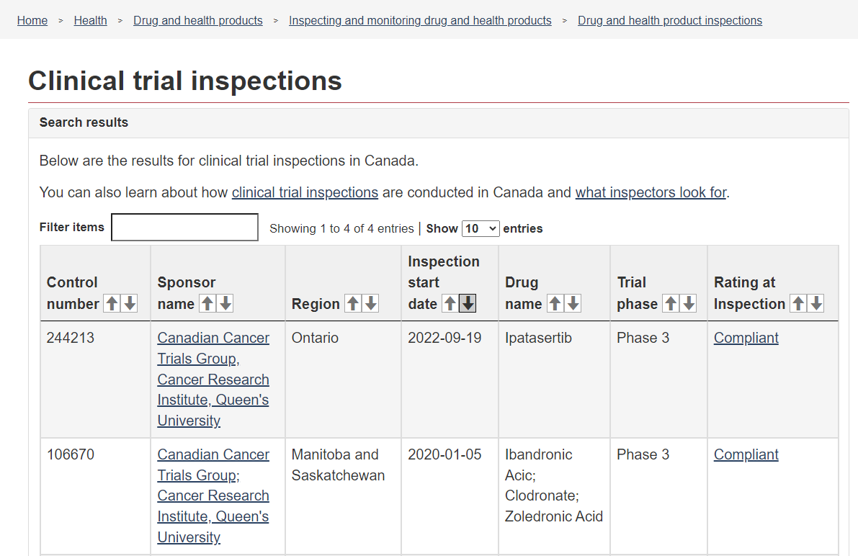
Health Canada Inspection Database

Slide 42
How to Avoid Inspection Observations (Examples)
Documentation: clear, accurate, contemporaneous:
If it’s not written down, it didn’t happen…
Training:
Institution clinical trial SOPs
GCP
Protocol training, etc.
QI oversight:
Of all staff and duties from data entry to pharmacy.
Delegation of Duties:
Ensuring duties are appropriately delegated to personnel with adequate qualifications
PLs are current and managed in real-time
Protocol Compliance

Slide 43
Examples
NB: Clinically Appropriate ≠ Acceptable

Slide 44
Observations
GCP Sponsor's obligations: C.05.010 C.05.010(b)
The clinical trial was not conducted according to the protocol.
Eligibility / baseline exams not done within protocol mandated timelines
Documentation of review by QI prior to randomization
Abnormal results should be assessed for clinical significance.

Slide 45
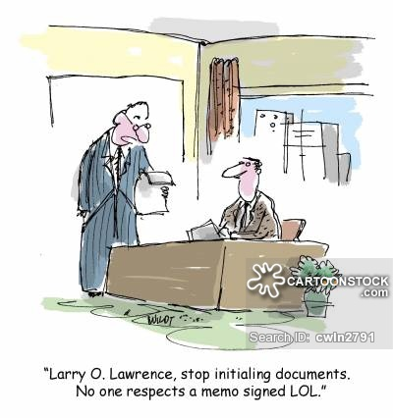
Action
Documentation should be present that the investigator reviewed eligibility & investigations prior to enrolment / treatment
Review can be documented by initialing the report or by commenting in the dictated note, including clinical significance.

Slide 46
Observation
GCP Sponsor's obligations: C.05.012 C.05.012(1)
The clinical trial records had errors and/or missing information that did not allow for complete and accurate reporting, interpretation, and verification

Slide 47
Action
Documentation must be present to confirm the protocol was followed.

Slide 48
Observation
GCP Sponsor's obligations: C.05.010 C.05.01O(j)
The drug was not handled and stored in keeping with Good Manufacturing Practices
After overlabeling with the new label, the old expiry date was not obscured resulting in the label displaying two expiry dates.
As per site's Master Drug Accountability Log, study drug kits were overlabelled whereas as per the record they were already dispensed – the labelling done lacked oversight including the number of kits overlabelled.

Slide 49
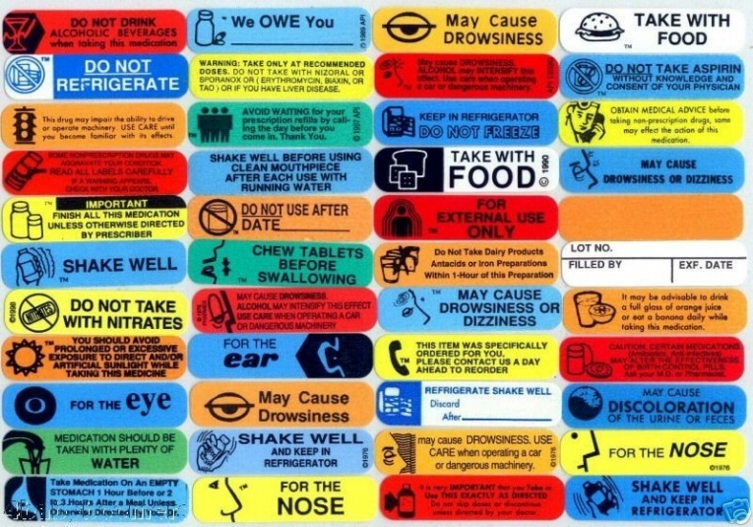
Action
Ensure only one expiry date is present
The DAL should only record kits being relabeled that were not dispensed prior to the relabeling.

