Slide 1
Land Acknowledgement – CCTG
As a national cooperative group, we recognize that what we now know as Canada is located on traditional, unceded, and treaty lands of First Nations, Inuit, and Métis peoples and that the Operations and Statistics Centre, at Queen’s University, is situated on traditional Anishinaabe and Haudenosaunee Territory.
With respect and gratitude, we acknowledge and honour the Indigenous peoples who have been stewards of the lands and waters for centuries and who continue to call these lands home.
We are committed to designing and conducting clinical trials that are culturally safe for all First Nations, Inuit, and Métis peoples.
Notes:
Pronunciations:
Anishnabeg: ah-nish-naw-bek
Chippewa: Chip-pe-wa
Haudenosaunee: hoodt-en-oh-show-nee
Wendat: When-dat
Inuit: Ee-noo-eet
Métis: May-tee
Anishinaabe: Ah-nish-ih-nah'-bey

Slide 2
“Who We Are & Where We Are Going”
Janet Dancey
2024 NICTC

Slide 3
Who is CCTG?
CCTG
Committees
Define priorities, oversee portfolio
National Network
Leaders, members, develop ideas, participate in trials
Research Programs
Early and late phase III programs, platforms, initiatives, methods
Operations & Statistical Centre
Scientific, methodology operations and administration of committees, network, trials
Engage peer, patients, industry
Identify and address trial challenges
Engage stakeholders

Slide 4
Key Milestones
Joseph L. Pater
1ST Trials that led to Global drug approval
Adolescent and Young Adult Trials
NCIC CTG Program Grant
1st industry funded trial
1ST sNDA trial started
Tumour bank created
Disease Site Committees
1st CCTG Intergroup trial
CSTB, QOL, CEA Cmttes
1ST CCTG Global NDA trials
NCI-NCTN Grant
EDIIA, PE Expanded
1st US Intergroup trial
Prevention Trial Initiative
Patient Rep Cmtte
Precision Medicine Trials
Pediatric IND Initiative
CFI MSI Grant
1980-1989 | 1990-1999 | 2000-2009 | 2010-2027
IND Program
1st UK Intergroup Trial
ICH GCP
CCTG new name
NIH Intergroup Grant
MediDataRAVE
Datasharing, Preop, Cell therapy Platforms
IND Program Expanded
Food and Drug Act Div 5
1st EORTC Intergroup Trial
Relocation to new facility
Compliance Expanded
CDISC Implementation
Scientific & Trial methods and operations collaborations
Elizabeth A. Eisenhauer
National & International regulatory experience
Information technology
New funding for expanded personnel and infrastructure
Notes:
In 1979, a Canadian Cancer Society strategic review led to the creation of a national clinical trials cooperative group that is now CCTG.
For over 40 years, CCS’s core funding has enabled CCTG’s significant growth and global impact.
CCS funding provides critical stable infrastructure supporting the network’s capabilities to conduct important trials that have changed clinical practice and improved patient outcomes in Canada and globally.

Slide 5
Canadian Cancer Trials Group
All Patients
All Treatments
All Trials
All Cancers
Canadian Cancer Trials Group is a network of centres, scientific committees AND research Operations and Statistics Centre that acts as sponsor for CCTG trials.

Slide 6
CCTG Today
EXTENSIVE NETWORK | LEADING ACADEMIC CENTRES
Operations and Statistics Centre at Queen’s University with 160 faculty and staff
>2100 Canadian investigators; 6000 worldwide
>85 Canadian institutions
>600 international centres | 40 countries | 6 continents
Only non-US group member of the NIH/NCI National Cancer Clinical Trial Network
IMPACT
>108,000 patients enrolled | 1,500-3,000 patients/year
>632 trials ongoing or completed
>236 phase I or II trials, many leading to phase II/III trials or part of industry partner’s development program
> 2000 publications + presentations/abstracts at national + international conferences
New standards of care, diagnostics, drug approvals, methods
20 phase III trials leading to registrations/new indications and changing standard of care
Education & Training of next generation trialists
CAPACITY
> 170 trials running concurrently
Scientific, operational, regulatory, data management to international regulatory standards
CORRELATIVE RESEARCH / BIO-BANKING FACILITIES
>400,000 specimens from 120 trials and >24,000 trial patients
Blood, plasma, serum + buffy coat, RBC pellets, DNA, RNA

Slide 7
CCTG Founding Principles & Governance
Academic-led:
Review/approval of trial design
Oversight of trial conduct, data management, analysis, publication
Relevant to Canadian patients, researchers, health care system
Network participation
Patient-centred and focused
MOUs between Queen’s/CCTG & CCS, CFI

Slide 8
Research Oversight Management
Research Oversight
Clinical Trials Committee
Scientific Peer Review
Data Safety Monitoring Committee
Safety and Quality
Scientific Priorities Trial Portfolio
Endpoint Committees
Scientific Committees
Support Committees
Secretariat, Trial Operations
CCTG OSC
Methods, Operations, Ethics/Regularoy Compliance
Membership, Leadership, Partnership
CCTG Network Members,
Peer Groups, Patients

Slide 9
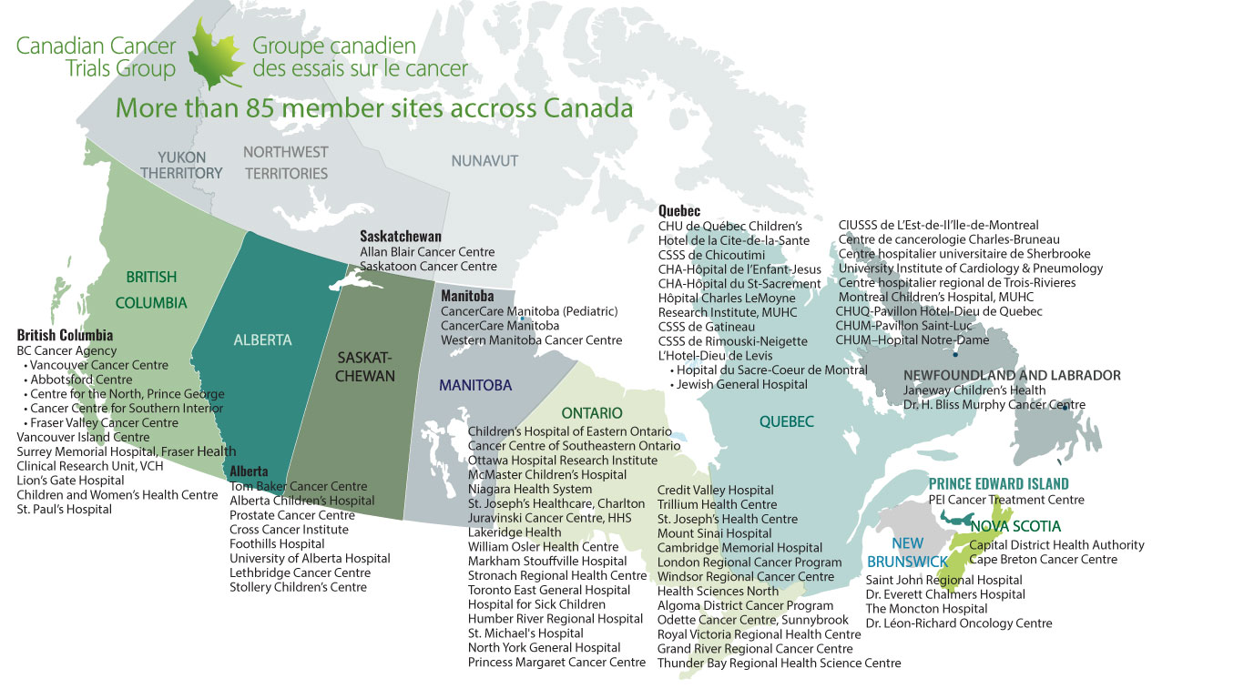
All Canadian adult and pediatric hospitals able to conduct cancer trials. All have 5-year agreements (not cancer trial-specific).

Slide 10
CCTG Leaders by Province
19
96
0
2
323
49
15
43
166
1
2
5
6
89
91
17
45
87
267
1086
397
Site Leaders & Executive
0
0
25
Chairs
3
3
Members
2
5
64
93
Notes:
3000 Network Leadership Roles
Site Leaders & Executive – Include Disease Site Chairs and Executive Committee Members
Chairs – Include Work Group / Disease Oriented Group / Study Chairs
Members – Include all Members of committees
Note: If an individual has multiple roles those are counted.
If examining leadership by distinct individuals in leadership roles is 1322
NEW 2021OCT24 – Breakdown by the Numbers
3020 Leadership Roles (Some individuals have multiple roles; Some individuals are Leaders but from ex Canada / International Sites/Groups)
There are 1317 “distinct” individuals with leadership roles
Of the 1317 total leaders, 1209 of those are from Canada… breakdown by province on the next slide

Slide 11
Other Impactful CCTG Activities
Methodology for the Development of Innovative Cancer Therapies
RECIST and RANO Working Groups
Linking trial and population health databases
Economic analysis in elderly patients with CLL
Initiative to Streamline Clinical Trials
Canadian Remote Access Framework

Slide 12
Trial Impact – Examples
BR.10 (Vinorelbine + Cisplatin vs. Observation in Resected Non–Small-Cell Lung Cancer)
Published NEJM 2005; Cited 2317 times
Total journal publications = 39 (230 unique authors, 89 institutions, 13 Countries)
LACE-BIO Consortium funded by NIH RO1 (L Seymour, PI)
CCTG BR.19, BR.31 Adjuvant Trials
LY.12 (R-GDP vs R-DHAP in Relapsed or Refractory Aggressive Non-Hodgkin’s Lymphoma)
Published JCO 2014; Cited 443
Total publications 18
SCHOLAR-1 Meta-analysis Blood 2017
Dataset used as the historical dataset for single-arm CAR T cell therapy trials to support their approvals.
Led to CCTG LY.17, LY.18 trial and and LIFE Study
Notes:
BR.10 Canadian provinces = 6 (BC, AB, ON, QC, NS, NB

Slide 13
Partners – Patient & Research Groups,
Public Funders, Industry
National
Pediatric Investigational New Drug Platform
National Adolescent Young Adult Trials Platform
Stand Up to Cancer Canada Dream Team, Canadian Breast Cancer Foundation, Terry Fox Research Institute Brain Tumour Group, Myeloma Canada Research Network, ExCELLirate Canada
Networks – Canadian Cancer Trials Network, Clinical Trials Ontario, and Network of Networks
United States
Canadian Collaborating Partner of the US National Clinical Trials Network (NCTN) and partner with US Groups
Cancer Research Institute
International
European Organization for the Research and Treatment of Cancer
Medical Research Council, University College London, Southampton
International Rare Cancer Initiative
Gynecologic Cancer Intergroup Group
Breast International Group
Australia – University of Sydney NHMRC, AGITG, ALTG, TROG, ANZUP
France – UNICANCER, IFCT
Spain – SLCG, Cris Foundation
Netherlands - NVALT
Italy – National Cancer Institute of Naples
Asia – Chinese University of Hong Kong
Consortia - Lung Immunotherapy NSCLC Consortium
Notes:
Preferred research partner for clinical trial expertise and knowledge within Canada, for US, and International peer groups in 22 countries (40 countries overall)

Slide 14
2022-2027 “Solving Cancer Together” Strategic Priorities, Platforms and Enabling Strategies
STRATEGIC PRIORITIES
3 Priorities, 3 Platforms, 4 Enablers
EDIIA, Patient, Network Engagement Initiatives
Builds on areas of strength/prior success
Precision medicine, immunotherapy, de-escalation trials, supportive care, cost analysis
Correlative endpoints:
“omic”, cfDNA and imaging, patient-reported outcomes, cost
Will:
Lead to innovations in treatment, trial design and endpoints,
Reduce burden of cancer/treatment/trials and improve access for patients
Demonstrate value
UNDERSTAND CANCER BIOLOGY
Innovative therapies and biomarker technologies
Improved efficacy
Outcome prediction & endpoints
Cancer/host biology
REDUCE THE BURDEN
Patients and Centres
Reduce toxicity
Improve access
Include patient perspective
DEMONSTRATE VALUE
HTA of new drugs
Better value SOC
Value methods
PLATFORMS
Cell Therapy, Preoperative Trials, Data Science
ENABLERS
Network Engagement, Trial Capabilities, Communications + Knowledge Translation, Sustainable Funding
https://www.ctg.queensu.ca/public/cctg-strategic-plan-2022-2027

Slide 15
CCTG Portfolio

Slide 16
Practice-Changing Trials Led by CCTG
Trial | Primary Endpoint Result/Indication and Impact | Journal / Cited*
CX.5 | A simple hysterectomy is a safe treatment option for women with low-risk early-stage cervical cancer | NEJM 2024 cited 8 times
IND.227 | Pembrolizumab plus platinum-pemetrexed chemotherapy represents a new first-line treatment option for with unresectable advanced or metastatic pleural mesothelioma | The Lancet 2023 cited 9 times
BR.36 Stage 1 | ctDNA analyses could be used as an early marker of immunotherapy response and may help guide therapy. | Nature Medicine 2023 cited 17 times
SC.24 | SBRT is superior to conventional radiation treatments in alleviating pain from spinal metastases | Lancet Oncology 2021 cited 10 times
CO28 | NEOadjuvant Chemotherapy, Excision and Observation for Early Rectal Cancer. Phase II trial | JCO 2023 cited 21 times
*Google Scholar, 22 April 2024
Notes:
CE.6 Canadian standard; JNCCN guideline; cancer centre guidelines
MCRN¯003/MYX·1: A Single Arm Phase II Study of High-Dose Weekly Carfilzomib Plus Cyclophosphamide and Dexamethasone in the Treatment of Relapsed Multiple Myeloma after 1-3 Prior Therapies
MYX.1
This convenient and cost-effective weekly carfilzomib triplet regimen is frequently used as a standard of care in Canadian practice
American J Hematol 2021; cited 1 time

Slide 17
Practice-Changing Trials Led by Other Groups That Included CCTG Participation
Trial | Primary Endpoint Result/Indication and Impact | Journal/Cited*
MA.36/ BIG 6-13 | Olaparib is new option for patients with germ-line BRCA high-risk breast cancer. Rich biorepository and QOL endpoints to follow | NEJM 2021; cited 930 times
MAC.12/ ECOG PACCT-1 | Allows more precise treatment of early breast cancer and aid in decision making for individuals | NEJM 2018; cited 2025 times
MAC.15/ S1007 | With use of Oncotype DX, women with 1-3 positive nodes can be successfully matched to the most appropriate treatment and, in many cases, safely omit chemotherapy | NEJM 2021; cited 461 times
MAC.18/BIG/IBCSG/Alliance | POSITIVE: A Study Evaluating the Pregnancy Outcomes and Safety of Interrupting Endocrine Therapy for Young Women with Endocrine Responsive Breast Cancer who Desire Pregnancy | NEJM 2023; cited 73 times
ENC.1/NRG GY018 | A Phase III Randomized, Placebo-Controlled Study of Pembrolizumab (in Addition to Paclitaxel and Carboplatin for Stage III or IVA, Stage IVB or Recurrent Endometrial Cancer | NEJM 2023 cited 173 times
MEC.5/SWOG S1404 | Phase III Randomized Trial Comparing Physician/Patient Choice of Either High Dose Interferon or Ipilimumab to MK-3475 (Pembrolizumab) in Patients with High Risk Resected Melanoma | Cancer Dis 2022; cited 44 times
*Google Scholar, 22 April 2024
Notes:
MA36, patients = 34, sites = 12, Investigators = 87, Key contributors in the development conduct and steering committee
MAC12, patients = 838, sites = 26, investigators = 140, enrollment of patients
MAC15, patients = 328, sites = 28, investigators = 153, CCTG contributed to many of the tissue samples from the MA9/SWOG-8814 that were used to validate the OncotypeDX in node-positive disease that was the underpinning of MAC15
PR17, patients = 204, sites = 21, investigators = 120, enrolled 18.5% of patients, CCTG has a leadership role (Dr. Wyatt) in molecular / genomic profiling of prospectively collected plasma cfDNA samples and archival tissue
SRC7, patients = 5, sites = 1, investigators = 3, enrollment of patients

Slide 18
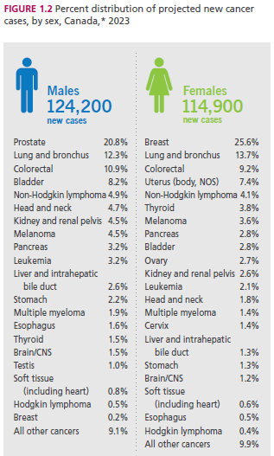
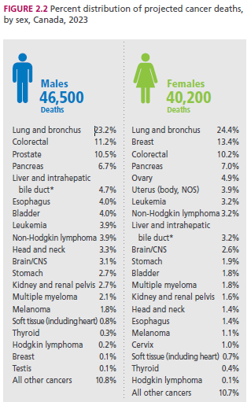
CCTG Today
CCTG clinical trials identify the best treatments for patients with ALL of these cancer types.
Source: Canadian Cancer Statistics 2023
Notes:
Cancer research investment with the greatest impact on health and well being of Canadian cancer patients

Slide 19
CCTG Value
Through CCTG Canadians have early access to high impact clinical trials and promising cancer treatments
CCTG is the only national network to conduct cancer clinical trials across all types of cancer across all treatments, types of cancer for the full range patients across all of Canada and with the international community

Slide 20
Why CCTG Trials Are Successful
Research leader(s) with idea
Partners to develop, run the trial,
Peers to enroll patients
Trials
Address an important question
Well designed
Well executed
Commitment of large numbers of people over time
Enjoy the workshop and the beginning of your professional career with CCTG!

Slide 21
CCTG will continue to identify new and better cancer treatments because of the Canadian Cancer Society.

