Slide 1
CCTG Patient Engagement
New Investigator Clinical Trials Course
Yvonne Murray
CCTG Patient Engagement Lead
2024Aug23

Slide 2
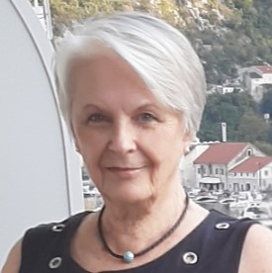
Overview
What does Patient Engagement look like at CCTG?
CCTG Strategic Plan and Patient Representative Committee Priorities
Patient Engagement in CCTG
Patient Engagement Model & Clinical Trial Touchpoints
Where to find out more
Judy Needham - Patient Representative Committee Chair

Slide 3
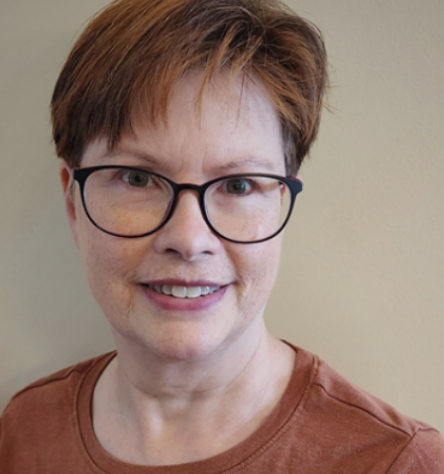
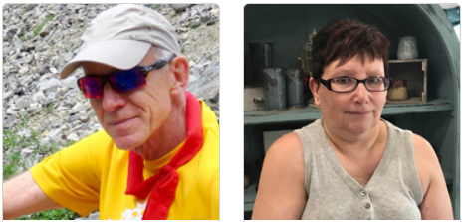
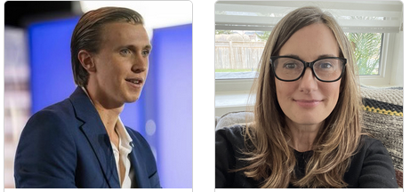
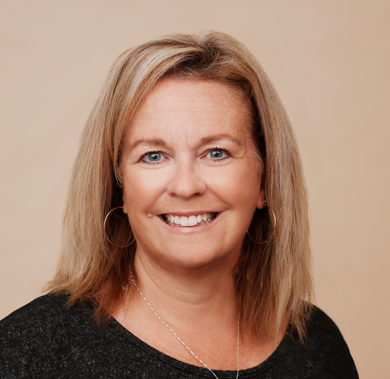
CCTG Patient Representative Committee
Inclusion of Patient Centred Endpoints
Inclusion of Patient Friendly Material
Influencing trials approved
Increasing awareness of clinical trials
Increasing accrual to trials
Assisting in Successful Funding for trials

Slide 4
CCTG Strategic Plan and Patient Representative Committee Priorities

Slide 5
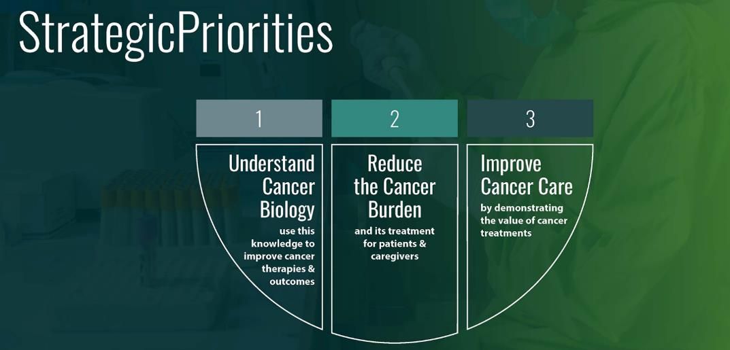
The CCTG Strategic Plan
“CCTG trials
• address questions important to researchers, clinicians and patients;
• evaluate interventions that are innovative; have the potential to change clinical practice;
• reflect an international caliber of science; and,
• include patients as partners.”

Slide 6
The CCTG Strategic Plan
Priority 2 – Reduce the Burden of Cancer
AND ITS TREATMENT FOR PATIENTS & CAREGIVERS
Recognizing that the patient is at the centre of research is important for clinical trials. The cancer experience presents many physical, emotional, and spiritual challenges that should be assessed and potentially improved.
CCTG has prioritized the inclusion of patient perspectives when addressing the impact of cancer treatments and are focused on developing trials that investigate a range of patient outcomes. Through this strategic priority, CCTG will develop a portfolio of trials and trial-related activities that will emphasize the assessment and reduction of the burden of treatment on patients and incorporate the patient perspective.

Slide 7
Patient Representative Committee Priorities
Sustain the CCTG Patients as Partners Model through committee member recruitment and training as well as investigator awareness initiatives
Continue identifying and addressing barriers to accrual through the review of new proposals, protocol, consent, and plain language summaries
Continued support of grant applications,
Investigate plain-language summaries at trial closure, and identification of other patient priorities in research
Maintain external partnerships, sharing of best practices with CCS, patient advocacy groups
Consider EDIIA in committee refreshment and trial reviews

Slide 8
Patient Engagement in CCTG

Slide 9
Patient Engagement in CCTG
CCTG has a dedicated patient engagement model
Patient Representatives (PRs) are recruited from across Canada to committee-specific positions for a (once-renewable) 3-year term
One or two patient reps per committee
Some Criteria
a lived experience as either a patient or caregiver in the Disease Site cancer,
comfort in representing the patient perspective in a primarily scientific environment/meeting,
desire and ability to review and comment on new trial proposals, protocols, etc
ability to access all meeting and trial information electronically
capacity to train, prepare for, and attend all committee meetings

Slide 10
Patient Engagement – CCTG Committees and Governance
Brain
Breast
GI
GU
Gynecological
Hematology
H&N
Lung
Melanoma
Sarcoma
Supportive Care
Scientific Committees
Disease Sites
Investigational New Drug (IND) Program
Oversight Governance Committees
Clinical Trials
Data Safety Monitoring
Support Committees
CRA
Patient Rep
Strategic Executive Advisory
Endpoint Committees
Pharmacy
Auditing Monitoring
Centre Representative
RTQA
Quality of Life
Economic Analysis
Correlative Biology / Banking
85 member sites and 2100 Canadian Investigators
Legend:
Patient Engagement
Operations and Statistics Centre at Queen’s (140 + Staff & 17 Faculty)

Slide 11
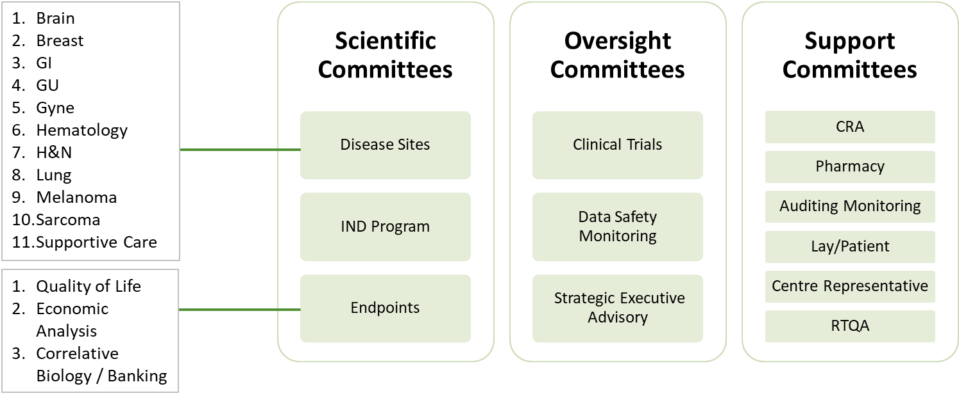
Patient Representative Committee – Collaborative Pan-Canadian Patient Engagement
Robert Taylor, Canmore, AB
Bill Richardson, Calgary, AB
Emi Bossio, Calgary, AB
Lindsay Clarke, Fort Saskatchewan, AB
Catherine Wreford Jasmine Heuring Winnipeg, MB
Marie-Terese Little, Victoria, BC
Judy Needham, Kelowna, BC Hilary Horlock, Vancouver, BC
Louise Bird, Wawota, SK
Deb Clark, Regina, SK
Janice Hodgson, Newmarket, ON
David McMullen, Ancaster, ON
Joan Petrie, London, ON
Martina Wood, Mississauga, ON
Haydn Bechthold, Ottawa, ON
Suzanne Wood, Toronto, ON
Michelle Audoin, Toronto ON
Carol Hill, Stittsville, ON
Erwin Wanderer,
Carol Gordon
Halifax, NS

Slide 12
Patient Engagement in CCTG
Canadian Cancer Trials Group Patient Representative
Train
Recruit
Orient
Engage
Train
Orient
Recruit
Patient Representative Terms of Reference Patient Representative Roles & Responsibilities
IAP2
Inform
Involve
Collaborate

Slide 13
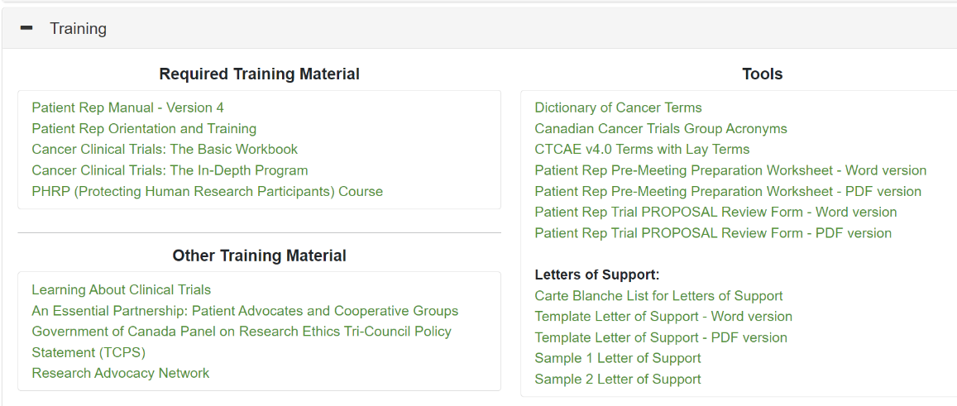
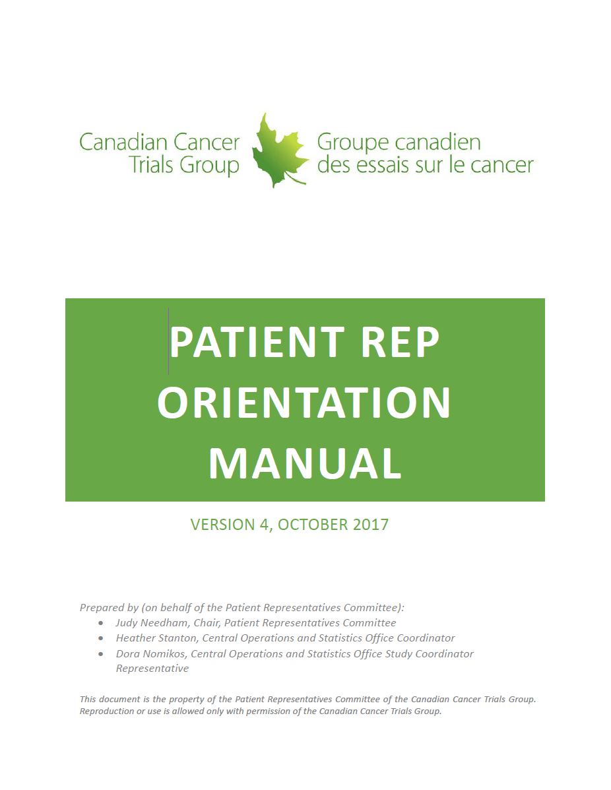
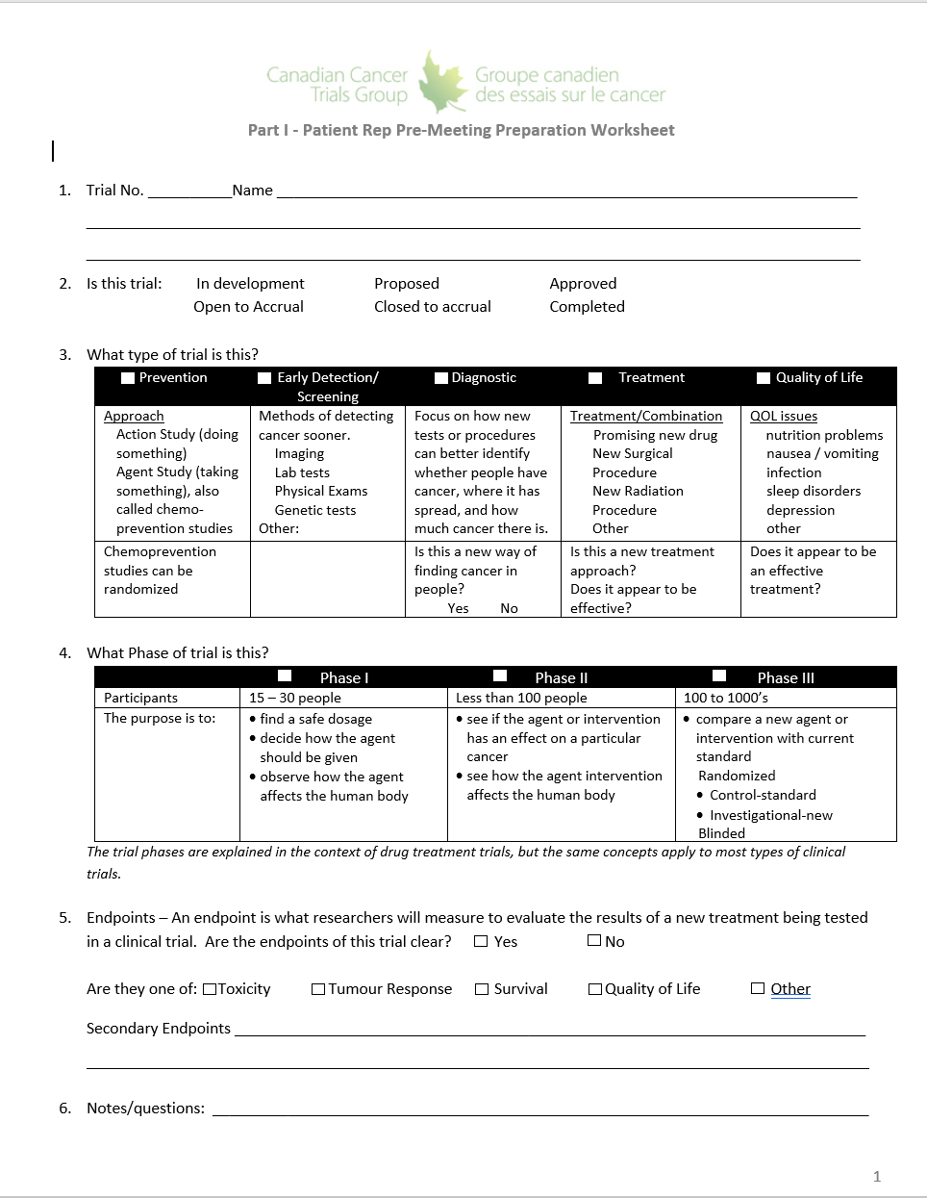
Patient Representative Orientation and Training
Engage
Train
Orient
Recruit
1.5 hr. Virtual Orientation:
Organizational Overview
Committee Overview/Schedule
Clinical Trial Touchpoints
Website
Orientation Manual:
Comprehensive handbook covering everything patient reps need to know about CCTG and the patient rep role
Annual Training Session (Spring Meeting)
Patient Representative Committee Website
Ideation
Proposal Development
Proposal Review / Approval
Develop Protocol & Consent
Operations Centre Activaton
Cancer Centres Activation
Accrual & Data Collection
Closure to Accrual
13
Follow Up/Data Collection
Endpoint(s) Met
Analysis & Reporting
Permanent Closure

Slide 14
Patient Engagement Model & Clinical Trial Touchpoints

Slide 15
Patient Engagement in CCTG
Engage
Train
Orient
Recruit
Engage
The role of Patient Representatives in the Canadian Cancer Trials Group (CCTG)
is to represent the perspective of patients and their families, and the public at large, in the development and delivery of cancer clinical trials.
This is achieved by
teaming with health care professionals/researcher, and
providing formal patient input at defined patient touchpoints in the CCTG clinical trial lifecycle, from ideation through to trial closure.
19

Slide 16
Patient Engagement in CCTG
Engage
Train
Orient
Recruit
Ideation
Engage
Proposal Development
The role of Patient Representatives in the Canadian Cancer Trials Group (CCTG)
is to represent the perspective of patients and their families, and the public at large, in the development and delivery of cancer clinical trials.
This is achieved by
teaming with health care professionals/researcher, and
providing formal patient input at defined patient touchpoints in the CCTG clinical trial lifecycle, from ideation through to trial closure.
Proposal Review / Approval
Develop Protocol & Consent
Operations Centre Activation
Cancer Centres Activation
Accrual & Data Collection
Closure to Accrual
Follow Up/Data Collection
With the objective of
Identifying potential patient barriers in trial development and design, inclusion of patient-centred endpoints, and accrual planning.
Endpoint(s) Met
Analysis & Reporting
Permanent Closure
20

Slide 17
The Canadian Cancer Trials Group Clinical Trial Lifecycle
Members
Operations and Statistics Centre
Ideation
Member Investigators
Disease Site Committees
and Executives
Proposal Development
Senior Investigators
Proposal Review / Approval
Clinical Trials Committee
Develop Protocol, Consent and Patient Facing Material
Trial Team Members
Operations Centre Activation
Cancer Centres Activation
Trial Team
Support Departments
Accrual & Data Collection
Member
Cancer Centres
Closure to Accrual
Follow Up/Data Collection
Endpoint(s) Met
Independent Data Safety
Monitoring Committee
Analysis & Reporting
Permanent Closure

Slide 18
The Canadian Cancer Trials Group Clinical Trial Lifecycle
Members
Operations and Statistics Centre
Ideation
Member Investigators
Disease Site Committees
and Executives
Proposal Development
Senior Investigators
Proposal Review / Approval
Clinical Trials Committee
Develop Protocol, Consent and Patient Facing Material
Trial Team Members
Operations Centre Activation
Cancer Centres Activation
Trial Team
Support Departments
Accrual & Data Collection
Member
Cancer Centres
Closure to Accrual
Follow Up/Data Collection
Legend:
Current
Patient Engagement
Planned
Patient Engagement
Endpoint(s) Met
Independent Data Safety
Monitoring Committee
Analysis & Reporting
Permanent Closure

Slide 19
Patient Rep Touchpoints in the CCTG Clinical Trial
Ideation
Ideation - Annual and 5-Year Strategic Planning
New Proposal Development
Tool
New Proposal Review Form
Objective
Assist with development of patient-centred trials
Proposal Development
DS Patient Reps
Provide input with respect to what’s important to patients
Proposal Review / Approval
Develop Protocol, Consent, Grant, Patient Facing Material
Operations Centre Activation
DS Patient Reps
“Walk through the proposal in a patient’s shoes.”
Provide feedback regarding potential patient barriers and suggestions that are important to patients (patient-centred outcomes – QoL, etc.),
Cancer Centres Activation
Accrual & Data Collection
Closure to Accrual
Follow Up/Data Collection
Endpoint(s) Met
Analysis & Reporting
Permanent Closure

Slide 20
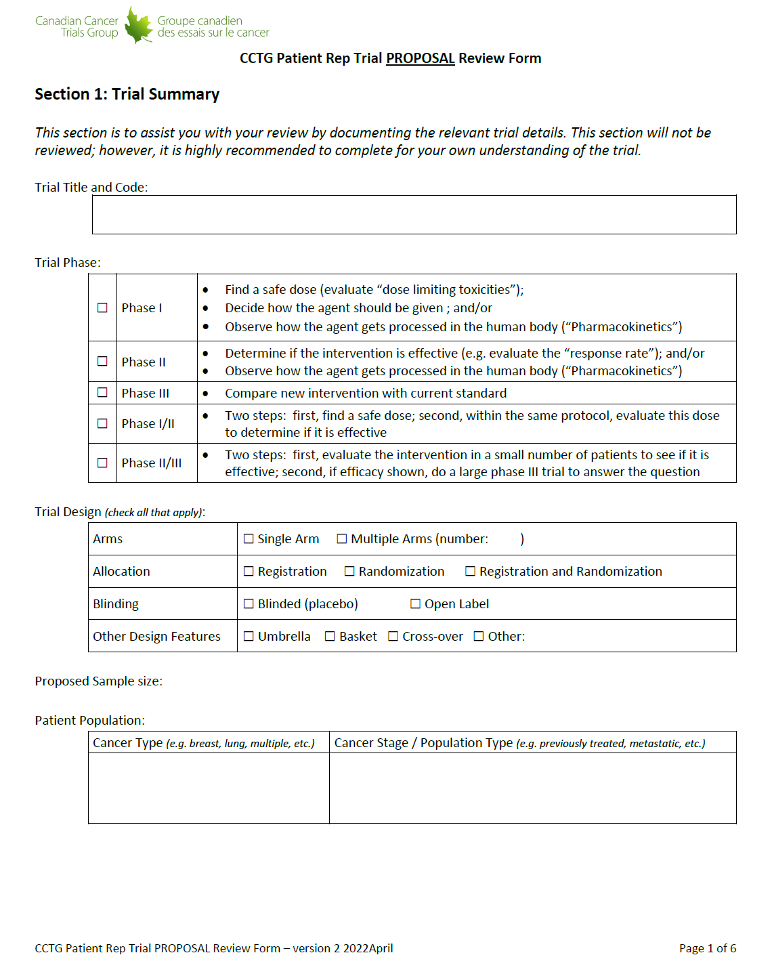
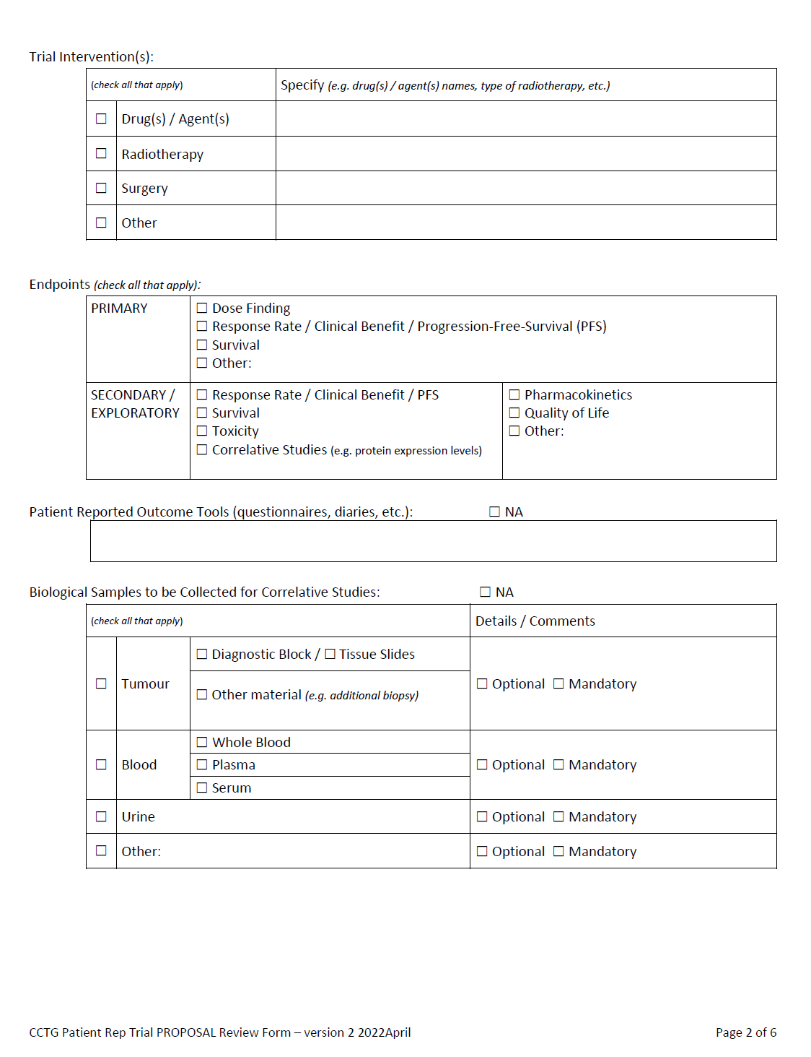
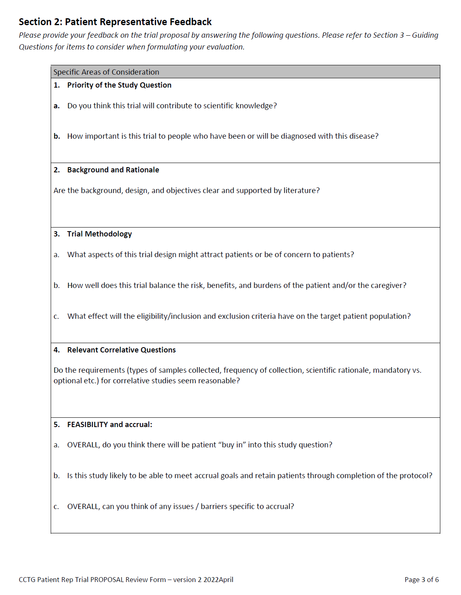
Patient Rep Touchpoints in the CCTG Clinical Trial
Ideation
New Trial Proposals Reviewed – Clinical Trials Committee (CTC)
Tool
New Proposal Review Form
Tool
CTC Review process and forms
Proposal Development
DS Patient Reps
Provide input to CTC Patient Reps to aid in their review
Ideally this is the second time a Patient Rep has seen this new trial
Proposal Review / Approval
Develop Protocol, Consent, Grant, Patient Facing Material
Operations Centre Activation
Cancer Centres Activation
Accrual & Data Collection
CTC Patient Reps
Reviews, scores, and prioritizes each new proposal at CTC along with primary and secondary scientific reviewers.
Closure to Accrual
Follow Up/Data Collection
Endpoint(s) Met
Analysis & Reporting
Permanent Closure

Slide 21
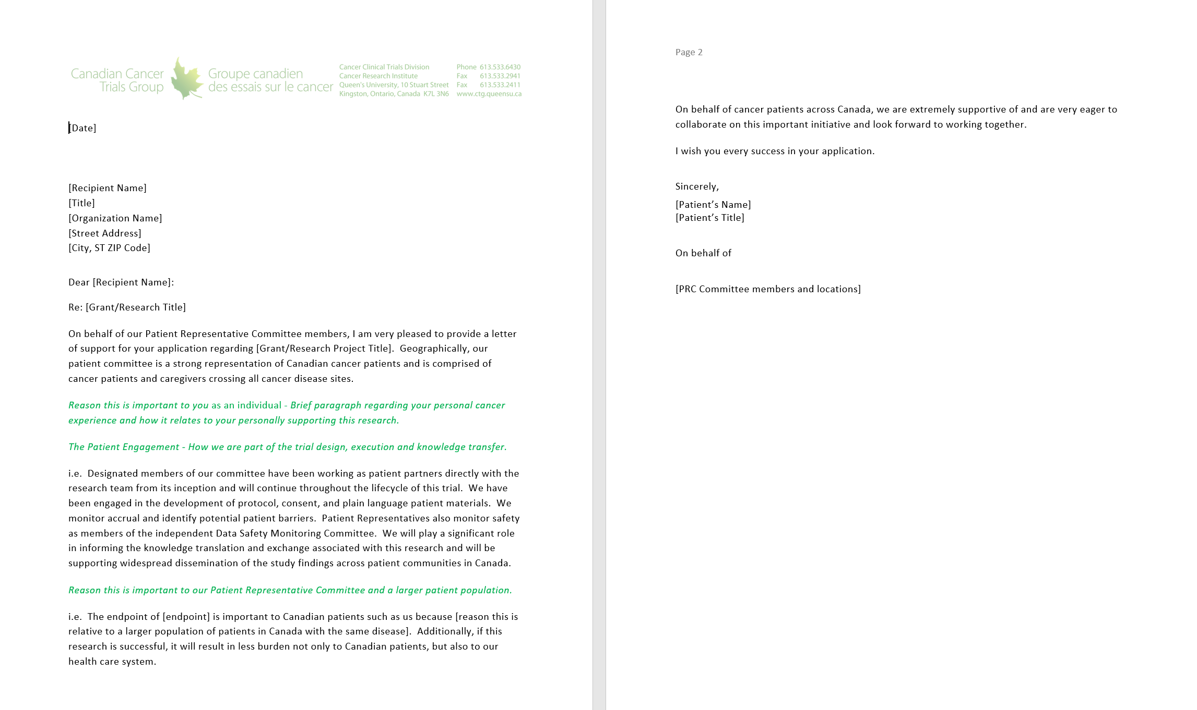
Patient Rep Touchpoints in the CCTG Clinical Trial
Ideation
New Trial Additional Funding/Grant Applications
Tool
Letter of Support template
Proposal Development
DSC Patient Reps
Collaborator or Co-applicant on all grant applications
Letter of Support on all grant applications
- Pan-Canadian patient voice of support
Proposal Review / Approval
Develop Protocol, Consent, Grant, Patient Facing Material
Operations Centre Activation
Cancer Centres Activation
Accrual & Data Collection
Closure to Accrual
Follow Up/Data Collection
Endpoint(s) Met
Analysis & Reporting
Permanent Closure

Slide 22
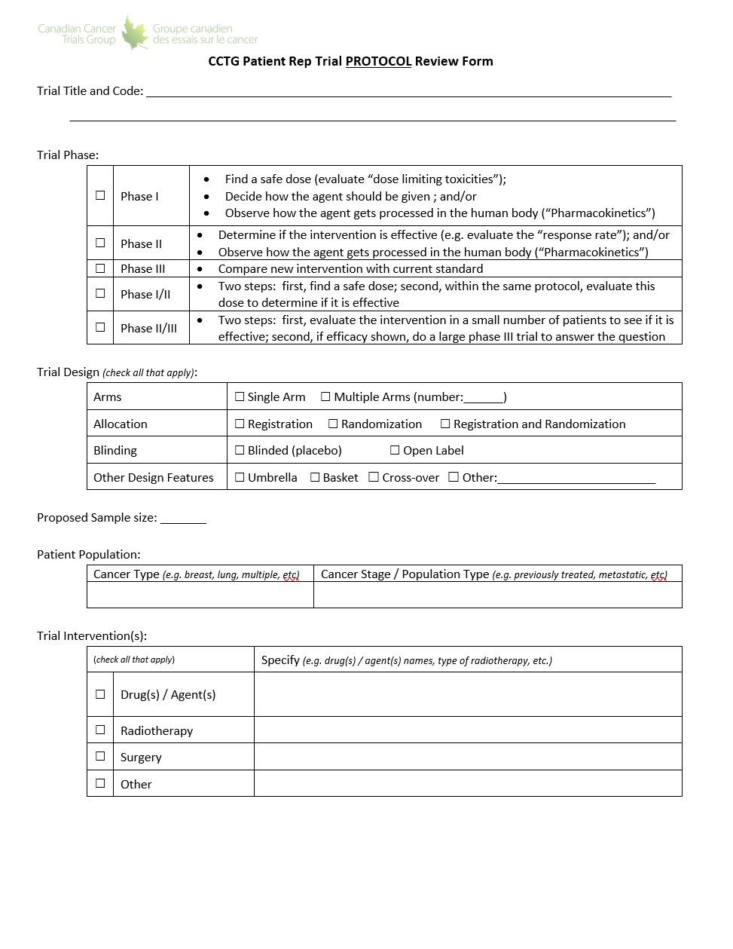
Patient Rep Touchpoints in the CCTG Clinical Trial
Ideation
Protocol, Consent, and Plain Language Summary Development
Tool
Protocol Review Form
Consent Review Form
Patient Facing Content template
Proposal Development
DS Patient Reps
Third time seeing the new trial
Protocol – last opportunity to provide patient feedback
Consent – Review draft from a patient perspective; provide feedback
Patient Facing Content/ Plain Language Summary – Review draft from a patient perspective; provide feedback.
Proposal Review / Approval
Develop Protocol, Consent, Grant, Patient Facing Material
Operations Centre Activation
Cancer Centres Activation
Accrual & Data Collection
Closure to Accrual
Follow Up/Data Collection
Endpoint(s) Met
Analysis & Reporting
Permanent Closure

Slide 23
Patient Rep Touchpoints in the CCTG Clinical Trial
Ideation
Trial Activation, Accrual, and Data Collection Phase
Tools
Trial Worksheet
Monthly accrual reports
Portfolio Summary Matrix Report
Tools
DSMC Reports
Proposal Development
DS Patient Reps
Track accrual, accrual issues, discussions; provide patient perspective in DSC committee meetings.
Proposal Review / Approval
Develop Protocol, Consent, Grant, Patient Facing Material
Operations Centre Activation
Cancer Centres Activation
Accrual & Data Collection
DSMC Patient Reps
Track, discuss, and make recommendations as required regarding adverse events, potential safety issues, and recruitment.
Closure to Accrual
Follow Up/Data Collection
Endpoint(s) Met
Analysis & Reporting
Permanent Closure

Slide 24
Patient Rep Touchpoints in the CCTG Clinical Trial
Ideation
Analysis & Reporting
Proposal Development
Patient Rep’s Role
Learn of the trial results in DSC meeting
Future: assist with plain language summaries of trial results
Proposal Review / Approval
Develop Protocol, Consent, Grant, Patient Facing Material
Operations Centre Activation
Cancer Centres Activation
Accrual & Data Collection
Closure to Accrual
Follow Up/Data Collection
Endpoint(s) Met
Analysis & Reporting
Permanent Closure

Slide 25
Patient Facing Content
Two-page plain language summary of a CCTG trial
Summarizes the basics – what, why, who, risks, what to expect, how to find out more
For awareness in the clinic, to give to a patient candidate for that trial/ accompany a consent form
Brochure, postcard and word document provided to participating centres
Content also used for Patient/Public Facing Trial Webpages - NEW

Slide 26
Patient Brochure - Example

Slide 27
Study Postcard - Example

Slide 28
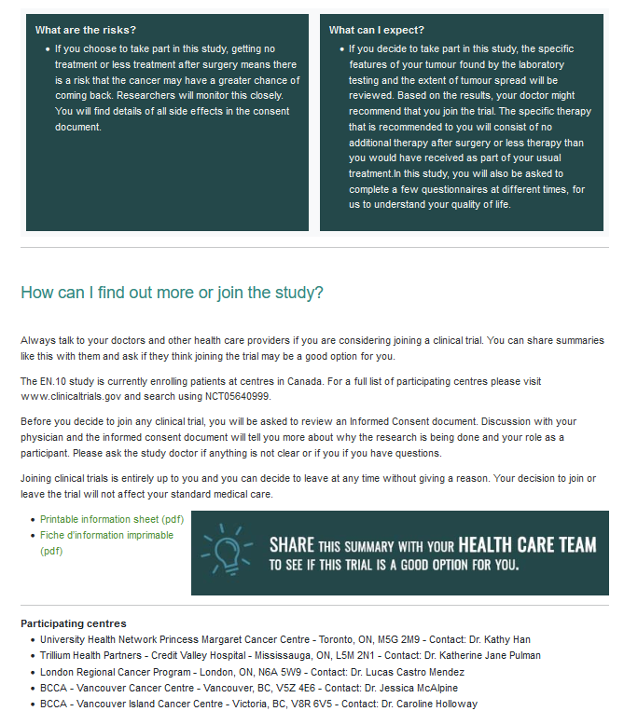
Patient/Public Facing Webpage - Example

Slide 29
Where to find out more

Slide 30
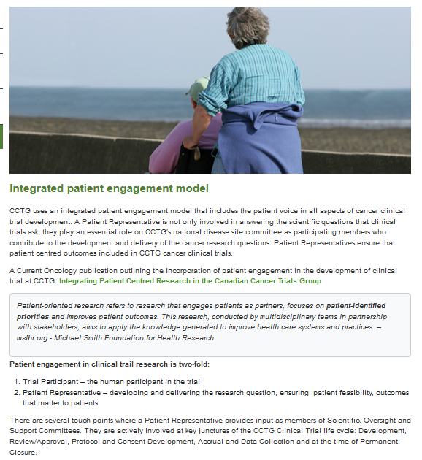
CCTG Website – Patient Representative Committee https://www.ctg.queensu.ca/

Slide 31
Thank you
Questions?
For more detail:
Needham, J.; Taylor, J.; Nomikos, D. Integrating Patient-Centred Research in the Canadian Cancer Trials Group. Curr. Oncol. 2021, 28, 630-639. https://doi.org/10.3390/curroncol28010062
Acknowledgment:
Judy Needham, Chair, Patient Representatives Committee

