Slide 1
Canadian Cancer Trials Group
“Who We Are & Where We Are Going”
2022 New Investigators Clinical Trial Course
Janet Dancey, MD, FRCPC
Director, Canadian Cancer Trials Group

Slide 2
Educational Objectives
Educational Objectives:
To provide context and enhance understanding of
History of the CCTG
Recent Accomplishments
Priorities for next 5 years

Slide 3
Canadian Cancer Trials Group
CCTG is a Canadian-based ACADEMIC RESEARCH NETWORK with more than
40 years of experience in the fight to end cancer.
Created through strategic decision and program grant of the Canadian Cancer Society
Additional grants from public funders and industry
CCTG Network drives health care innovation by developing and testing new cancer treatments and protocols and is a mechanism for diffusion of innovation through its investigator network.
SCIENTIFIC AND OPERATIONAL EXCELLENCE: Unique expertise; national and international phase I-III trial design and conduct
EXTENSIVE EXPERT NETWORK
CCTG provides benefits to patients through early access to promising treatments on trials and identifying better treatments that become new standards of carer
Notes:
The CCTG is a cooperative oncology group that designs and administers clinical trials in cancer therapy, supportive care and prevention. Founded in 1980, it is a national program of the Canadian Cancer Society, as it represents its largest and most impactful research investment.

Slide 4
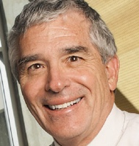
CCTG – Key Milestones
Joseph L. Pater
NCIC CTG Program Grant
1st industry funded trial
1ST sNDA trial started
Tumour bank created
Disease Site Committees
1st CCTG Intergroup trial
CSTB, QOL, CEA Comms
1ST CCTG Global NDA trials
NCI-NCTN Grant
1st US Intergroup trial
Patient Rep Comm
CFI MSI Grant
Grants Renewed
1980-1989 | 1990-1999 | 2000-2009 | 2010-2019
IND Program
1st UK Intergroup Trial
ICH GCP
CCTG new name
NIH Intergroup Grant
MediDataRAVE
IND Program Expanded
Food and Drug Act Div 5
1st EORTC Intergroup Trial
Relocation to new facility
Datasharing Policy & Platform
Compliance Expanded
CDISC Implementation
Scientific collaboration
Elizabeth A. Eisenhauer
International regulatory experience
Information technology
New funding for expanded personnel and infrastructure
Notes:
First Industry Trial = SC1 A Comparison of Methylprednisolane Sodium Succinate and Metoclopramide Hydrochloride in the Prevention of Nausea and Vomiting Produced by Cancer Chemotherapy
First Intergroup Trial = ME5 National Intergroup Protocol For Intermediate Thickness Melanomas 1.0 to 4.0mm Evaluation of Optimal Surgical Margins (2 Vs 4cm) Around the Primary Melanoma and Evaluation of Elective Regional Lymph Node Dissection
First CTG led NDA trial – MA5 - 1990
First CTG led US intergroup study - BR8 - 1992
First Trial With UK OS4 SARCOMA 1993 A Randomized Trial of Two Chemotherapy Regimens in the Treatment of Operable Osteosarcoma - Doxorubicin-Cisplatin vs Methotrexate-Vincristine-Doxorubicin + Doxorubicin-Cisplatin + Bleomycin-Cyclophosphamide-Dactinomycin
First Trial With EORTC = BL5 A Phase III Study of Primary Chemotherapy in Locally Advanced Transitional Cell Carcinoma of the Bladder
First CCTG Led Global NDA trial = BR21/PA3
Rave License agreement signed late 2006/Rolled out first Rave trial in 2007
PA1 and MA19 were both 1997 and ones we did everything.
OV9 was different as eortc had a database CCTG has one and then BMS had one and were reconciled. But think was intended as a group trial.

Slide 5
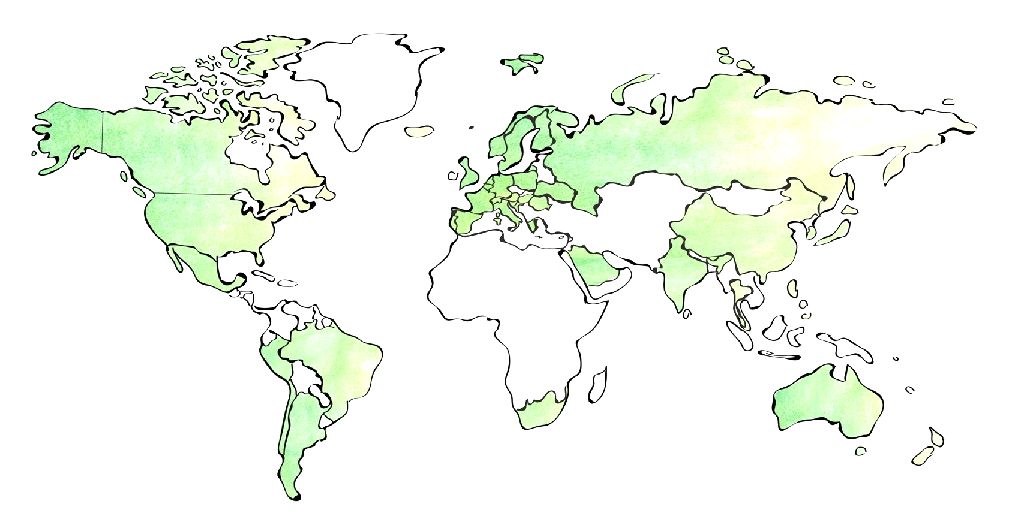
Canadian Cancer Trials Group
> 85 Canadian institutions,
>700 international centres, 40 countries, 6 continents
Phase I-III trials, all cancers, treatments, patients
Methods development, secondary analyses
Education and training
Operations and Statistical Centre
130 HQP + 15 Faculty with unique expertise to conduct complex clinical trials
> 508 trials ongoing or completed
> 2000 publications;
150+ trials running concurrently
15 New trials activated/year
Bio-banking facilities
>400,000 specimens from
>27,000 trial patients
New treatments, diagnostics, methods, standards
Better outcomes for patients

Slide 6
Preferred Partner for National and International Groups
National
Pediatric Investigational New Drug Platform
National Adolescent Young Adult Trials Platform
Stand Up to Cancer Canada Dream Team, Canadian Breast Cancer Foundation, Terry Fox Research Institute Brain Tumour Group, Myeloma Canada Research Network, ExCELLirate Canada
Networks – Canadian Cancer Clinical Trials Network, Clinical Trials Ontario, and Network of Networks
United States
Canadian Collaborating Partner of the US National Clinical Trials Network (NCTN) and partner with US Groups
Cancer Research Institute
International
European Organization for the Research and Treatment of Cancer
Medical Research Council, University College London, Southampton
International Rare Cancer Initiative
Gynecologic Cancer Intergroup Group
Breast International Group
Australia – University of Sydney NHMRC, AGITG, ALTG, TROG, ANZUP
France – UNICANCER, IFCT
Spain – SLCG, Cris Foundation
Netherlands - NVALT
Italy – National Cancer Institute of Naples
Asia – Chinese University of Hong Kong
Consortia - Lung Immunotherapy NSCLC Consortium
Notes:
Preferred research partner for clinical trial expertise and knowledge within Canada, for US, and International peer groups in 22 countries (40 countries overall)

Slide 7
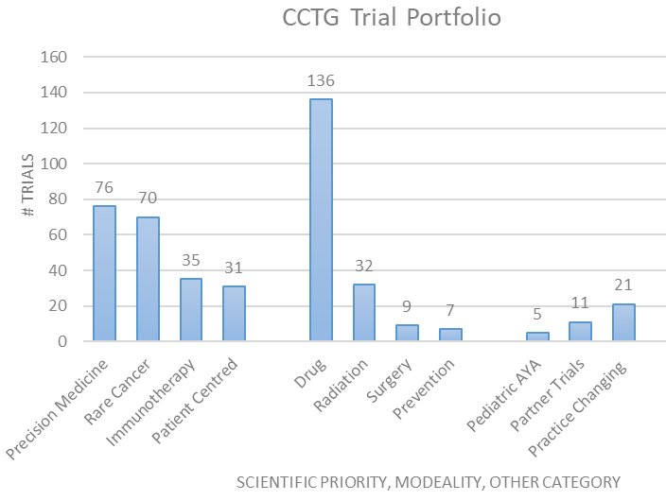
CCTG Research is Innovative, and Leads to Advances
2017-2022
211 active trials
138 accruing, 66 opened
15,000 patients accrued
Biospecimens, PROs, economic analyses
21 late phase trial analyses
14 practice changing trials
+Trials results support new research
Meta-analysis, secondary research projects
Notes:
CCTG trials are important because we test every type of new treatments (e.g., drugs, surgery, radiotherapy, lifestyle interventions and prevention) to see if they are safe and provide better options for patients. In addition, CCTG trials have identified new standards of care and improved outcomes for patients with all types of cancer, including rare cancers and pediatric cancers.
This is why the CCTG cancer research investment has the greatest impact on the health and well-being of Canadian cancer patients.
During last 5 years, broad and deep portfolio of active trials summarized on the right.
21 late phase trials analysis, 14 led to new standards of care,
Results led to new trials, and data/biospecimens to new research
Across cancers, cancer settings, treatment modality and patient population.
5 included pediatric/AYA patients
4 evaluated therapies for primary prevention of cancer
Most evaluated drugs targeting the molecular pathways of tumour or immune cells
7 trials evaluated surgical interventions
23 evaluated radiation/ chemoradiotherapy
Almost all trials included biospecimen collections
Phase III trials additionally included QOL and economic analyses

Slide 8
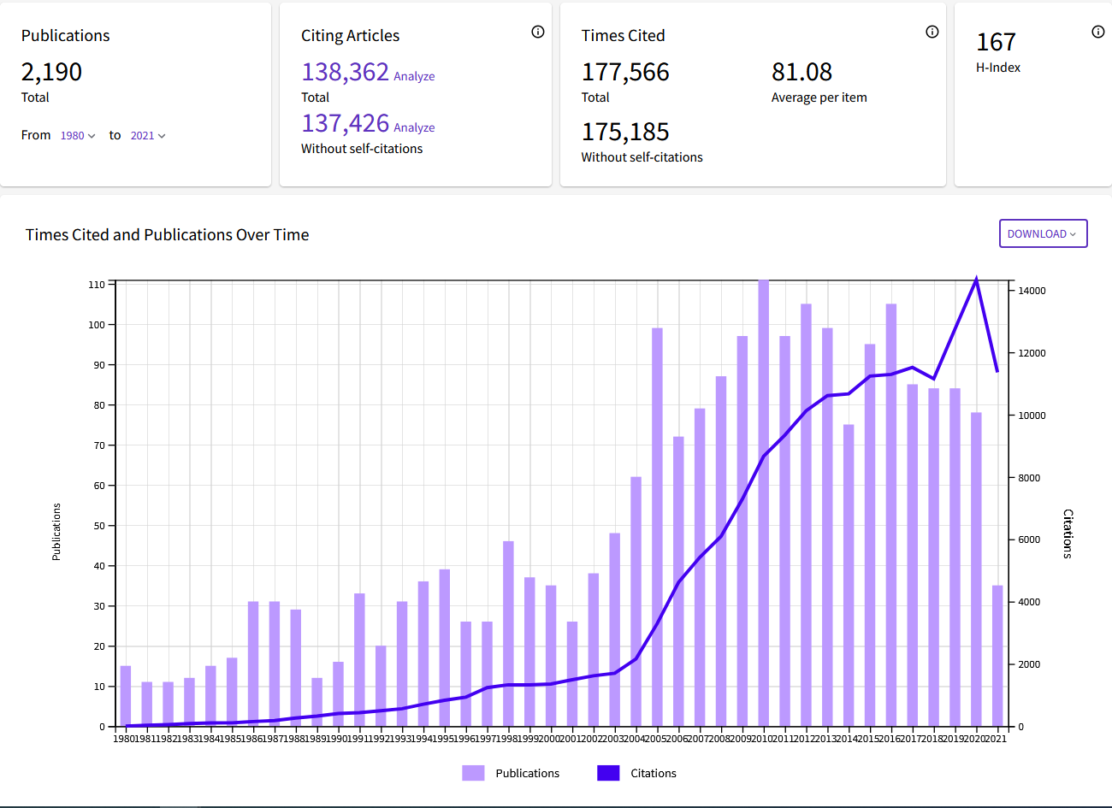
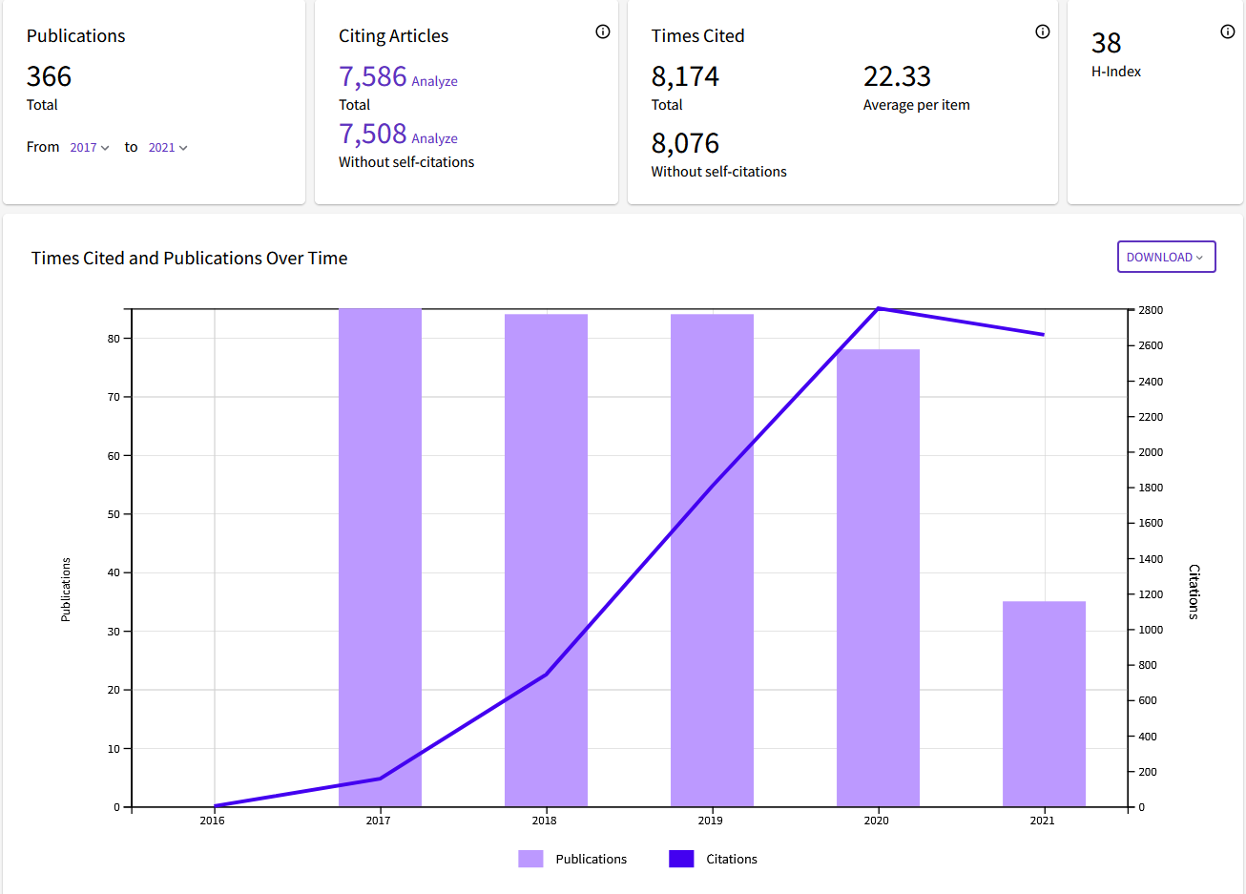
CCTG Web of Science Citation Reports
1980-2021
2017-2021

Slide 9
Trial Impact – Examples
BR.10 Vinorelbine + Cisplatin vs. Observation in Resected Non–Small-Cell Lung Cancer.
Published NEJM 2005; Cited 2085 times
Total journal publications = 38; 230 unique authors, 89 institutions, 13 Countries)
LACE-BIO Consortium
CCTG BR.19, BR.31 Adjuvant Trials
LY.12 randomized phase III trial
Published JCO 2014; Cited 205
Total publications = 18
SCHOLAR-1 Meta-analysis Blood 2017
Dataset used as the historical dataset for single-arm CAR T cell therapy trials to support their approvals.
Led to CCTG LY.17, LY.18 and LIFE trials
Notes:
BR.10 Canadian provinces = 6 (BC, AB, ON, QC, NS, NB

Slide 10
Trial methods and results are used by others
Trial and data methods are used by others
Statistics, trial design, endpoints
Patient engagement model
Remote Audit and Monitoring
Canadian Remote Access Framework for Trials (CRAFT)

Slide 11
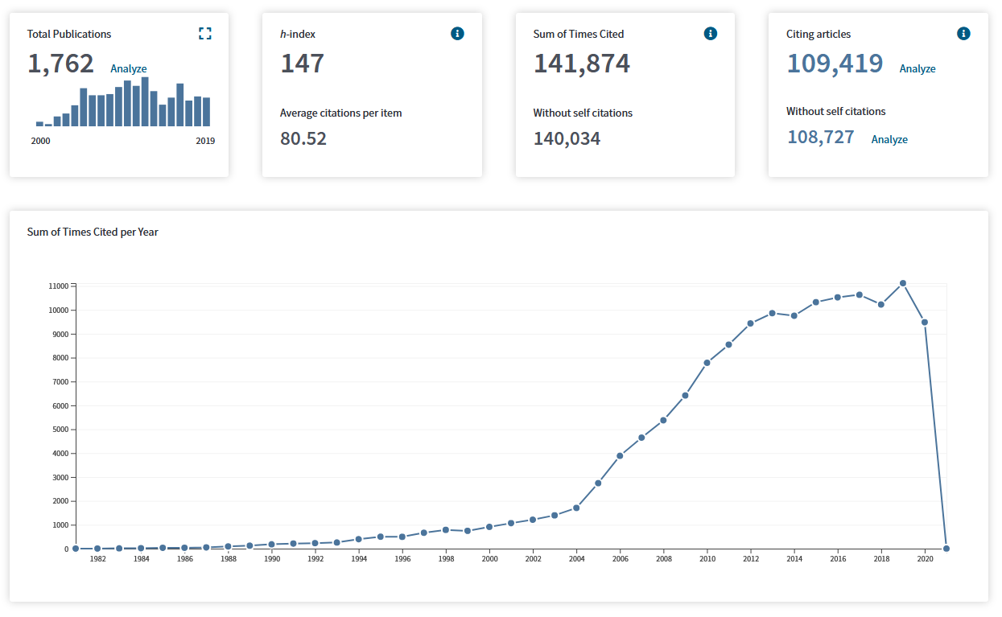
CCTG Research Provides Value and Impact
17 Phase III clinical trials completed accrual and resulted in drug or pathology cost avoidance 1999-2011
Total drug cost savings: $27,935,957
$8,744 DCA per patient
42% Targeted therapy: $11,900,775 (5 trials)
Combined pathology and drug cost avoidance: $32,130,806
Tang P et al, Curr Oncol 2016
Volunteerism of over 200 research leaders and 5000 CDN
and 19,000 international investigators, trial staff and 3000 patient volunteers per year

Slide 12
New Scientific Priorities will Lead to New Advances
1. Understand Cancer Biology
2. Reduce the burden
2027 Strategic Plan defines 3 priorities, 3 platforms and 4 enablers
Builds on areas of strength/prior success
precision medicine, immunotherapy, de-escalation trials, symptom control, cost analysis
Multiple correlative endpoints
“omic”, cfDNA and imaging, patient-reported outcomes, cost
Will lead to
innovations in treatment, trial design and endpoints,
Reduce burden of cancer/treatment/trials and improve access for patients
Demonstrate value
Innovative therapies and biomarker technologies
Improved efficacy,
Outcome prediction & endpoints
Cancer/host biology
Patients at the centre
Reduce toxicity
Improve access
Include patient perspective
3. Demonstrate Value
HTA of new drugs
Better value SOC
Value methods
Platforms: Cell therapy, Data Science, Preoperative Trials
Enablers: Network Engagement, Trial Capabilities, Communications/KT, Sustainable Funding
https://www.ctg.queensu.ca/cctg_news/solving-cancer-together-cctg-strategic-plan-2022-2027

Slide 13
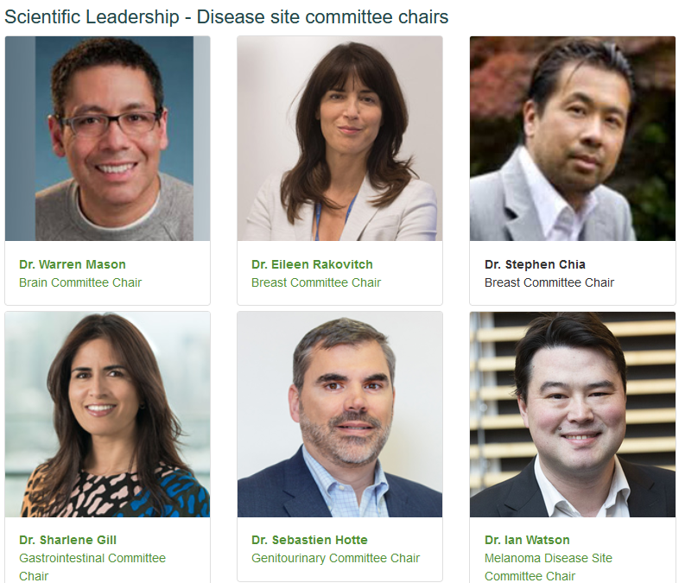
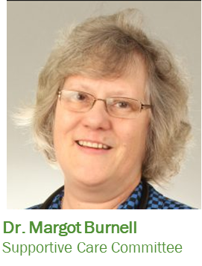
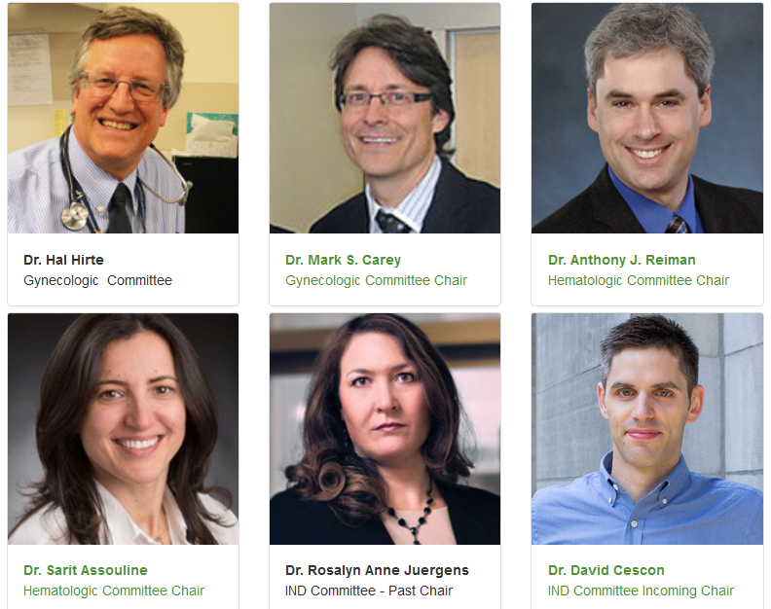
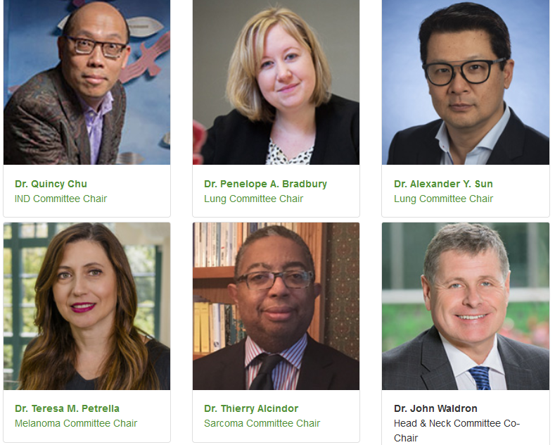
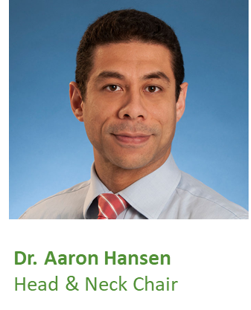
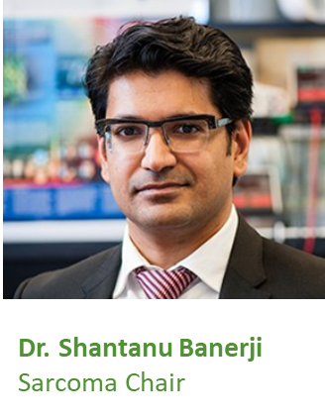
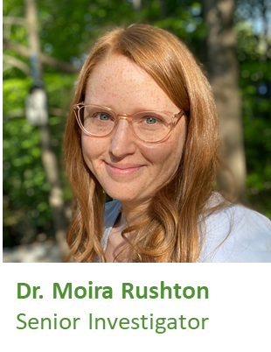
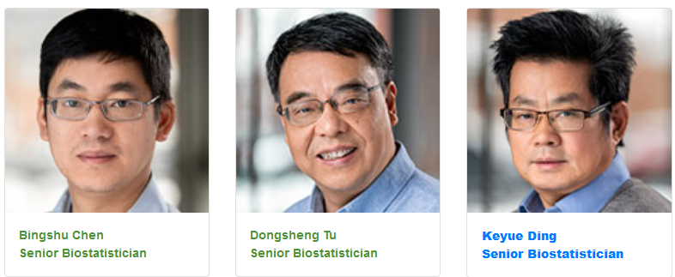
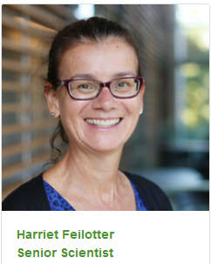
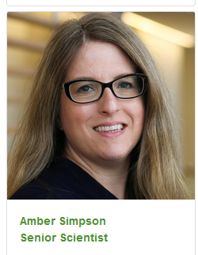
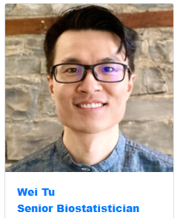
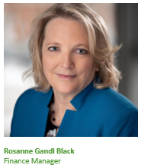
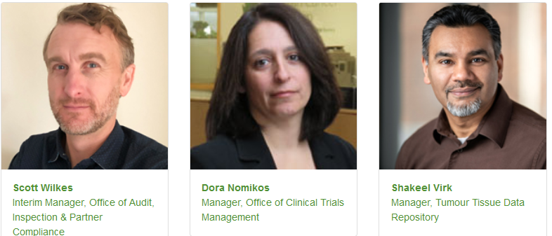
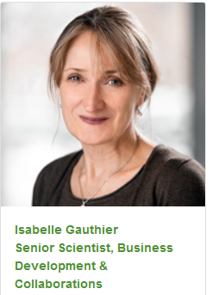
Key to Success: Highest Calibre Canadian Trialists
Canadian Cancer Trials Group Committee Chairs
Canadian Cancer Trials Group OSC Researchers and Staff Leaders
Notes:
Our research comes from the CCTG network and leaders
15 Scientific Committees (10 disease specific, INDC, Supportive Care, endpoint committees
The chairs/co-chairs are clinical researchers with national/international reputation within the research field, senior faculty based at the OSC
Trials and related research are proposed from members from across Canada and selected through peer review

Slide 14
CCTG Leaders by Province
Notes:
Researcher leaders are from across Canada.
Across committees, subcommittees, trials and centres – 1322/~1200 individuals in leadership roles from across Canada
3000 Network Leadership Roles
Site Leaders & Executive – Include Disease Site Chairs and Executive Committee Members
Chairs – Include Work Group / Disease Oriented Group / Study Chairs
Members – Include all Members of committees
Note: If an individual has multiple roles those are counted.
If examining leadership by distinct individuals in leadership roles is 1322
NEW 2021OCT24 – Breakdown by the Numbers
3020 Leadership Roles (Some individuals have multiple roles; Some individuals are Leaders but from ex Canada / International Sites/Groups)
There are 1317 “distinct” individuals with leadership roles
Of the 1317 total leaders, 1209 of those are from Canada… breakdown by province on the next slide

Slide 15
Investigators by Discipline
CCTG investigators include full range of researchers from laboratory, clinical, health services and allied health professions
Most Canadian cancer specialists are CCTG investigators
Investigator Categories | CCTG | RCPSC | Professional Association
General Surgical Oncology | 62 | 96 | 160
Gynecologic Oncology | 104 | 92 | 92
Hematology | 339 | 724 | NA
Medical Oncology | 641 | 655 | 383
Radiation Oncology | 527 | 590 | 300
Thoracic Surgery | 82 | 144 | NA
Urology | 44 | 729 | NA
*Active members – data from Royal College of Physicians and Surgeons of Canada; Canadian Association of Medical Oncologist, Canadian Association of Radiation Oncologist, Canadian Society of Surgical Oncology; requested from Canadian Urologic Oncology Group); NA Not Available

Slide 16
Young Investigator Education + Training > 300 Students and Investigators 2016-2021
Activity | Number of Trainees/ Young Investigators | 2023-2029
Numbers/Types of Trainees: MSc PhD Post-doctoral fellows Post-MD trainees | 36 8 1 3 | New Post Doctoral Fellow Position
Training: CCTG Practicum – 17 Young Investigator Workshop at Spring Meeting New Investigator Clinical Trials Course MD Oncology Sub-Specialty Training | 17 109 110 10 | Expand Practicum Digital Training Modules
Young investigator leadership of trials | 25 | Junior Study Chairs
Publications that included young investigators | 120
Notes:
Over 300 students/young investigator trainees have participated in OSC education/training initiatives
These activities will continue and new ones will be implemented

Slide 17
Trainees and Investigators become Leaders
Examples
Dr. Ali Hosni, CCTG New Investigator Practicum Program; Co-Chair HN11 trial Co-PI of CIHR Grant HN11;
Dr. Bethany Monteith CCTG Fellowship; Hematology Disease Site Member
Dr. Marshall Pitz; 2016 Recipient of the Elizabeth Eisenhauer Young Investigator Award; Incoming Brain DSC Co-Chair (Spring 2022)
Dr. Michael Ong; 2021 Recipient of the Elizabeth Eisenhauer Young Investigator Award; Melanoma IND WG Leader,
Leaders become internationally recognized
Gairdner Wightman Awardees: Frances Shepherd, Elizabeth Eisenhauer

Slide 18
CCTG “Firsts”
Canadian-wide cancer research network.
Lead new investigational drug trials, international cancer treatment trials, new cancer drug approvals worldwide.
Conduct all phases of trials, all treatment modalities, for all patients, all cancers and across cancer trajectory.
Canadian led multi-centre precision medicine platform trials matching patients to specific therapies based on genetic profile.
Patient representative committee and engagement across all trial activities,
Economic analysis committee.
Trial biobank & trial data sharing policy and platform available for research.
First and only non-US member of the US National Clinical Trials Network.

Slide 19
Notable CCTG Trials
Symptom control
Corticosteroids and 5HT3 antagonists are effective in reducing N/V of chemotherapy.
Corticosteroid and SBRT for pain control
Brain
Temozolomide in GBM,
Radiotherapy for CNS metastases
Breast
Anthracyclines, antiestrogen therapies, HER2, surgery and radiation
Prevention, local, locally advanced, metastatic disease
GI
5FU regimens, target therapies in CRC
Adjuvant therapy for pancreatic cancer
GU
Androgen blockade, radiotherapy, Prostate cancer
Gyne:
Paclitaxel and carboplatin in ovarian cancer
Hematology
ABVD and radiotherapy in HD
Induction/consolidation in AML
Chemotherapies for NHL
DCF in Hairy Cell Leukemia
HN
Targeted therapies, platinum combinations
IND
Carboplatin, Paclitaxel, Pemetrexed
Targeted therapies (EGFR, Anti-angiogenesis,
Basket/Platform trials
Lung Cancer
Etoposide and cisplatin and radiotherapy in SCLC
Chemotherapy, targeted therapy and early radioatherapy in NSCLC
Efficacy of Platinum doublet, Pemetrexed and erlotinib in advanced NSCLC
Melanoma
The first CCTG intergroup and first CCTG surgical trial.
Immunotherapies
Sarcoma
XRT for STS
Quality of Life
The first demonstration that QOL data could be successfully collected in cancer clinical trials, was a prognostic factor, minimally important difference.
Correlative Science
KRAS in CRC
EGFR mutations NSCLC
Breast Cancer
Methodology
“Pragmatic” approach to clinical trial design.
One of the first economic analyses in cancer

Slide 20
CCTG Trials Benefit Canadians
CCTG led clinical trials identify the best treatments for patients with ALL of these cancer types
PRICELESS
Notes:
CCTG trials have identified new standards of care and improved outcomes for patients with all types of cancer, including rare cancers and pediatric cancers.
This is why the CCTG cancer research investment has the greatest impact on the health and well-being of Canadian cancer patients.
Cancer research investment with the greatest impact on health and well being of Canadian cancer patients

Slide 21
Key Messages
Leading Canadian Cancer Research Network
Highly impactful
2022-2027 scientific priorities, objectives, activities will lead to new advances
Investigators and Clinical Trial Staff are critical to success
Enjoy the workshop and the beginning of your professional career with CCTG!

